Slide 1



Doing business with USACE - Baltimore district
Tamika Gray and Michael Stearns
USACE - Baltimore District
Small Business Office
26 MARCH 2025

Slide 2
agenda
01 | Introduction | t. Gray / m. stearns
02 | USACE - overview | M. STEARNS
03 | USACE - Baltimore district | M. STEARNS
04 | Small business Office | M. STEARNS
05 | Obligations and sb goals | t. gray
06 | Obligations and sdvosb goals | t. gray
07 | Doing business with us | t. gray
08 | IN CONCLUSION | T. gray
1

Slide 3
INTRODUCTION
2

Slide 4
USACE - overview
3

Slide 5
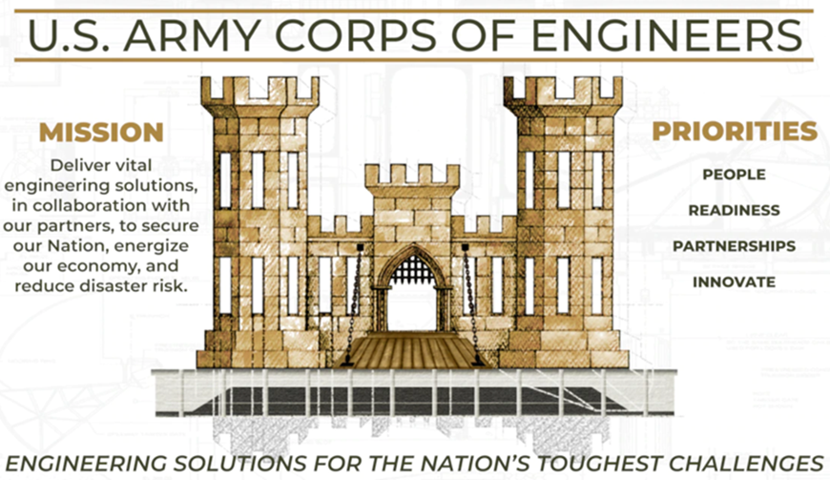
USACE - overview
Mission and priorities
Winning = Performing quality contracts on time, within budget, safely!
4
Notes:
NOTES:
The three Mission pillars are Military Construction (MILCON), Interagency and International Support (IIS), and Civil Works. We also have Contingency Operations, like working with the Federal Emergency Management Agency (FEMA) on disaster relief missions, geospatial, and research and development (R&D).
MILCON: Engineering and construction on military bases around the globe for Army, Air Force, National Guard, etcetera. USACE is the authorized construction agent for the Army. Naval Facilities Engineering Command (NAVFAC) is for the Navy and Marine Corps. In general, USACE or NAVFAC is for the Air Force.
IIS: Working with other non-Department of Defense (DoD) agencies on engineering and construction projects (e.g., U.S. Customs and Border Protection [CBP], Department of Veterans Affairs [VA], National Park Service [NPS], U.S. Forest Service (USFS), etcetera).
Civil Works: Think water resources and environmental protection, navigation, flood control, etcetera.
On the next slide, we will discuss how we are staffed and positioned.

Slide 6
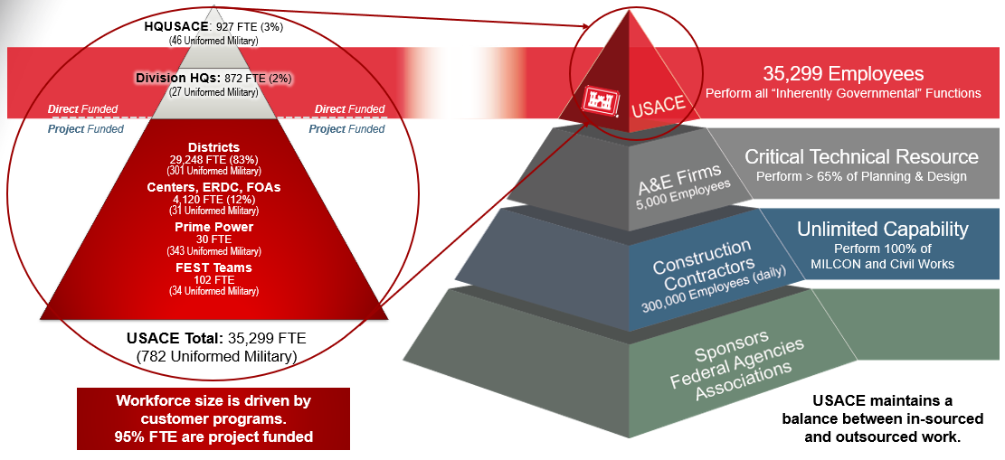
USACE - overview
organization and manpower
5
Notes:
NOTES:
Our greatest asset is our people. Here is how we breakout, by mission, across the country.
ACRONYMS:
A-E Architecture-Engineer
ERDC Engineer Research and Development Center
FEST Forward Engineer Support Team
FOA Field Operating Activity
FTE Full-Time Equivalent
HQUSACE Headquarters, United States Army Corps of Engineers
MILCON Military Construction

Slide 7
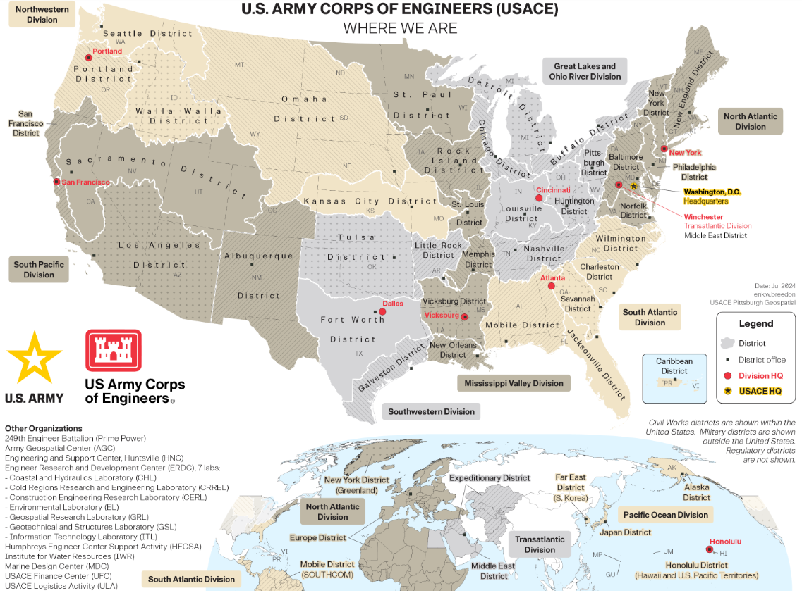
USACE - overview
Where we are
  Numbers at a Glance
  35,299 Employees
  09 Divisions
  42 Districts
  04 Centers
  Global Reach
  FY24 Numbers
  $27.96B - Obligations (Total)
  41.2k - Contract Actions
  USACE International Boundary Map
6
Notes:
NOTES:
We encourage you to click on the hyperlink to access the USACE International Boundary Map. Map provides information for each of our nine Divisions, 42 Districts, and four Centers to include locations, addresses, phone numbers, emails, and websites. We highly encourage you to reach out to the appropriate office(s) that cover the geographical area(s) where you are located or where you want to work for.
Each District / Center has its own mission and specialties and provide a mix of MILCON, IIS, Civil Works, and Contingency Operations.
Our four Centers include the following:
Army Geospatial Center (AGC) at Alexandria, VA - Delivers geospatial data and products.
Engineer Research and Development Center (ERDC) at Vicksburg, MS - Research and development (R&D) and prototype work. They are further broken down into the following:
Coastal and Hydraulics Laboratory (CHL) at Vicksburg, MS
Cold Regions Research and Engineering Laboratory (CRREL) at Hanover, NH
Construction Engineering Research Laboratory (CERL) at Champaign, IL
Environmental Laboratory (EL) at Vicksburg, MS
Geospatial Research Laboratory (GRL) at Alexandria, VA
Geotechnical and Structures Laboratory (GSL) at Vicksburg, MS
Information Technology Laboratory (ITL) at Vicksburg, MS
Humphreys Engineer Center Support Activity (HECSA) at Fort Belvoir, VA - Day-to-day installation and management support services to the HQUSACE and other USACE activities located in the National Capital Region.
Huntsville Center (HNC) at Huntsville, AL - Provides technical engineering expertise that is National and global in scope.

Slide 8
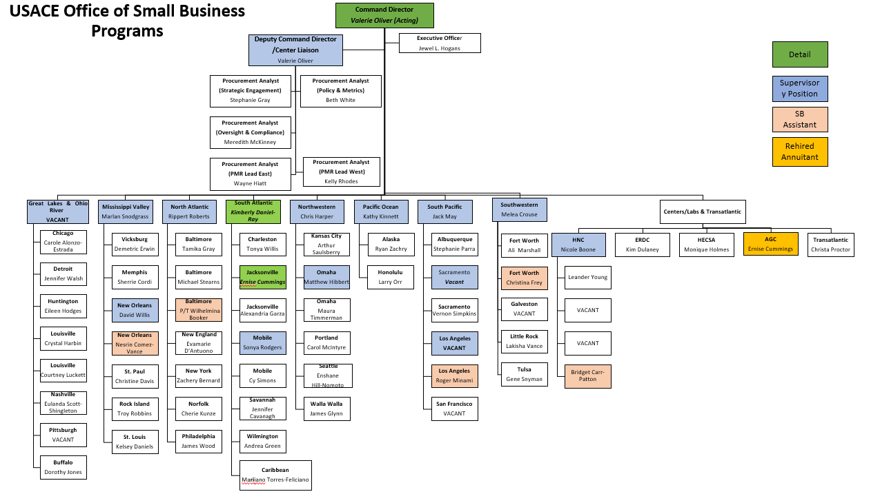
USACE - overview
osbp organizational chart
7
Notes:
NOTES:
Information current as of February 20, 2025.
We encourage you to click on the chart to access a list of contacts for each of our Districts / Centers. Contact information includes the Department of Defense Activity Address Code (DoDAAC), general email inbox, and associated website.
If the list it outdated, you can also navigate to Districts / Centers using: https://www.usace.army.mil/Missions/Locations/. Each webpage has a Business With Us → Small Business link at the top where you can find useful information such as a general email inbox, Forecast of Contracting Opportunities (FCO), Active Indefinite Delivery Contracts (IDCs), information on Regulatory Enforcement Fairness, etcetera.

Slide 9
USACE - overview
list of contracting dodaacs
Baltimore District’s DoDAAC is W912DR and the Office ID W2SD ENDIST BALTIMORE
8
Notes:
NOTES:
We encourage you to search for opportunities with USACE using the System for Award Management (SAM). Each DoDAAC is a six-position code that uniquely identifies a unit, activity, or organization that has the authority to requisition, contract for, receive, have custody of, issue, or ship Government-owned assets, or fund / pay bills for materials and/or services.
CAUTION:
You can search for opportunities on SAM using the DoDAAC; however, it will not yield accurate results. It is recommended you first use the DoDAAC to then identify the corresponding Office ID. Searching using the Office ID will yield accurate results.
For example, Baltimore District’s DoDAAC is W912DR. Its corresponding Office ID is W2SD ENDIST BALTIMORE. Using the Office ID will yield accurate results while the DoDAAC will yield inaccurate results.

Slide 10
USACE - overview
Obligations by DoDAAC (fy22 to fy24)
Information is from SAM → Data Bank → Standard Reports → Federal Contract Actions and Dollars
9
Notes:
10
NOTES:
Information is a comparison of the 55 DoDAACs under USACE.
There are currently nine USACE Districts / Center with two or more small business professionals. They are:
Baltimore (x2.5)
Huntsville (x5)
Jacksonville (x2)
Los Angeles (x2)
Louisville (x2)
Mobile (x2)
New Orleans (x2)
Omaha (x2)
Sacramento (x2)

Slide 11
USACE - overview other useful information
Contractor Database - Database of contractors and subcontractors interested with doing work with USACE. Information used as a form of market research.
Doing Business With USACE - Roadmap to Success - Provides a general overview on how to best approach and do business with USACE.
Dredging Information System (DIS) - Public website providing historical and upcoming dredging opportunities throughout USACE.
Emergency Response - Fillable webform for firms interested in supporting our Emergency Response efforts.
Geographic Information System (GIS) Data - Provides shared and trusted USACE geospatial data, services, and applications for use by our partner agencies and the public.
Helpful Hints - Meeting with District / Center Personnel - Provides general guidance on how to approach USACE. Guidance includes researching the District / Center, know who will be attending the meeting, treating the meeting like a job interview, tailoring the briefing to the District / Center, and lead the meeting.
Information for Companies Selling Information Technology (IT) Products / Services or Innovative Solutions - Provides guidance on how USACE procures IT products / services. Information on innovative solutions can be found at the bottom of the webpage.
10
Notes:
11
NOTES:
Contractor Database - Registering in the database does not increase or decrease a firm’s odds of receiving a Government contract. It is also not required to receive an award. Firms are highly encouraged to engage with Districts / Centers to seek opportunities that align with your firm’s capabilities and interests.
Doing Business With USACE - Roadmap to Success - Consists of 10 stops. Slightly outdated.
Dredging Information System (DIS) - Site is useful for those who execute and support dredging-related activities.
Emergency Response - Form is self-explanatory. Firms may also register in the Disaster Response Registry. Information is located at: https://www.acquisition.gov/content/disaster-response-registry
Geographic Information System (GIS) Data - Data categories include Navigation, Environmental, Military, Civil Works, Water Resources, Infrastructure, Regulatory, and Emergency Management. Applications include Corpsmap Viewer, Military Installations, Ranges, and Training Areas, Formerly Used Defense Sites (FUDS), National Levee Database, National Inventory of Dams, and USACE Supplemental Projects Viewer.
Helpful Hints - Meeting with District / Center Personnel - Engaging the small business professional is the easiest way to gain access to a new District / Center. Before reaching out, ensure your firm’s capabilities and experience align with what the District / Center procures. You can determine that by reviewing historical acquisitions information in SAM, USAspending, or similar and by reviewing their FCO. If you feel like you’re a match, email the small business professional and provide a one- to two-page capability statement. If you want to schedule a capability presentation, be vocal about it. Also, it is helpful if you know which geographical areas, installations, acquisitions, and/or types of work you are interested in. This will help the small business professional narrow down who should attend the presentation on the Government’s end.
Information for Companies Selling IT Products or Services or Innovative Solutions - IT is not a major component of what USACE procures.

Slide 12
USACE - Baltimore district
11

Slide 13
USACE - Baltimore district
general information
1,100 civilians employed
290 miles of federal navigation channels maintained
148 miles of federal flood risk management levees overseen, preventing ~$16B in damages
27 military installations / programs supported within the Pennsylvania, Maryland, District of Columbia, and Virginia areas
15 reservoir projects managed, preventing ~$4B in flood damages
04 recreation projects operated, hosting 1.4M+ visitors
Operates Washington Aqueduct, which supplies an average of 135M gallons of drinking water to the District of Columbia, Arlington County, and other portions of Northern Virginia
Supports oyster restoration via the construction of 670+ acres of oyster reefs to improve water quality and habitat for other Chesapeake Bay creatures
Protects environmentally sensitive coastlines through the restoration of 1,715 acre of remote island habitats
Leases and supports 300+ Armed Forces Career Centers and 180+ housing units
One of five Centers of Expertise for Military Munitions Design
Regional Center of Expertise for fire protection, HTRW, radiological health physics, secure facility design, and subsurface explorations
Technical Center of Expertise for DoD National Relocation Program (DNRP)
12

Slide 14
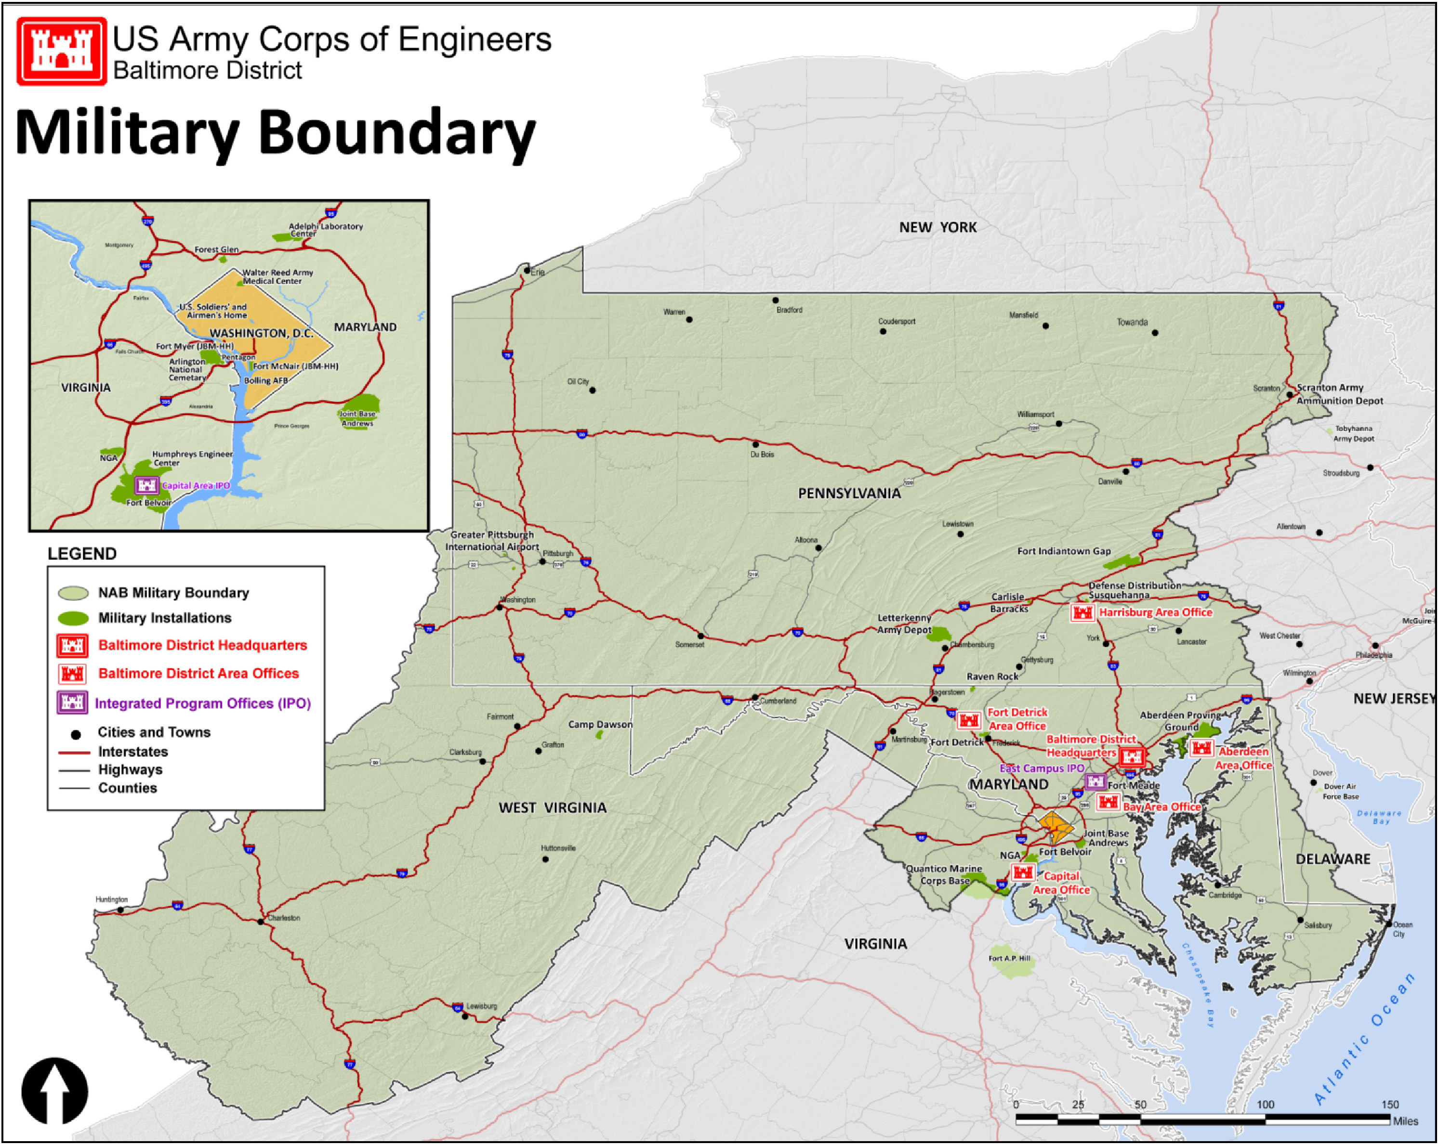
USACE - Baltimore district
military construction boundary Map
  Military Installations / Portfolios Supported
  Pennsylvania
  Carlisle Barracks
  DLA Distribution Center Susquehanna
  Fort Indiantown Gap
  Letterkenny Army Depot
  Raven Rock Mountain Complex
Maryland
Aberdeen Proving Ground
Adelphi Laboratory Complex
Fort Detrick
Fort Meade
Joint Base Andrews
USDA Beltsville Agricultural Research Center
District of Columbia
JBM-HH (Fort McNair)
Joint Base Anacostia - Bolling
Naval Research Laboratory
  Virginia
  Fort Belvoir
  Humphreys Engineering Center
  JBM-HH (Fort Myer)
  Pentagon
13

Slide 15
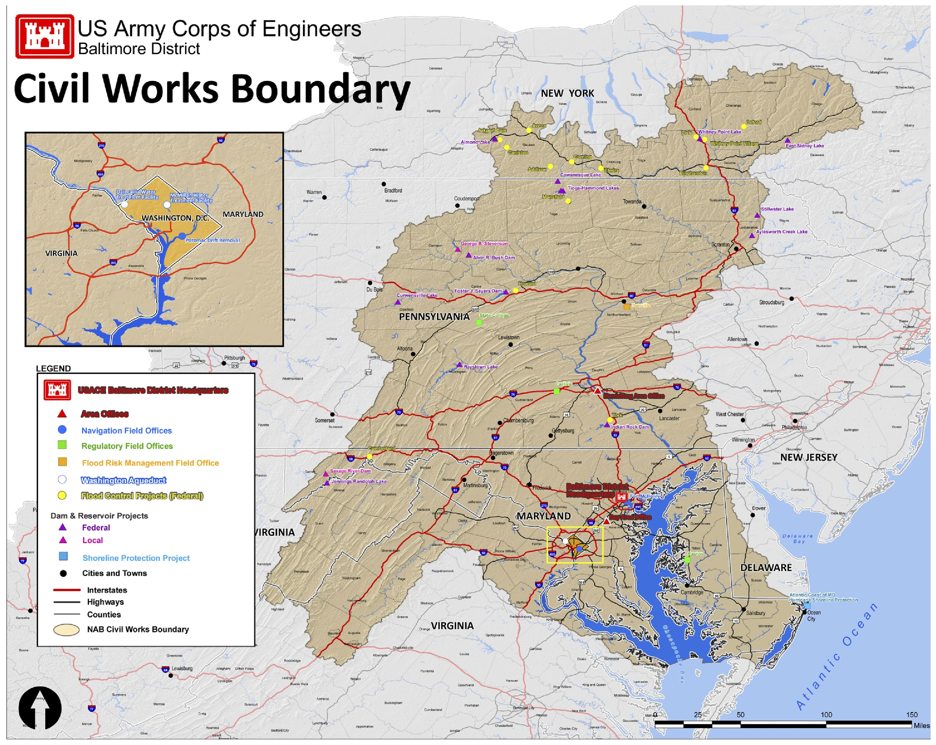
USACE - Baltimore district
civil works boundary Map
  Dam and Recreational Sites
  New York
  Almond Lake
  Arkport Dam
  East Sidney Lake
  Whitney Point Lake
  Pennsylvania
  Alvin R. Bush Dam
  Aylesworth Lake
  Codorus Creek
  Cowanesque Lake
  Curwensville Lake
  Foster J. Sayers Dam
  Indian Rock Dam
  Raystown Lake
  Stillwater Lake
  Tioga - Hammond Lakes
  West Virginia
  Jennings Randolph Lake
14

Slide 16
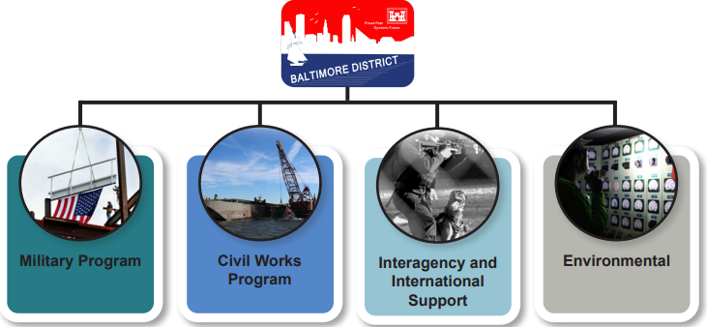
USACE - Baltimore district
our programs / mission statement
MISSION
Deliver vital engineering solutions in collaboration with our partners to serve and strengthen the Nation, energize the economy, and reduce disaster risks.
15

Slide 17
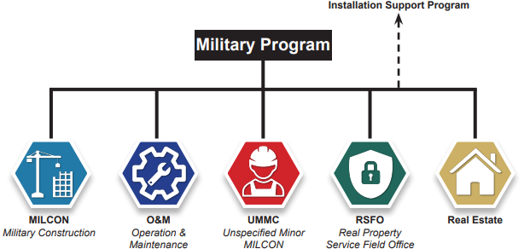
USACE - Baltimore district
military programs
16

Slide 18
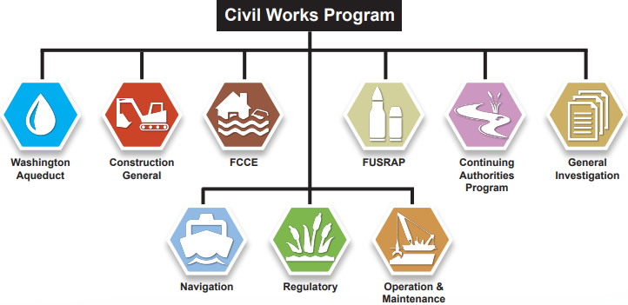
USACE - Baltimore district
civil works program
17
Notes:
ACRONYMS:
FCCE Flood Control and Coast Emergencies
FUSRAP Formerly Utilized Sites Remedial Action Program

Slide 19
USACE - Baltimore district
interagency and international support
Provides technical assistance to non-DoD federal agencies, state and local governments, tribal nations, private U.S. firms, international organizations, and foreign governments.
Most work is funded on a reimbursable basis.
Projects are managed under the governance structure that most closely matches to scope of the project.
One project of note is Baltimore District’s upcoming acquisition of Construct Community Living Center (CLC) for Department of Veterans Affairs (VA) at Perry Point, MD. Construction is projected in FY28.
18
Notes:
NOTES:
Description for the Construct CLC for Department of VA is … Construct a new 173,000 GSF, 96-bed CLC to consolidate existing functions housed in several buildings, each over 60 years old at Perry Point VA Medical Center. Construction of the new CLC would meet the latest programmatic requirements and would be designated to VA's current CLC standards to include resident houses with private rooms and baths, as well as medical and community amenities and parking.

Slide 20
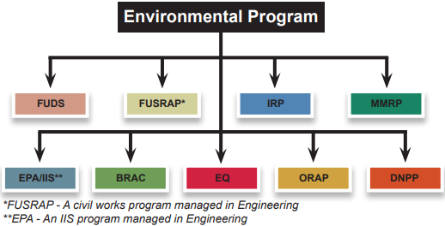
USACE - Baltimore district
environmental program
19
Notes:
ACRONYMS:
BRAC Base Realignment and Closure
DNPP Deactivated Nuclear Power Plant Program
EPA Environmental Protection Agency
EQ Environmental Quality
FUDS Formerly Used Defense Sites
FUSRAP Formerly Utilized Sites Remedial Action Program
IIS Interagency and International Support
IRP Installation Restoration Program
MMRP Military Munitions Response Program
ORAP Operational Range Assessment Program

Slide 21
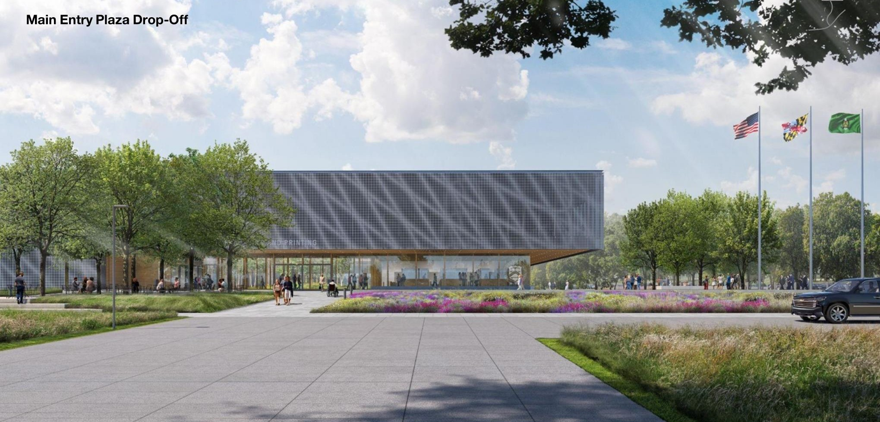
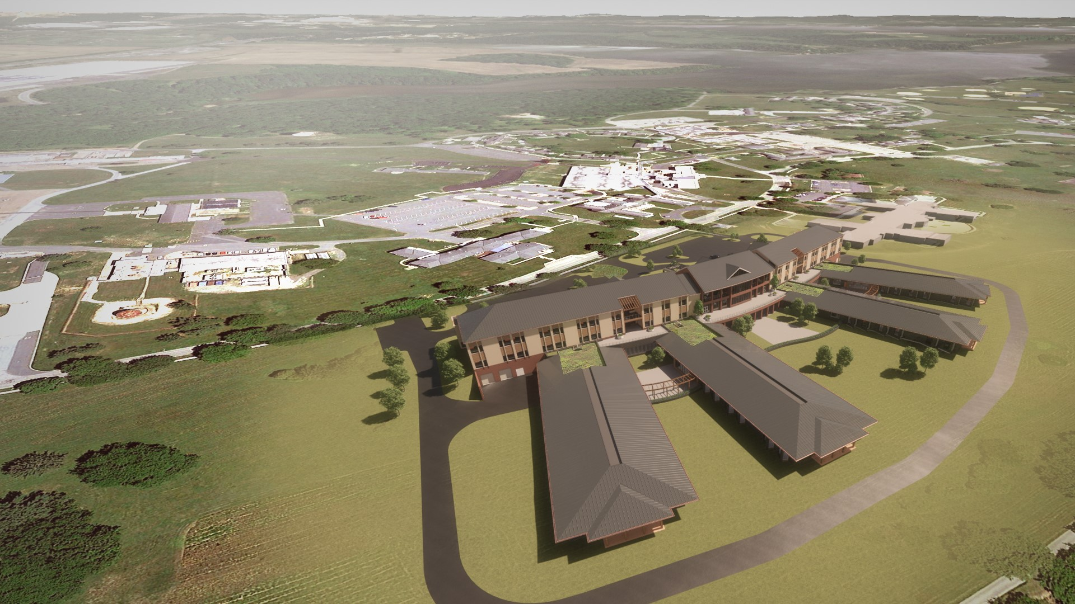
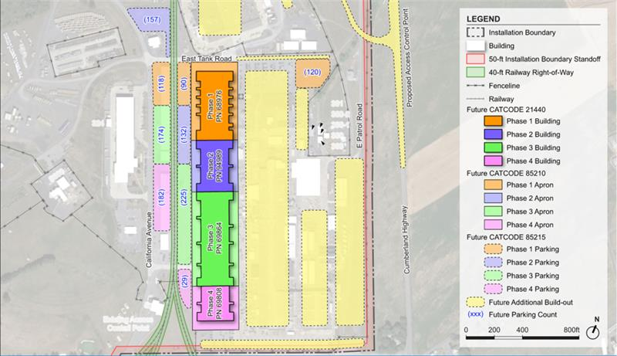
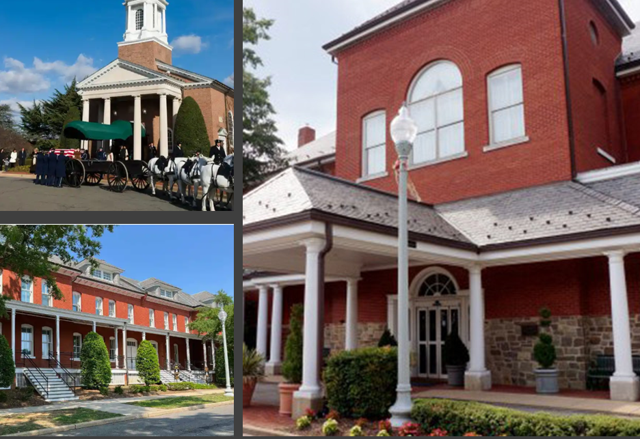
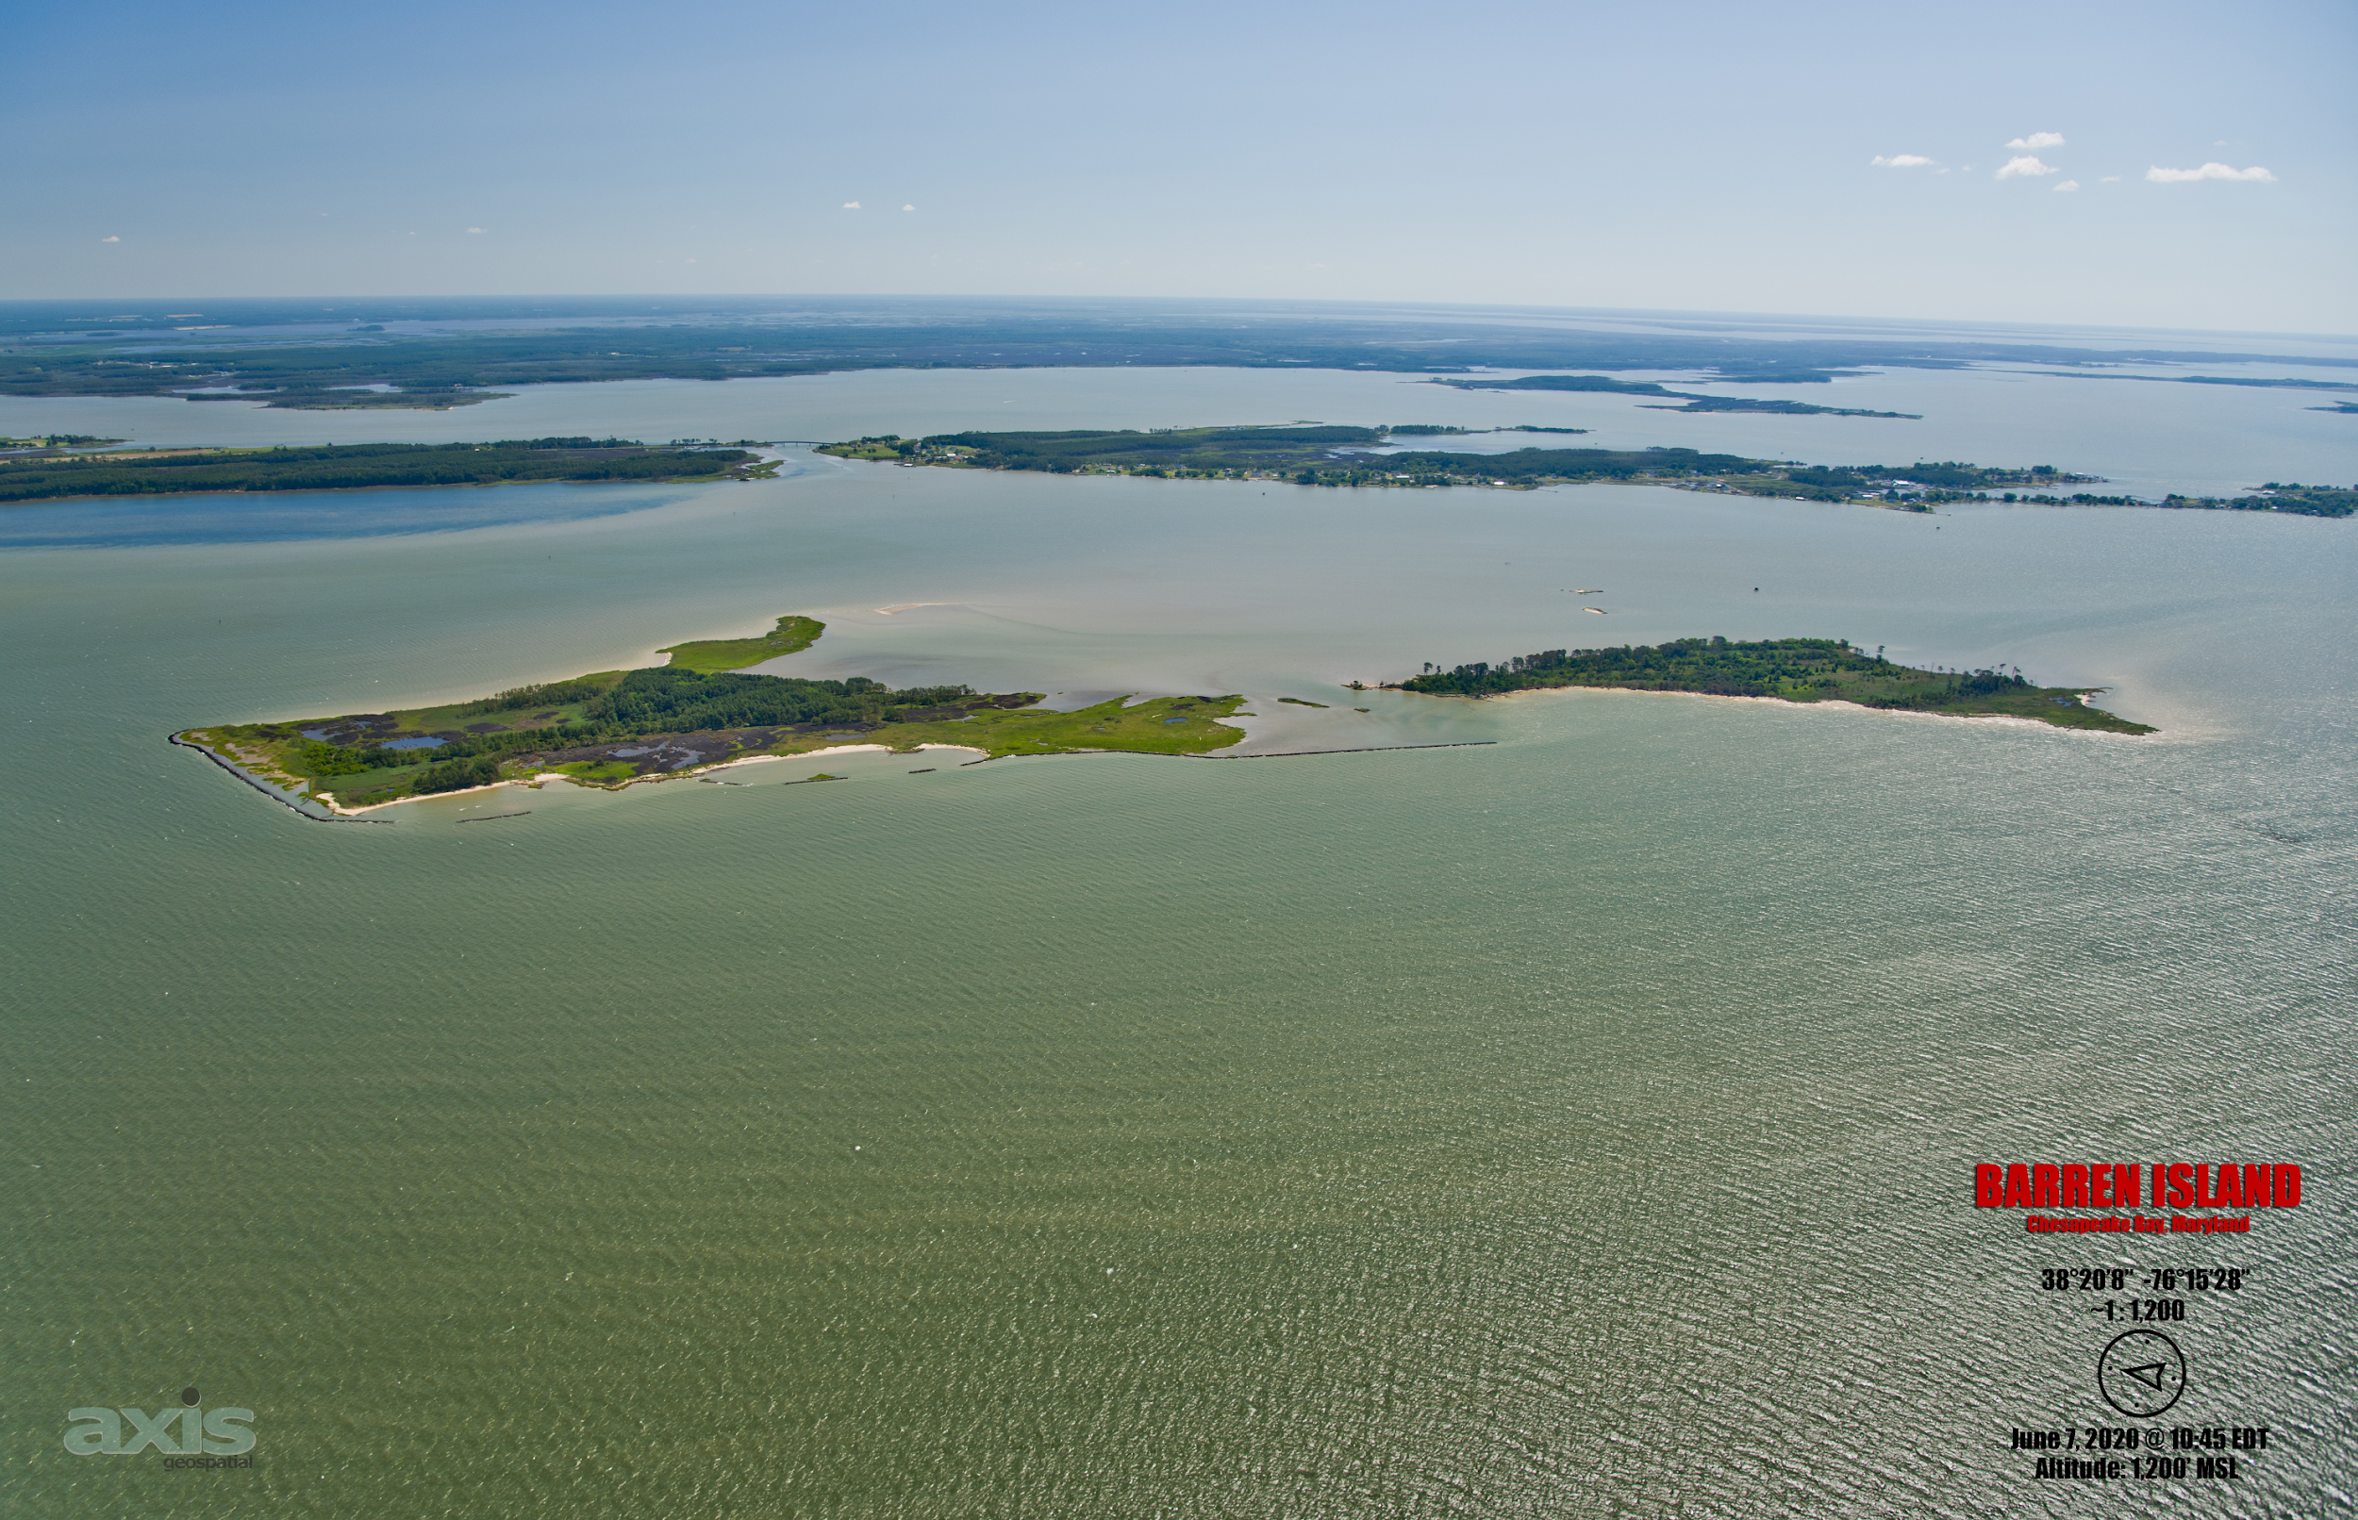
USACE - Baltimore district
program highlights
Bureau of Engraving and Printing
Currency Production Facility
Beltsville, MD
Veteran Affairs
Community Living Center
Perry Point, MD
Multiple Projects
Letterkenny Army Depot
Chambersburg, PA
Multiple Projects
Joint Base Myer - Henderson Hall
Fort Myer, VA
Mid Chesapeake Bay Island
Ecosystem Restoration
Dorchester County, MD
20

Slide 22
Small business office
21

Slide 23
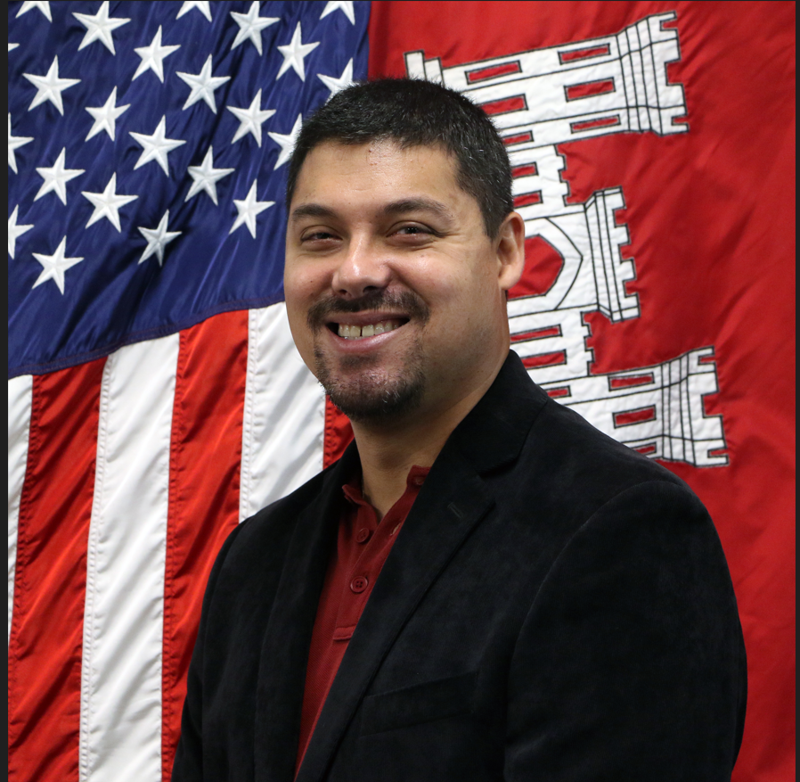
Small business office
Highlights (fy24) and initiatives (fy25)
Key Highlights (FY24):
Highest ever dollars obligated for SB (~$420M) and SDB (~$298M).
Met our HUBZone goal for the sixth consecutive year.
Awards made to six new small business entrants to the Government and 12 new small business entrants to USACE.
Initiatives (FY25):
Automating and sharing historical data to assist with market research and notifying Industry of opportunities.
Targeting outreach towards small business programs we historically have difficulties in achieving goals with (i.e., SDVOSBs and WOSBs).
Streamlining capability presentations with internal stakeholders to ensure maximum participation and quicker turnaround times with requests.
Sending out weekly notices of USACE - Baltimore District’s original postings on SAM.gov.
Tamika Gray
Deputy for Small Business
Michael Stearns
Deputy for Small Business
22

Slide 24
Obligations and sb goals
23

Slide 25
Obligations and sb goals
Top 5 naics codes (Fy22 to fy24)
Information is from SAM → Data Bank → Standard Reports → Total Actions by NAICS
Click Below for Detailed Information on Top NAICS Obligations for Small Business Programs
Total
SB
SDB
SDVOSB
WOSB
HUBZone
24
Notes:
25

Slide 26
Obligations and sb goals
goal achievements (fy25)
Information is from SAM → Data Bank → Standard Reports → Small Business Achievements, Excluding Deobligations
 | Goals (Actual) met or exceeded Goals (Army) and Goals (NAB).
 | Goals (Actual) met or exceeded Goals (Army) or Goals (NAB) but not both.
 | Goals (Actual) did not meet Goals (Army) and Goals (NAB).
25
Notes:
NOTES:
Information is current as of March 21, 2025.
ACRONYMS:
DoD Department of Defense
FY Fiscal Year
HUBZone Historically Underutilized Business Zone
NAB Baltimore District
SB Small Business
SDB Small Disadvantaged Business
SDVOSB Service-disabled Veteran-owned Small Business
WOSB Women-owned Small Business

Slide 27
Obligations and sdvosb goals
26

Slide 28
Obligations and sdvosb goals
Top 10 naics codes - SDVOSB (Fy23 to fy24)
Information is from SAM → Data Bank → Standard Reports → Total Actions by NAICS
Click Below for Detailed Information on Top NAICS Obligations for Small Business Programs
Total
SB
SDB
SDVOSB
WOSB
HUBZone
27

Slide 29
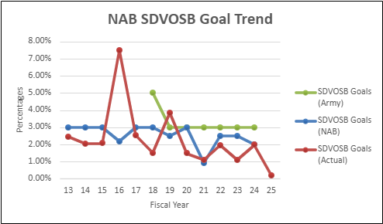
Obligations and sdvosb goals
SDVOSB Concern spending / goals (Fy13 to FY25)
Information is from SAM → Data Bank → Standard Reports → Small Business
Achievements, Excluding Deobligations
28
Notes:
NOTES:
Information is current as of March 21, 2025.

Slide 30
Doing business with us
29

Slide 31
Doing business with us primary difference between VA and dod
Department of Veterans Affairs (VA) has the singular authority to increase contracting opportunities to eligible SDVOSBs / VOSBs under the Veterans Affairs Acquisition Regulations (VAAR) subpart 819.70 (The VA Veterans First Contracting Program). Per VAAR 819.7005, the order of priority (highest to lowest) is SDVOSBs, VOSBs, 8(a) / HUBZone Firms, and other small business set asides with due deference to WOSBs.
DoD does not have that authority. Per FAR 19.203(c), for acquisitions over the simplified acquisition threshold (SAT), the contracting officer shall first consider an acquisition for small business programs before considering a small business set-aside. Per FAR 19.203(a), there is no order of precedence amongst the programs.
30

Slide 32
Doing business with us how we procure
Common Acquisition Methods / Strategies
  Standalone “C” Contracts
  Indefinite-Delivery, Indefinite-Quantity (IDIQ) Contracts
  Blanket Purchase Agreements (BPAs)
  8(a) Sole Sources
  Task / Delivery Orders Against Existing IDIQs
  Calls Against BPAs
Less Common Acquisition Methods / Strategies
  Orders thru GSA Advantage / Federal Supply Schedules
  Set-asides Other than Small Business and Competitive 8(a)
31
Notes:
NOTES:
Standalone “C” contracts encompass Invitation for Bids (IFBs), Best-Value (i.e., Lowest-Price Technically Acceptable [LPTA] and Tradeoff), and other negotiated acquisitions.

Slide 33
Doing business with us suggestions for doing business with us
Ensure you are registered in the System for Award Management (SAM) and that you access the Dynamic Small Business Search (DSBS) through the SBA Connect portal.
Keep your SAM profile and DSBS profiles updated to ensure they are accurate, current, and complete. This is used this to verify your representations and certifications and to conduct market research.
Do your homework! Review our historical procurements (e.g., in SAM.gov; FPDS.gov) to ensure that we procure the supplies and services your firm offers.
Review information on our Small Business webpage. Includes current and future contracting opportunities, active indefinite delivery contracts, past and future engagements / outreach events, resources and helpful links, and other useful information.
Respond to our market research / sources sought notices to demonstrate your interest and help influence the type of small business set-aside.
Keep engaged and reach out to us should you have any questions or concerns.
32
Notes:
Engaging the small business professional is the easiest way to gain access to a new District / Center. Before reaching out, ensure your firm’s capabilities and experience align with what the District / Center procures. You can determine that by reviewing historical acquisitions information in SAM, USAspending, or similar and by reviewing their FCO. If you feel like you’re a match, email the small business professional and provide a one- to two-page capability statement. If you want to schedule a capability presentation, be vocal about it. Also, it is helpful if you know which geographical areas, installations, acquisitions, and/or types of work you are interested in. This will help the small business professional narrow down who should attend the presentation on the Government’s end.

Slide 34
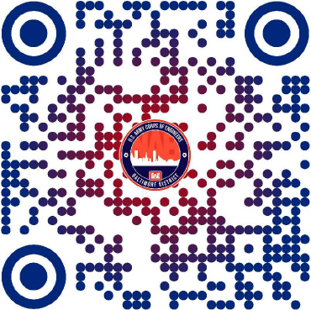
Doing business with us qr code to Baltimore district webpage
USACE - Baltimore District → Business With Us
33

Slide 35
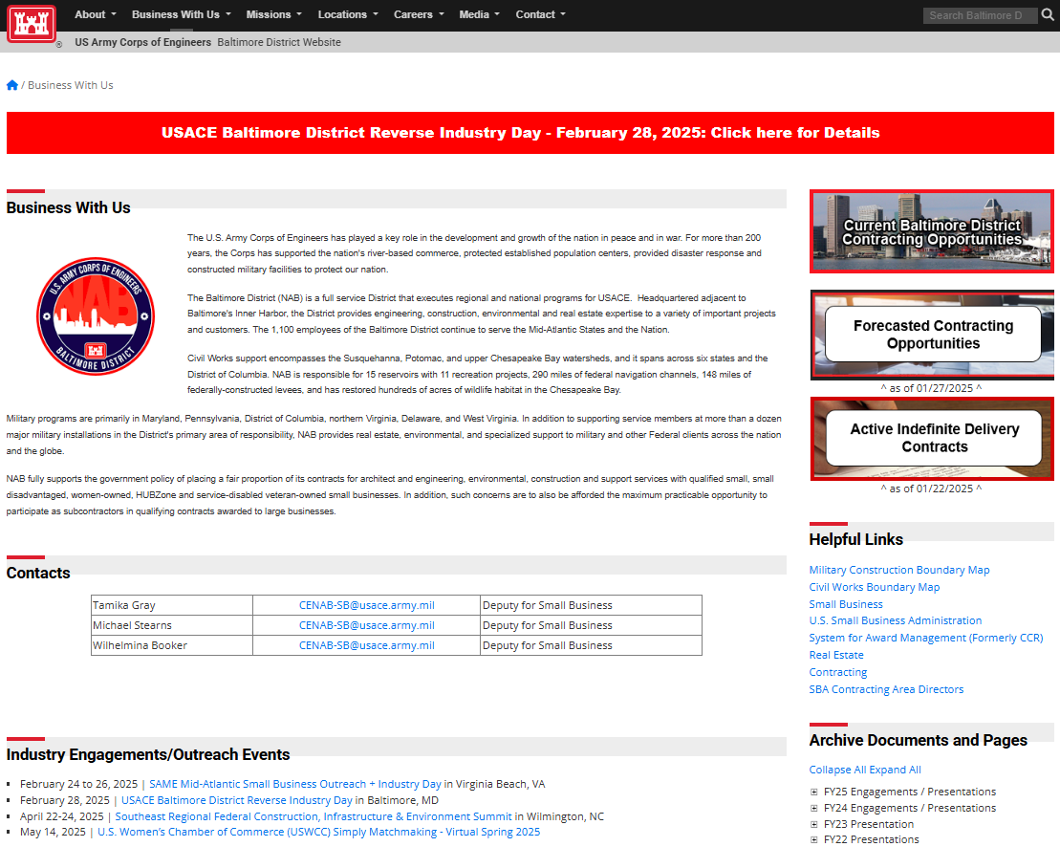
Doing business with us
Baltimore district webpage
Active Opportunities
on SAM
More Information on
Small Business
Forecasts /
Active IDCs
Small Business Points of Contact
District Boundary
Maps
Engagements / Outreach Events
34

Slide 36
Doing business with us
Future industry engagements
Dates​ | Engagement Title​ | Location​
April 22 to 24, 2025 | Southeast Regional Federal Construction, Infrastructure & Environment Summit | Wilmington, NC
May 14, 2025 | U.S. Women’s Chamber of Commerce (USWCC) Simply Matchmaking - Virtual Spring 2025 | Virtual
November 19, 2025 | U.S. Women’s Chamber of Commerce (USWCC) Simply Matchmaking - Virtual Fall 2025 | Virtual
35
Notes:
NOTES:
Information is current as of March 21, 2025.

Slide 37




Doing business with us
Follow us on social media
@USACEBaltimore
36

Slide 38
In conclusion
37

Slide 39
In conclusion
points of contact
Tamika Gray
Deputy for Small Business
U.S. Army Corps of Engineers
North Atlantic Division - Baltimore District
CENAB-SB@usace.army.mil
Michael Stearns
Deputy for Small Business
U.S. Army Corps of Engineers
North Atlantic Division - Baltimore District
CENAB-SB@usace.army.mil
38

Slide 40

In conclusion
questions and answers
39

Slide 41
BUILDING STRONG.
40

Slide 42
Backup slides
41

Slide 43
Acronyms and expansions (1 of 2)
42

Slide 44
Acronyms and expansions (2 of 2)
43

Slide 45
USACE - overview
mandatory centers of expertise (MCX)
Mandatory Centers of Expertise
Ballistic Missile Defense System
Centers of Standardization
Control System Cybersecurity
Cost Engineering
Critical Infrastructure Cybersecurity
Curation / Management Archaeological Collections
Dam Safety Modification
Electronic Security Systems
Environmental and Munitions
Facilities Explosives Safety
Fuel Facilities (Petroleum, Oils, and Lubricants)
Homeowners Assistance Program
Hydroelectric Design Center
Inland Navigation Design Center
Marine Design Center
Mandatory Centers of Expertise
Medical Facilities
Modeling, Mapping, and Consequences Production
Protective Design Center
Range Training Land Program
Risk Management Center
Sign Standards
Transportation Systems Center
Utility Monitoring and Control Systems
44
Notes:
NOTES:
Links lead to the MILCON Requirements, Standardization, and Integration (MRSI) website. Each link provides the center’s website, points of contact, relevant Engineering Regulation (ER) for specific centers, and a brief description of each center.
Mandatory Center of Expertise (MCX): A USACE organization that has been approved by HQUSACE as having a unique and exceptional technical capability in a highly specialized subject area that is critical to other USACE commands. A CX receives its designation as an MCX when one or more services provided by the CX are mandatory as defined in the specific Engineering Regulation. An MCX also must make a business case demonstrating its cost effectiveness, value, and responsiveness are necessary above that needed for a Technical Center of Expertise (TCX). An MCX must provide reasoning and justification for an MCX rather than a TCX during the initial approval process. Mandatory services to be rendered by an MCX are published in an ER specific to the MCX. Project delivery teams (PDTs) must utilize the services of the applicable MCX as required in the specific ER. These services may be reimbursable or centrally funded depending on the specific program

Slide 46
USACE - overview
technical centers of expertise (tCX)
Technical Centers of Expertise
Aircraft Hanger Fire Protection
CAD / BIM Technology Center
Collaboration and Public Participation Center
Corrosion Control and Cathodic Protection
DD 1391 / Eng Form 3086 Review Center
DoD National Relocation Program
Facility Systems Safety
Heating, Ventilation, and Air Conditioning
Historic Structures and Buildings
Hydroelectric Engineering Center
Installation Support
Joint Airborne LiDAR Bathymetry Center
Military Housing Privatization Initiative
Paint Technology Center
Photogrammetric Mapping
Technical Centers of Expertise
Power Reliability Enhancement
Rapid Response
Remote Sensing / GIS Technology Center
Reserves Real Property Exchange
Subsurface Exploration Center
Survey Engineering and Mapping Center
Sustainment Management Systems
Tribal Nation
Water and Wastewater Treatment
Welding and Metallurgy
45
Notes:
NOTES:
Links lead to the MILCON Requirements, Standardization, and Integration (MRSI) website. Each link provides the center’s website, points of contact, and a brief description of each center.
Technical Center of Expertise (MCX): A USACE organization that has been approved by HQUSACE as having a unique or exceptional technical capability in a specialized subject area that is beneficial to other USACE commands. The services to be rendered by a TCX are voluntary, advisory, and reimbursable.

Slide 47
Obligations and sb goals
Top 10 naics codes - sb (Fy23 to fy24)
Information is from SAM → Data Bank → Standard Reports → Total Actions by NAICS
Click Below for Detailed Information on Top NAICS Obligations for Small Business Programs
Total
SB
SDB
SDVOSB
WOSB
HUBZone
46

Slide 48
Obligations and sb goals
Top 10 naics codes - SDB (Fy23 to fy24)
Information is from SAM → Data Bank → Standard Reports → Total Actions by NAICS
Click Below for Detailed Information on Top NAICS Obligations for Small Business Programs
Total
SB
SDB
SDVOSB
WOSB
HUBZone
47

Slide 49
Obligations and sb goals
Top 10 naics codes - WOSB (Fy23 to fy24)
Information is from SAM → Data Bank → Standard Reports → Total Actions by NAICS
Click Below for Detailed Information on Top NAICS Obligations for Small Business Programs
Total
SB
SDB
SDVOSB
WOSB
HUBZone
48

Slide 50
Obligations and sb goals
Top 10 naics codes - HUBZONE (Fy23 to fy24)
Information is from SAM → Data Bank → Standard Reports → Total Actions by NAICS
Click Below for Detailed Information on Top NAICS Obligations for Small Business Programs
Total
SB
SDB
SDVOSB
WOSB
HUBZone
49

Slide 51
Obligations and sb goals goal achievements (fy21 to fy24)
 | Goals (Actual) met or exceeded Goals (Army) and Goals (NAB).
 | Goals (Actual) met or exceeded Goals (Army) or Goals (NAB) but not both.
 | Goals (Actual) did not meet Goals (Army) and Goals (NAB).
50
Notes:
ACRONYMS:
DoD Department of Defense
FY Fiscal Year
HUBZone Historically Underutilized Business Zone
NAB Baltimore District
SB Small Business
SDB Small Disadvantaged Business
SDVOSB Service-disabled Veteran-owned Small Business
WOSB Women-owned Small Business

Slide 52
Fy25 contracting opportunities
Disclaimers / Notes:
FCO is required semiannually per Public Law (PL) 100-656 (Business Opportunity Development Reform Act of 1988).
FCO does not show potential 8(a) sole source awards and acquisitions being issued as delivery / task orders off existing contracts.
FCO is for informational purposes only. The information listed therein is subject to change.
The requirements may or may not be executed and are contingent upon funding, real estate, permits, congressional approvals, and other factors that affect the requirements.
Under ‘Anticipated Solicitation Date’, green, bolded text confirms that the solicitation is / was available on SAM as of the date of this presentation. Black text represents a projected solicitation date.
Under ‘Anticipated Acquisition Strategy’, green, bolded text confirms that the strategy has been verified via market research. Black text represents an anticipated acquisition strategy.
Anticipated acquisition strategies are subject to change based on market research and as requirements are further defined. Small business concerns are highly encouraged to respond to Baltimore District's Sources Sought Notices, which is an influential form of market research.
51

Slide 53
Fy25 contracting opportunities architectural-engineering services
Description | Location | Anticipated Solicitation Date (By Quarter) | Capacity | Anticipated Acquisition Strategy
Multi-Disciplined Design Services for Military / SRM Programs (MATOC) (Contemplates Targeted Award of 12 Contracts. Includes a Small Business Reserve Targeted Award of Six Contracts) | NAD-wide | FY25, Q3 | $500M | Unrestricted w/SB Reserves
A-E Services for Civil Works (MATOC) (Contemplates Targeted Award of ????? Contracts) | NAD-wide | FY25, Q3 | $60M | Set-Aside SB
Topographic, Surveying, Mapping, and Geospatial Services (MATOC) (Contemplates Award of Three Contracts) | NAD-wide | FY25, Q3 | $8M | Set-Aside SB
Commissioning Support Services (SATOC) | Fort Meade, MD | FY25 | TBD | TBD
52
Notes:
NOTES:
Information is current as of March 21, 2025.

Slide 54
Fy25 contracting opportunities environmental services
Description | Location | Anticipated Solicitation Date (By Quarter) | Magnitude of Construction | Anticipated Acquisition Strategy
No Opportunities to Forecast
53
Notes:
NOTES:
Information is current as of March 21, 2025.

Slide 55
Fy25 contracting opportunities international and interagency support
Description | Location | Anticipated Solicitation Date (By Quarter) | Magnitude of Construction | Anticipated Acquisition Strategy
C&O Canal Rehabilitation (Phase 2) | Great Falls, MD | FY25, Q3 | $500k to $1M | Set-Aside SB
Construct BEP Currency Production Facility | Beltsville, MD | FY25 | $500M+ | Unrestricted
54
Notes:
NOTES:
Information is current as of March 21, 2025.

Slide 56
Fy25 contracting opportunities milcon / rsfo
Description | Location | Anticipated Solicitation Date (By Quarter) | Magnitude of Construction | Anticipated Acquisition Strategy
Construct Cybersecurity Operations Facility | Fort Meade, MD | FY25, Q2 | $100M to $250M | Unrestricted
Construct Component Rebuild Shop (Phase 1) at Letterkenny Army Depot | Chambersburg, PA | FY25, Q3 | $250M to $500M | Unrestricted
Construct Missile / Munitions Distribution Facility at Letterkenny Army Depot | Chambersburg, PA | FY25, Q4 | $25M to $100M | TBD
Construct Rocket and Missile Maintenance Facility at Letterkenny Army Depot | Chambersburg, PA | FY25, Q4 | $25M to $100M | TBD
Repair the Interiors of Buildings 213 and 1978 | Fort Belvoir, VA | FY25, Q4 | $10M to $25M | TBD
Construct Fire Alarm and Suppression Upgrades to Building 5681 at Joint Base Anacostia-Bolling | Washington, D.C. | FY25, Q4 | $5M to $10M | Set-Aside SB
55
Notes:
NOTES:
Information is current as of March 21, 2025.

Slide 57
Fy25 contracting opportunities civil works (1 of 3)
Description | Location | Anticipated Solicitation Date (By Quarter) | Magnitude of Construction | Anticipated Acquisition Strategy
Rock Wall Stabilization at Alvin R. Bush Dam | Clinton County, PA | FY25, Q3 | $25M to $100M | Unrestricted
Outlet Work Gates | Whitney Point, NY | FY25, Q3 | $10M to $25M | TBD
Butterfly Valve and Insulation Replacement at Jennings Randolph Lake | Elk Garden, WV | FY25, Q3 | $5M to $10M | Set-Aside SB
Plum Creek Community Park Culvert Removal and Stream Restoration | Adams County, PA | FY25, Q3 | $1M to $5M | Set-Aside SB
Pave Asphalt Access Roads at Alvin R. Bush Dam | Clinton County, PA | FY25, Q3 | TBD | Set-Aside SB
James Island Ecosystem Restoration (Phase 1) | Dorchester County, MD | FY25, Q4 | $250M to $500M | Unrestricted
56
Notes:
NOTES:
Information is current as of March 21, 2025.

Slide 58
Fy25 contracting opportunities civil works (2 of 3)
Description | Location | Anticipated Solicitation Date (By Quarter) | Magnitude of Construction | Anticipated Acquisition Strategy
Baltimore Harbor and Channels Maintenance Dredging - MD | MD | FY25, Q4 | $25M to $100M | Unrestricted
Baltimore Harbor and Channels Maintenance Dredging - Cape Henry | Virginia Beach, VA | FY25, Q4 | $10M to $25M | Unrestricted
Atlantic Coast of Maryland Beach Renourishment | Ocean City, MD | FY25, Q4 | $10M to $25M | Unrestricted
Upper Wicomico River Maintenance Dredging | Salisbury, MD | FY25, Q4 | $1M to $5M | Set-Aside SB
North East River Maintenance Dredging | Elkton, MD | FY25, Q4 | $1M to $5M | Set-Aside SB
Rock Hall Harbor Maintenance Dredging | Rock Hall, MD | FY25, Q4 | $1M to $5M | Set-Aside SB
57
Notes:
NOTES:
Information is current as of March 21, 2025.

Slide 59
Fy25 contracting opportunities civil works (3 of 3)
Description | Location | Anticipated Solicitation Date (By Quarter) | Magnitude of Construction | Anticipated Acquisition Strategy
St. Patrick Creek Maintenance Dredging | St. Mary’s County, MD | FY25, Q4 | $1M to $5M | Set-Aside SB
Bank Armoring of Low-Level Outlet Channel and Deposition Removal at Raystown Lake | Hesston, PA | FY25, Q4 | $1M to $5M | Set-Aside SB
Shoal Removal at Codorus Creek Flood Risk Management (Levee) | York, PA | FY25, Q3 | $1M to $5M | Set-Aside WOSB
58
Notes:
NOTES:
Information is current as of March 21, 2025.

Slide 60
Fy25 contracting opportunities
Washington aqueduct (1 of 3)
Description | Location | Anticipated Solicitation Date (By Quarter) | Capacity | Anticipated Acquisition Strategy
Mechanical Services (SATOC) | Washington, D.C. | FY25, Q3 | $20M | Set-Aside SB
Electrical Services (SATOC) | Washington, D.C. | FY25, Q3 | $8M | Competitive 8(a)
Water Mains and Valves Emergency Repair Services (SATOC) | Washington, D.C. | FY25, Q3 | $8M | Competitive 8(a)
Phosphoric Acid (75%) (SATOC) | Washington, D.C. | FY25, Q3 | Dependent on Awardee’s Unit Price | Set-Aside SB
Quicklime (SATOC) | Washington, D.C. | FY25, Q3 | Dependent on Awardee’s Unit Price | Set-Aside SB
Residuals Dewatering Polymer (SATOC) | Washington, D.C. | FY25, Q3 | Dependent on Awardee’s Unit Price | Set-Aside SB
59
Notes:
NOTES:
Information is current as of March 21, 2025.

Slide 61
Fy25 contracting opportunities
Washington aqueduct (2 of 3)
Description | Location | Anticipated Solicitation Date (By Quarter) | Capacity | Anticipated Acquisition Strategy
Aqua Ammonia (19%) (SATOC) | Washington, D.C. | FY25, Q3 | Dependent on Awardee’s Unit Price | Set-Aside SB
60
Notes:
NOTES:
Information is current as of March 21, 2025.

Slide 62
Fy25 contracting opportunities
Washington aqueduct (3 of 3)
Description | Location | Anticipated Solicitation Date (By Quarter) | Magnitude of Construction | Anticipated Acquisition Strategy
Replace McMillan North Clearwell | Washington, D.C. | FY25, Q3 | $25M to $100M | Unrestricted
McMillan Reservoir Cove Dredging | Washington, D.C. | FY25, Q3 | $5M to $10M | Competitive 8(a)
Grounds Maintenance | Washington, D.C. | FY25, Q3 | $1M to $5M | Set-Aside EDWOSB
Cable Inspection and Lubrication | Washington, D.C. | FY25, Q3 | $500k to $1M | Set-Aside SB
Crane and Hoist Inspection and Maintenance | Washington, D.C. | FY25, Q3 | $100k to $250k | Set-Aside SB
Fire Extinguisher Inspection, Maintenance, and Certification | Washington, D.C. | FY25, Q3 | $25k to $100k | Set-Aside SB
61
Notes:
NOTES:
Information is current as of March 21, 2025.

Slide 63
Fy25 contracting opportunities services (1 of 3)
Description | Location | Anticipated Solicitation Date (By Quarter) | Capacity | Anticipated Acquisition Strategy
DoD National Relocation Program (BPA) (Contemplates Number of Master Agreements is One) | Baltimore, MD | FY25, Q3 | $32.5M | Unrestricted
62
Notes:
NOTES:
Information is current as of March 21, 2025.

Slide 64
Fy25 contracting opportunities services (2 of 3)
Description | Location | Anticipated Solicitation Date (By Quarter) | Magnitude of Construction | Anticipated Acquisition Strategy
Park Attendant Services at Raystown Lake | Hesston, PA | FY25, Q2 | $250k to $500k | Set-Aside SB
Mowing Services at Tioga-Hammond Recreational Areas | Tioga, PA | FY25, Q2 | $250k to $500k | Set-Aside SB
Tenant Improvements for Armed Forces Recruiting Stations | PA, WV, VA, MD, DE, and D.C. | FY25, Q3 | $1M to $5M | Set-Aside SDVOSB
Document and Media Shredding Services | Baltimore, MD | FY25, Q3 | $100k to $250k | Set-Aside SB
Debris Vessel Reynolds Maintenance | Baltimore, MD | FY25, Q3 | $100k to $250k | Set-Aside SB
Aquatic Plant Control at Raystown Lake | Hesston, PA | FY25, Q3 | $100k to $250k | Set-Aside SB
63
Notes:
NOTES:
Information is current as of March 21, 2025.

Slide 65
Fy25 contracting opportunities services (3 of 3)
Description | Location | Anticipated Solicitation Date (By Quarter) | Magnitude of Construction | Anticipated Acquisition Strategy
Herbicide Application at Alvin R. Bush Dam, Curwensville Lake, Foster Joseph Sayers Dam, and Howard Levee | PA | FY25, Q2 | $100k to $250k | Set-Aside SB
Park Attendant Services at Jennings Randolph Lake | Elk Garden, WV | FY25, Q2 | $25k to $100k | Set-Aside SB
Grounds Maintenance and Snow Removal for Fort McHenry Field Offices | Baltimore, MD | FY25, Q3 | $25k to $100k | Set-Aside SB
64
Notes:
NOTES:
Information is current as of March 21, 2025.

Slide 66
Fy25 contracting opportunities supplies
Description | Location | Anticipated Solicitation Date (By Quarter) | Magnitude of Construction | Anticipated Acquisition Strategy
No Opportunities to Forecast
65
Notes:
NOTES:
Information is current as of March 21, 2025.

