Slide 1
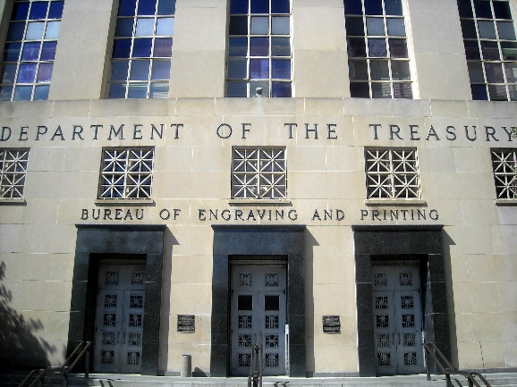
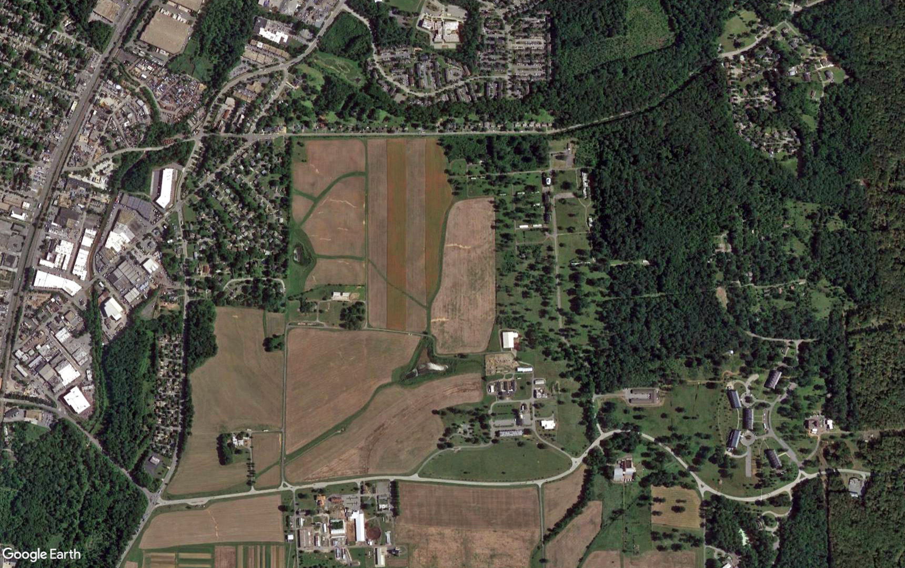
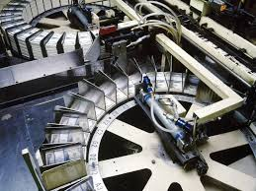
Public Webinar Replacement Currency Production Facility at the Beltsville Agricultural Research Center Draft Environmental Impact Statement December 2, 2020
American Sign Language translation is provided by Levi Myers and Felicia Pickering in the Participants panel.
We recommend viewing this presentation in WebEx’s Side-by-Side view, which is identified by the icon in blue:

Slide 2
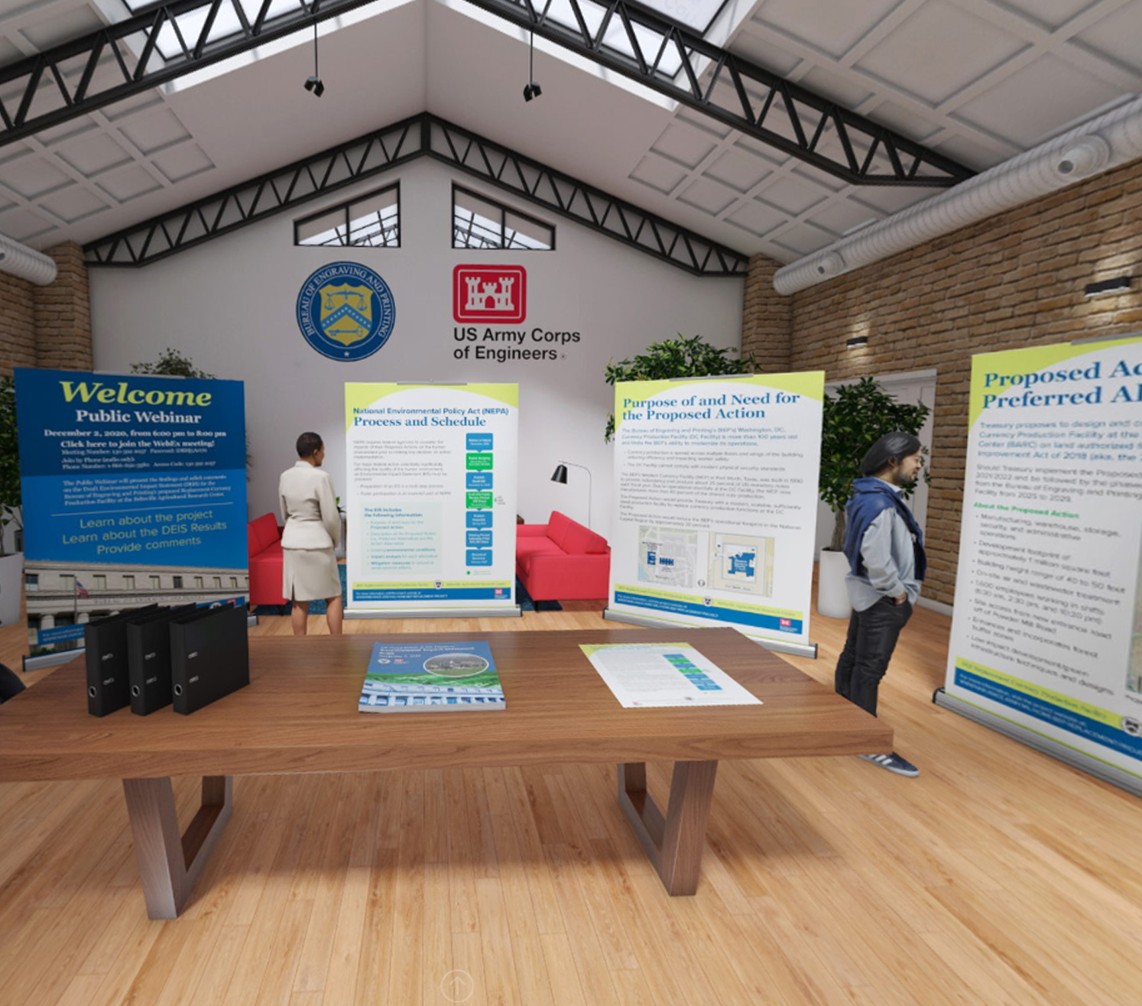
Online Resources
Project Website
https://www.nab.usace.army.mil/home/bep-replacement-project/
Contains the Draft EIS, supporting analyses, background reports, project-specific studies, and informational posters summarizing the project.
Online Reading Room
https://bep-eis.consultation.ai/
Contains a virtual open house of Draft EIS materials.

Slide 3
National Environmental Policy Act (1969)
Requires federal agencies to consider impacts of their proposed actions prior to making any decision on action implementation
Major actions with the potential to significantly affect the human environment require an Environmental Impact Statement (EIS)
Preparation of an EIS is a multi-step process, with several opportunities for public input
Public participation is an essential part of NEPA!

Slide 4
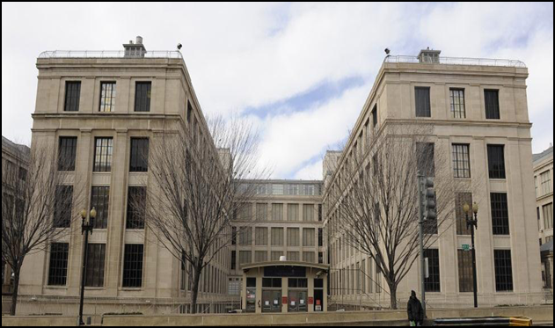
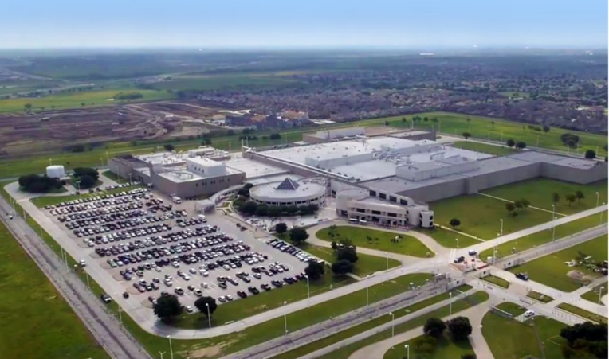
About the US Department of the Treasury
The Bureau of Engraving and Printing (BEP) is the bureau within Treasury responsible for manufacturing US currency notes.
Treasury operates currency production facilities in Washington, DC and Fort Worth, Texas.
The Washington, DC Facility is over 100 years old.
DC Main Building (constructed 1918)
Texas Facility (constructed 1990)

Slide 5
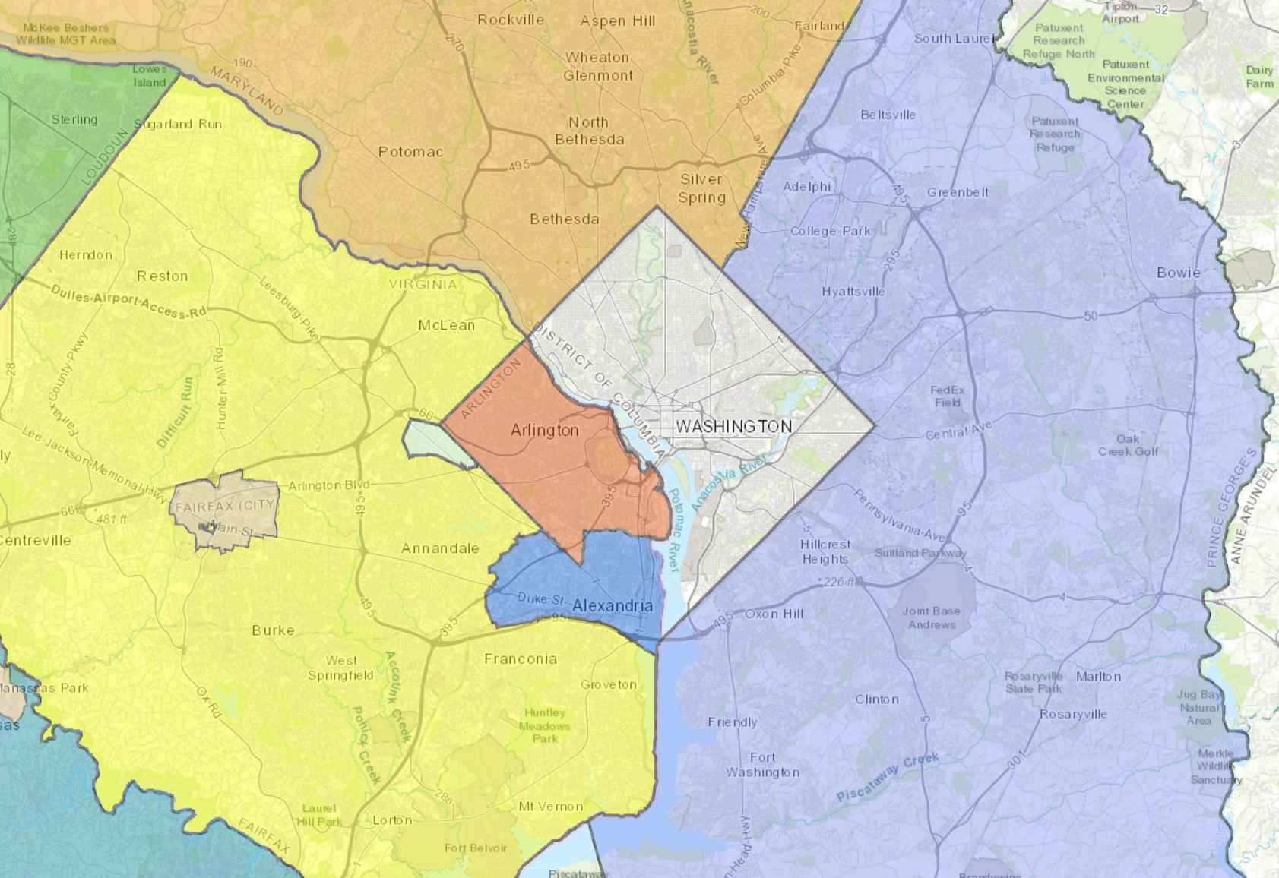
THE NEED FOR THE PROPOSED ACTION is to replace the BEP’s obsolete DC Facility that is neither able to support modern currency production nor support the BEP’s current and future mission.
The DC Facility cannot be effectively modernized due to its condition, configuration, and location.
Treasury initially evaluated over 80 sites within the National Capital Region for the proposed currency production facility.
THE PURPOSE OF THE PROPOSED ACTION is to construct and operate a new, approx. 1 million square foot currency production facility on an available parcel that meets the BEP’s requirements.
Beltsville Agricultural Research Center

Slide 6
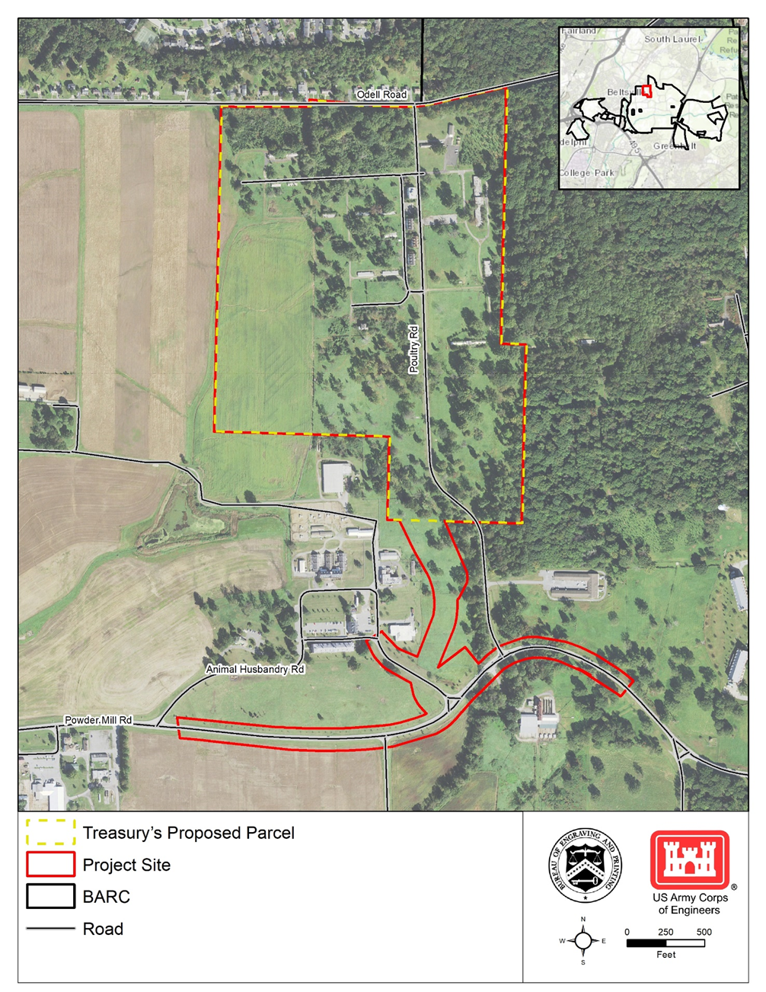
Proposed Project Site
Project Site Location
Treasury’s proposed parcel is located between Odell Road and Powder Mill Road at the Beltsville Agricultural Research Center (BARC).
This site is located in the 200 Area building cluster of BARC.
The land has been authorized for transfer under the Agriculture Improvement Act of 2018
The site currently consists of cropland, meadows, scattered trees, and numerous abandoned and deteriorating buildings.

Slide 7
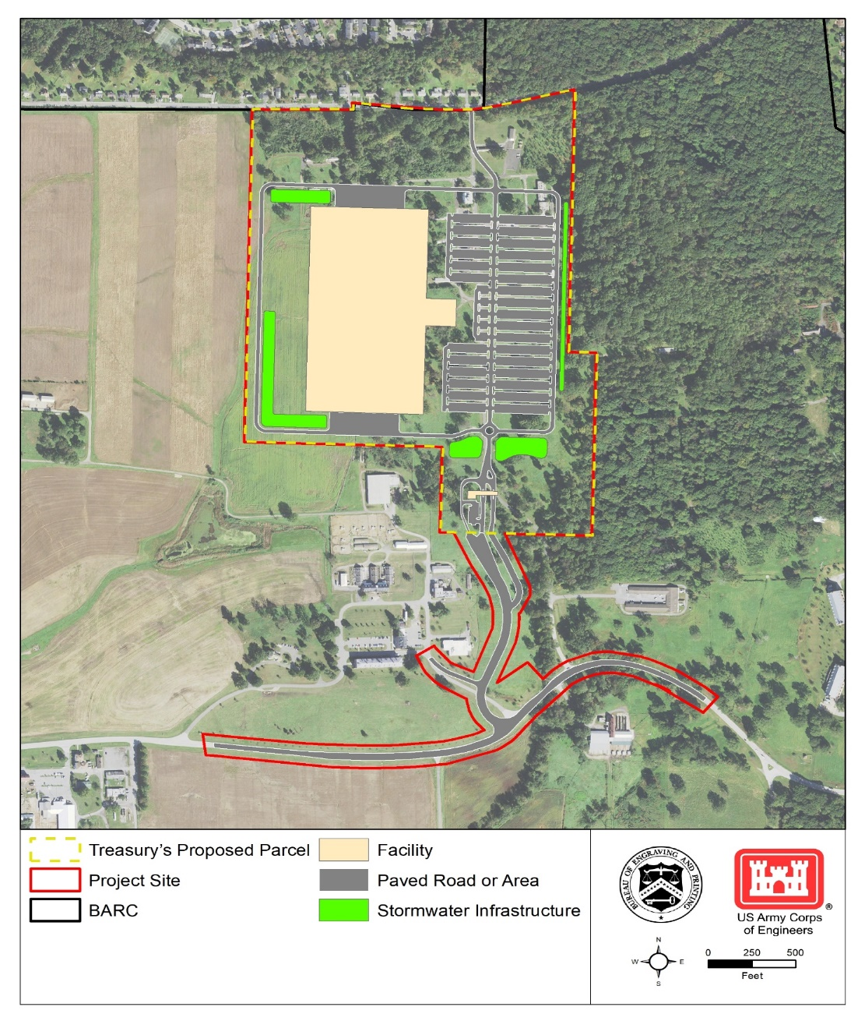
Proposed Action/ Preferred Alternative
Preliminary Conceptual Site Plan
Treasury proposes to construct a modern currency production facility at BARC.
Manufacturing, warehouse, storage, security, and administrative functions
1,600 employees working in shifts
Site access from new entrance road off Powder Mill Road
Green Infrastructure/Low Impact Development (GI/LID) and other sustainability design features
Construction is anticipated from 2022–2025, followed by transitioning operations from the DC Facility from 2025–2029.

Slide 8
Alternatives Studied in Detail in Draft EIS
Arr
PREFERRED ALTERNATIVE Construct and operate the proposed currency production facility at BARC as described in the Draft EIS.
ACHIEVES the Proposed Action’s purpose and need.
Arr
NO ACTION ALTERNATIVE Do not implement Proposed Action. Continue to operate under current conditions to extent possible.
DOES NOT ACHIEVE the Proposed Action’s purpose and need.
Serves as a comparative baseline for the Preferred Alternative.

Slide 9
Resources Evaluated in Draft EIS
Land use
Visual resources
Air quality
Noise
Geology, topography, and soils
Water resources
Biological resources
Cultural resources
Traffic and transportation
Utilities
Socioeconomics / environmental justice
Hazardous / toxic materials / waste
Human health and safety

Slide 10
Key Findings of the Draft EIS
THE NO ACTION ALTERNATIVE would result in potentially significant adverse impacts to two resource areas.
Cultural resources
Traffic and transportation
THE PREFERRED ALTERNATIVE would result in potentially significant adverse impacts to five resource areas:
Visual resources
Water resources
Cultural resources
Traffic and transportation
Socioeconomics and environmental justice
Impacts to all other resource areas would be negligible, less-than-significant adverse, or beneficial.

Slide 11
Public Comment Opportunity
VERBAL COMMENTS (TONIGHT)
Press “Raise Hand” button on WebEx to raise your hand
State your name, affiliation, and contact info; OR request to remain anonymous
Provide your comment within 3 minutes
All comments will be recorded and addressed appropriately in Final EIS
WRITTEN COMMENTS
Email: BEP-EIS@usace.army.mil
Use Project Website: https://www.nab.usace.army.mil/home/bep-replacement-project/
Mail to:
ATTN: Bureau of Engraving and Printing
(BEP) Project EIS US Army Corps of Engineers, Baltimore
District Planning Division 2 Hopkins Plaza, 10th Floor Baltimore, MD 21201
Public comment period extends through December 21, 2020

Slide 12
Thank you!
Please take this opportunity to:
Visit the online reading room (https://bep-eis.consultation.ai/) or project website (https://www.nab.usace.army.mil/home/bep-replacement-project/) to learn more about the Proposed Action and its potential impacts, read the Draft EIS, and access this presentation
Develop a better understanding of what is proposed and why, as well as potential environmental impacts
Provide us with informed, substantive, specific, and clear comments on your concerns about the Proposed Action, alternatives, or potential environmental impacts so they can be addressed in the Final EIS
Thank you for your interest and involvement in this process!

