Slide 1


Usace Baltimore small business program updates & opportunities
Tamika Gray
USACE - Baltimore District
Small Business Office
23 MAY 2024

Slide 2
AGENDA
01 | WHO WE ARE | T. GRAY
02 | SMALL BUSINESS OFFICE | T. GRAY
03 | OBLIGATIONS ($m) FY20 TO FY23 | T. GRAY
04 | FY23 PROGRAM HIGHLIGHTS | T. GRAY
05 | FY24 CONTRACTING OPPORTUNITIES | T. GRAY
06 | DOING BUSINESS WITH US | T. GRAY
07 | FOLLOW US | T. GRAY

Slide 3
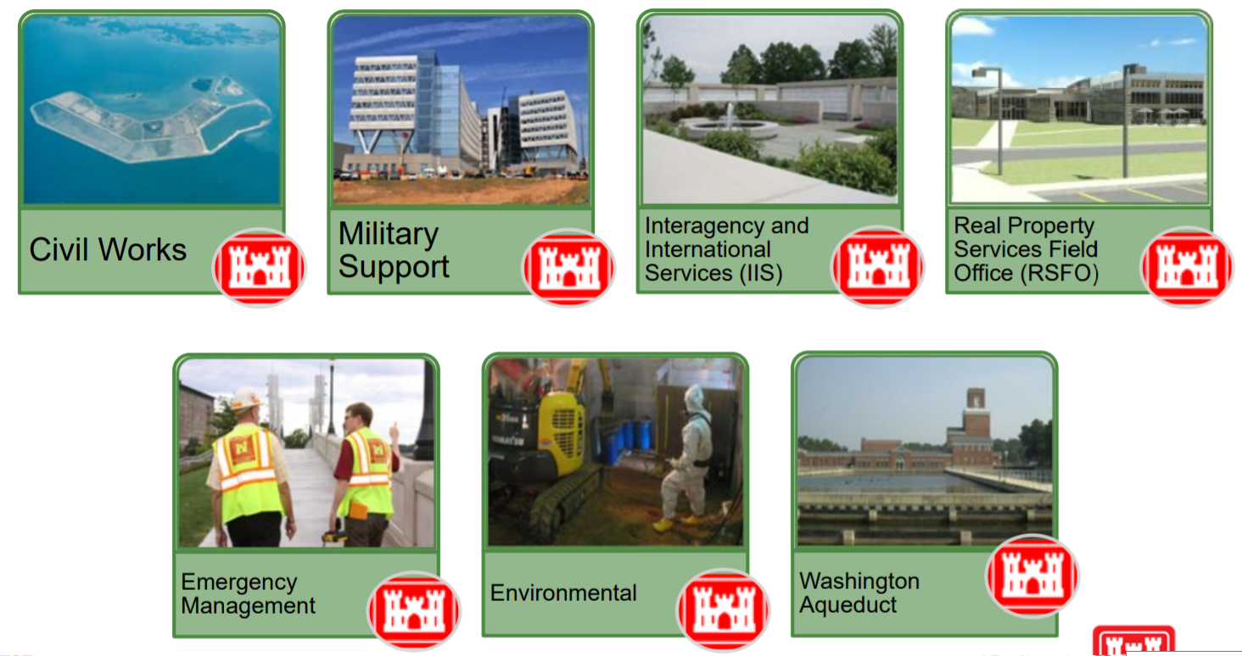
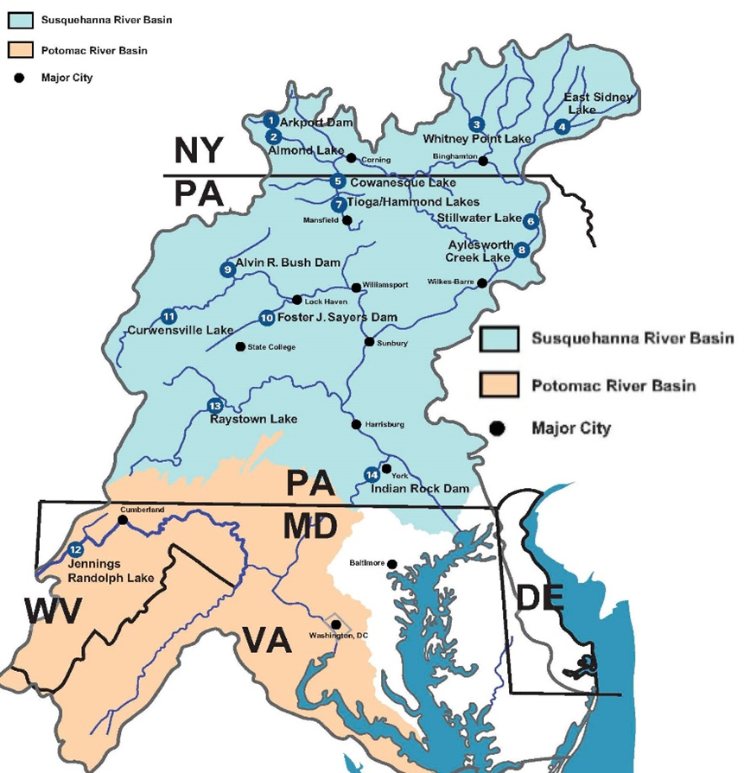
WHO WE ARE
MISSION
Deliver vital engineering solutions in collaboration with our partners to serve and strengthen the Nation, energize the economy, and reduce disaster risks.

Slide 4
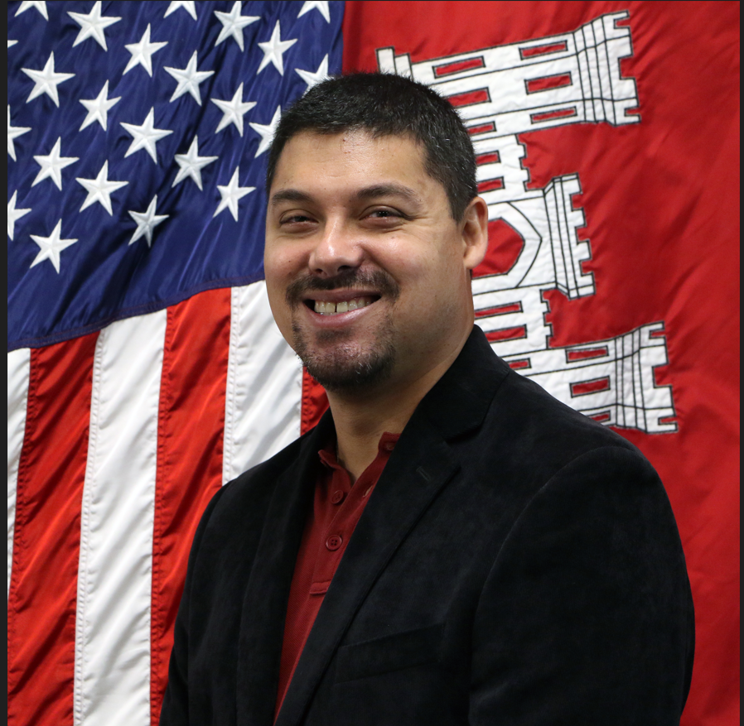
SMALL BUSINESS OFFICE (1 of 2)
Key Highlights (FY23):
Over $373M awarded to small businesses.
Small Business Office grew from one to 2-1/2 FTEs.
Initiatives (FY24):
Monthly updates to our Forecast of Contracting Opportunities, Active IDC List, Small Business Goal Achievements, and Industry Engagements / Outreach Events.
Visiting outlying installations and project offices to discuss small business matters.
Updated language for Small Business Participation evaluation factor. Includes a template for submission and restricts number of pages.
Assisting Contracting Division with implementing strategies for contractor compliance with FAR Clause 52.219-14 (Limitations on Subcontracting).
How to Reach Us:
CENAB-SB@usace.army.mil
Tamika Gray
Deputy for Small Business
Michael Stearns
Deputy for Small Business

Slide 5
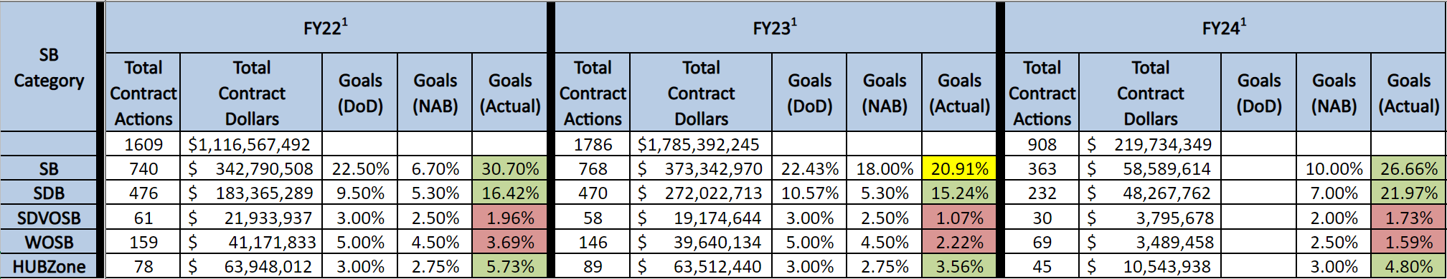
SMALL BUSINESS OFFICE (2 of 2)
FY22 to FY24 Small Business Goals / Accomplishments (as of May 1, 2024)
Dates​ | Engagement Title​ | Location​
May 23, 2024 | USACE Baltimore Small Business Program Updates & Opportunities | Aberdeen, MD
June 4 to 6, 2024 | USACE’s Annual Dredging Meeting at South Atlantic Division HQ | Atlanta, GA
July 17, 2024 | National Small Business Federal Contracting Summit (Summer 2024) | Arlington, VA
November 20 to 22, 2024 | 2024 SAME Small Business Conference | New Orleans, LA
February 24 to 26, 2025 | SAME Mid-Atlantic Small Business Outreach + Industry Day | Virginia Beach, VA
Future Industry Engagements (as of May 20, 2024)

Slide 6
OBLIGATIONS ($m) FY20 TO FY23

Slide 7
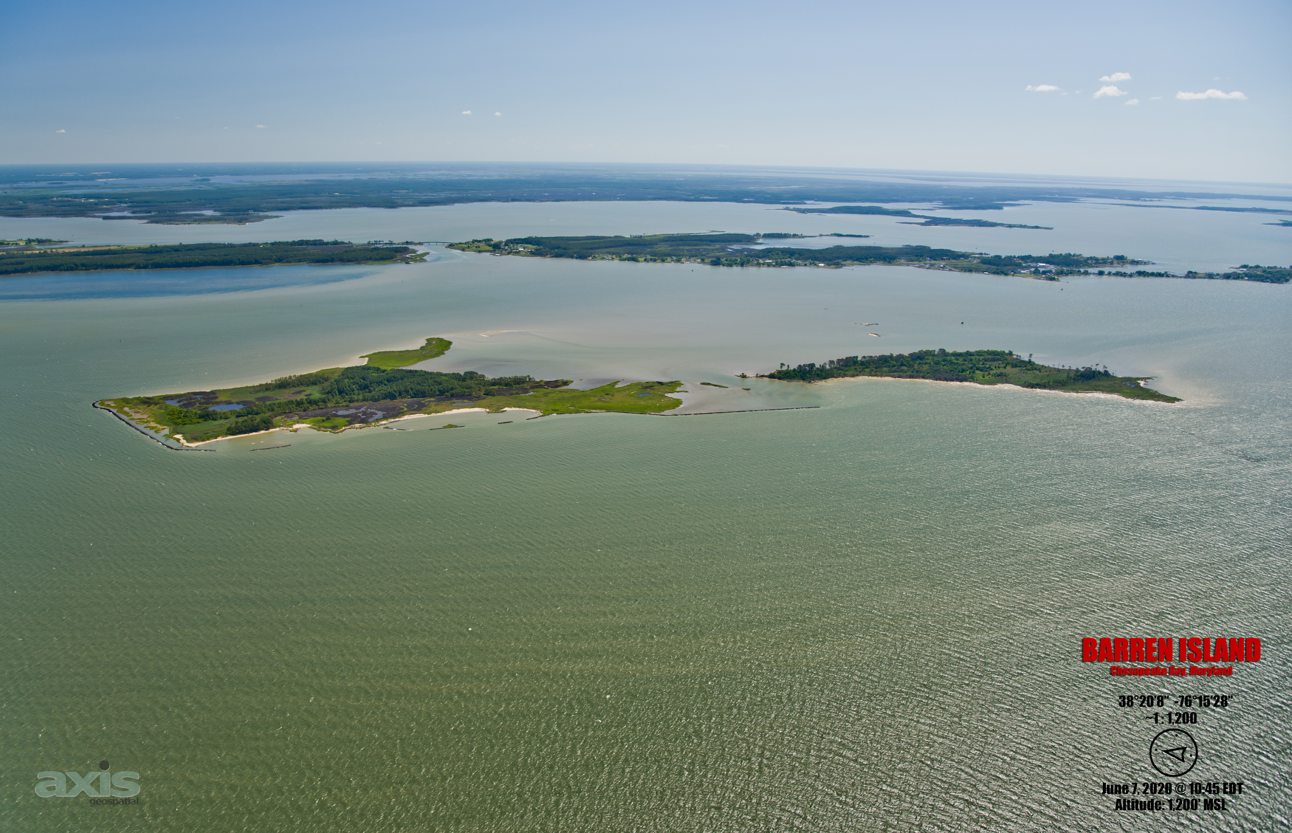
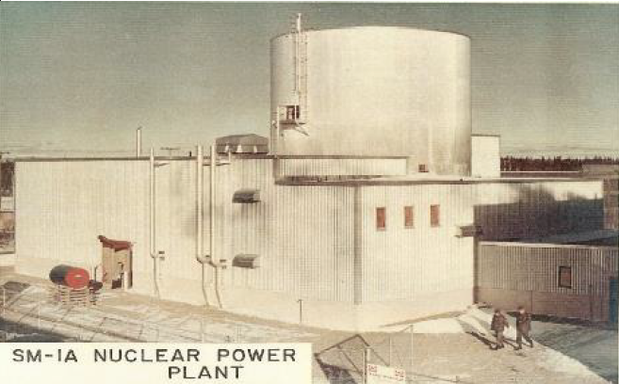
Fy23 program highlights
Renovate Nolan Building for INSCOM
Fort Belvoir, VA
Construct East Campus Building 5
Integrated Design and Construction
Fort Meade, MD
Baltimore Harbor Maintenance Dredging
Barren Island Ecosystem Restoration
Initial Construction Contract
Decommission and Dismantle SM-1A Reactor
Fort Greely, AK

Slide 8
Fy24 contracting opportunities
Disclaimers / Notes:
Forecast of Contracting Opportunities (FCO) is required per PL 100-656 (Business Opportunity Development Reform Act of 1988).
FCO is for informational purposes only. The information listed herein is subject to change.
The requirements may or may not be executed and are contingent upon funding, real estate, permits, and other factors that affect the requirements.
Under ‘Anticipated Solicitation Date’, green, bolded text confirms that the solicitation is / was available on http://www.sam.gov as of the date of this update. Black text represents a projected solicitation date.
Under ‘Anticipated Acquisition Strategy’, green, bolded text confirms that the strategy has been verified via market research. Black text represents a projected acquisition strategy.
Projected strategies are subject to change based on market research and as requirements are further defined. Small Business concerns are highly encouraged to respond to Baltimore District's Sources Sought Notices, which is an influential form of market research.

Slide 9
Fy24 contracting opportunities
Architectural-engineering services (1 of 2)
Description | Location | Anticipated Solicitation Date (By Quarter) | Capacity | Anticipated Acquisition Strategy
Multi-Disciplined Design Services for Military / SRM Programs (MATOC) (Contemplates Targeted Award of 12 Contracts, which includes a Small Business Reserve Targeted Award of Six Contracts) | NAD-wide | FY24, Q4 | $360M | Unrestricted w/SB Reserves
Value-Engineering Services (Contemplates Award of Three Contracts) | NAD-wide | FY24, Q4 | $12M | SB Set-Aside
Cost Engineering / Scheduling Services (MATOC) (Contemplates Award of Up to Three Contracts) | NAD-wide | TBD | TBD | SB Set-Aside

Slide 10
Fy24 contracting opportunities
Architectural-engineering services (2 of 2)
Description | Location | Anticipated Solicitation Date (By Quarter) | Magnitude of Construction | Anticipated Acquisition Strategy
Construction Management Services for BEP Currency Production Facility | Beltsville, MD | FY24, Q4 | $25M to $100M | SB Set-Aside

Slide 11
Fy24 contracting opportunities
environmental services
Description | Location | Anticipated Solicitation Date (By Quarter) | Magnitude of Construction | Anticipated Acquisition Strategy
Optimized Remediation Contract for Joint Base McGuire-Dix-Lakehurst | Burlington County, NJ | FY24, Q3 | $25M to $100M | SB Set-Aside
Optimized Remediation Contract for Joint Base Cape Cod | Buzzards Bay, MA | FY24, Q3 | $25M to $100M | SB Set-Aside
BRAC PFAS RIs at Four Army Installations | Nation-wide | FY24, Q3 | $25M to $100M | SB Set-Aside

Slide 12
Fy24 contracting opportunities
INTERNATIONAL AND INTERAGENCY SUPPORT
Description | Location | Anticipated Solicitation Date (By Quarter) | Magnitude of Construction | Anticipated Acquisition Strategy
Dyke Marsh Wetland Restoration and Stabilization - Fix Sill Settlement | Alexandria, VA | FY24, Q3 | $500k to $1M | SB Set-Aside

Slide 13
Fy24 contracting opportunities
Milcon / rsfo (1 of 2)
Description | Location | Anticipated Solicitation Date (By Quarter) | Magnitude of Construction | Anticipated Acquisition Strategy
Construct Joint Missile Maintenance Facility at Letterkenny Army Depot | Chambersburg, PA | FY24, Q3 | $25M to $100M | Unrestricted
Effluent Decontamination System for Fort Detrick | Frederick, MD | FY24, Q3 | $25M to $100M | SB Set-Aside
Repair Buildings 309 and 390 at Aberdeen Proving Ground | Charles County, MD | FY24, Q3 | $25M to $100M | TBD
Demolition of Buildings 121 (Bliss Hall) and 122 (Root Hall) at Carlisle Barracks | Carlisle, PA | FY24, Q3 | $10M to $25M | Competitive 8(a)
DLA Site Improvements at Fort Meade | Anne Arundel County, MD | FY24, Q3 | $10M to $25M | Competitive 8(a)
Construct Lot 12 (Riverbank Park) at Fort Meade | Anne Arundel County, MD | FY24, Q3 | $5M to $10M | SB Set-Aside

Slide 14
Fy24 contracting opportunities
Milcon / rsfo (2 of 2)
Description | Location | Anticipated Solicitation Date (By Quarter) | Magnitude of Construction | Anticipated Acquisition Strategy
Abatement of NCO Quarters / Pool Complex within UEPH Site at Joint Base Myer-Henderson Hall | Arlington, VA | FY24, Q3 | $1M to $5M | SB Set-Aside
Construct Two Overwatch Guard Facilities for Two ACPs at Fort Belvoir | Fairfax County, VA | FY24, Q3 | $1M to $5M | Competitive 8(a)
Replace Chiller at Building A47 for Naval Research Laboratory | Washington, D.C. | FY24, Q3 | $1M to $5M | SB Set-Aside
Construct Component Rebuild Shop, Phase 1 at Letterkenny Army Depot | Chambersburg, PA | FY24, Q4 | $250M to $500M | Unrestricted
Replace Transformers at Buildings 210, 214, and 215 for Naval Research Laboratory | Washington, D.C. | FY24, Q4 | $1M to $5M | SB Set-Aside
Repair Building 215 at Fort Belvoir | Fairfax County, VA | FY24, Q4 | $100k to $250k | SB Set-Aside

Slide 15
Fy24 contracting opportunities
CIVIL WORKS (1 of 3)
Description | Location | Anticipated Solicitation Date (By Quarter) | Magnitude of Construction | Anticipated Acquisition Strategy
Mid-Chesapeake Bay (Barren Island) Island Ecosystem Restoration - Phase 2 Stone Structures and Features | Dorchester County, MD | FY24, Q3 | $25M to $100M | SB Set-Aside
Replace Tunnel and Warm Water Slide Gate at Raystown Lake | Huntingdon County, PA | FY24, Q3 | $10M to $25M | SB Set-Aside
Cell 6 and 11 Dike Raisings at Poplar Island | Talbot County, MD | FY24, Q3 | $10M to $25M | SB Set-Aside
Sewer Extension at Moscow Borough | Moscow Borough, PA | FY24, Q3 | $1M to $5M | Unrestricted
Replace Dam Gate and Hoist at Stillwater Lake | Forest City, PA | FY24, Q3 | $1M to $5M | Unrestricted
Shoal Removal at Codorus Creek Flood Risk Management (Levee) | York County, PA | FY24, Q3 | $1M to $5M | WOSB Set-Aside

Slide 16
Fy24 contracting opportunities
CIVIL WORKS (2 of 3)
Description | Location | Anticipated Solicitation Date (By Quarter) | Magnitude of Construction | Anticipated Acquisition Strategy
Replace Gatehouse Electrical System at Stillwater Lake | Forest City, PA | FY24, Q3 | $500k to $1M | SB Set-Aside
Dam Control Tower Electrical Rehabilitation at Stillwater Lake | Forest City, PA | FY24, Q3 | $500k to $1M | HUBZone Set-Aside
Replace Pedestrian Bridge at Northwest Branch Anacostia | Adelphi, MD | FY24, Q3 | $500k to $1M | Unrestricted
Replace Guardrail at Aylesworth Dam | Archbald Borough, PA | FY24, Q3 | $100k to $250k | SB Set-Aside
Baltimore Harbor Maintenance Dredging - York Spit Channel | Chesapeake Bay, MD | FY24, Q4 | $25M to $100M | Unrestricted
FY25 Baltimore Harbor Maintenance Dredging - MD Portions | Patapsco River and Chesapeake Bay, MD | FY24, Q4 | $25M to $100M | Unrestricted

Slide 17
Fy24 contracting opportunities
CIVIL WORKS (3 of 3)
Description | Location | Anticipated Solicitation Date (By Quarter) | Magnitude of Construction | Anticipated Acquisition Strategy
Twitch Cove and Big Thorofare Jetty Rehabilitation | Somerset County, MD | FY24, Q4 | $1M to $5M | SB Set-Aside
North East River Maintenance Dredging | Cecil County, MD | FY24, Q4 | $1M to $5M | SB Set-Aside

Slide 18
Fy24 contracting opportunities
Washington aqueduct (1 of 2)
Description | Location | Anticipated Solicitation Date (By Quarter) | Capacity | Anticipated Acquisition Strategy
Construction, Maintenance, and Repair at Washington Aqueduct (JOC) | Washington, D.C. | FY24, Q4 | $25M | Unrestricted
Mechanical Services at Washington Aqueduct (SATOC) | Washington, D.C. | FY24, Q4 | $20M | SB Set-Aside
Electrical Services at Washington Aqueduct (SATOC) | Washington, D.C. | FY24, Q4 | $8M | Competitive 8(a)
Description | Location | Anticipated Solicitation Date (By Quarter) | Magnitude of Construction | Anticipated Acquisition Strategy
Replace McMillan North Clearwell at Washington Aqueduct | Washington, D.C. | FY24, Q3 | $25M to $100M | Unrestricted

Slide 19
Fy24 contracting opportunities
Washington aqueduct (2 of 2)
Description | Location | Anticipated Solicitation Date (By Quarter) | Magnitude of Construction | Anticipated Acquisition Strategy
Cable Inspection and Lubrication at Washington Aqueduct | Washington, D.C. | FY24, Q3 | $500k to $1M | SB Set-Aside
Truck Scale Maintenance and Repair Services at Washington Aqueduct | Washington, D.C. | FY24, Q3 | $25k to $100k | SB Set-Aside

Slide 20
Fy24 contracting opportunities
Services
Description | Location | Anticipated Solicitation Date (By Quarter) | Magnitude of Construction | Anticipated Acquisition Strategy
Drain / Abutment Cleaning and Video Inspection at Tioga Dam and Mansfield Levee | Mansfield, PA | FY24, Q3 | $500k to $1M | SB Set-Aside
Repair Three Survey and Three Debris Barges for Survey / Debris Removal Section | Chesapeake Bay and its Tributaries | FY24, Q3 | $250k to $500k | SB Set-Aside
Quorum Subscription Services | Baltimore, MD | FY24, Q3 | $250k to $500k | SB Set-Aside
Refuse Services at Raystown Lake | Huntingdon County, PA | FY24, Q3 | $250k to $500k | SB Set-Aside
Gravel Road Maintenance at Raystown Lake | Huntingdon County, PA | FY24, Q3 | $100k to $250k | SB Set-Aside
Elevator Maintenance at Jennings Randolph Lake | Mineral County, WV | FY24, Q3 | $25k to $100k | SB Set-Aside

Slide 21
Fy24 contracting opportunities
supplies
Description | Location | Anticipated Solicitation Date (By Quarter) | Magnitude of Construction | Anticipated Acquisition Strategy
Furnish and Install Furniture for Suite 700 for U.S. Cyber Command | Annapolis Junction, MD | FY24, Q3 | $500k to $1M | SB Set-Aside
Furnish and Install Furniture for Building 1155 at Fort Belvoir | Fairfax County, VA | FY24, Q3 | $500k to $1M | SB Set-Aside
Furnish and Install Furniture for Building HPFS1 for Washington Headquarters Service | Arlington, VA | FY24, Q3 | $100k to $250k | SB Set-Aside
Seismic Flat Plate Dilatometer Testing System and Accessories for NAB's Geotechnical Branch | Baltimore, MD | FY24, Q3 | $25k to $100k | SB Set-Aside

Slide 22
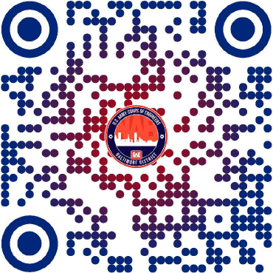
Doing business with us
USACE - Baltimore District --> Business With Us

Slide 23
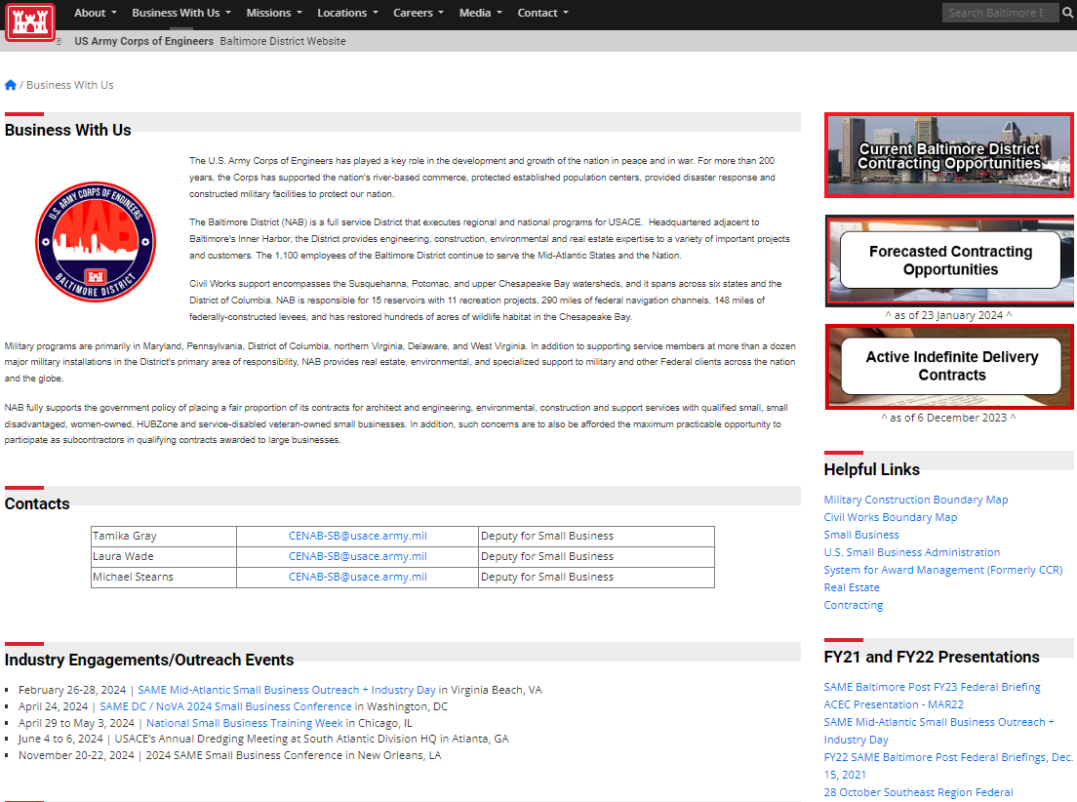
Doing business with us
More Information on Small Business
Forecasts /
Active IDCs
Small Business Points of Contact
District Boundary
Maps
Engagements / Outreach Events

Slide 24




FOLLOW US
@USACEBaltimore

Slide 25
BUILDING STRONG.

