Slide 1


2024 American Small Business Contracting Summit
Ian Griffith
USACE - Baltimore District
Chief, Military Programs
24 APRIL 2024

Slide 2
AGENDA
01 | WHO WE ARE | I. Griffith
02 | OBLIGATIONS ($m) FY20 TO FY23 | I. Griffith
03 | FY24 CONTRACTING OPPORTUNITIES | I. Griffith
04 | DOING BUSINESS WITH US | I. Griffith
05 | FOLLOW US | I. Griffith

Slide 3
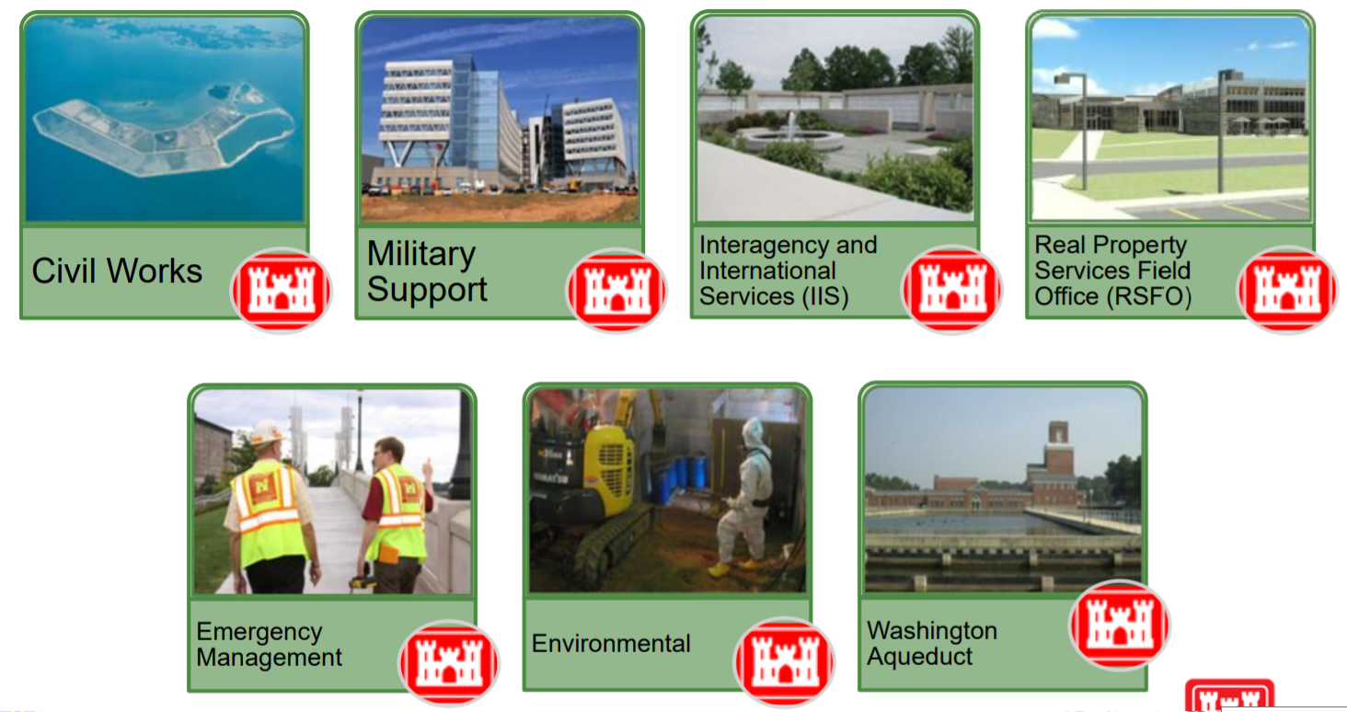
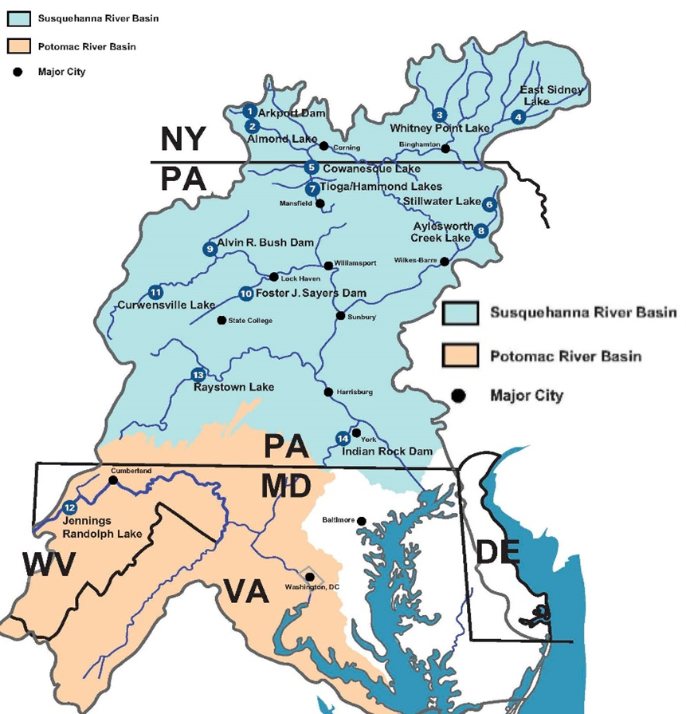
WHO WE ARE
MISSION
Deliver vital engineering solutions in collaboration with our partners to serve and strengthen the Nation, energize the economy, and reduce disaster risks.

Slide 4
OBLIGATIONS ($m) FY20 TO FY23

Slide 5
Fy24 contracting opportunities
Architectural-engineering services (1 of 2)
Description | Location | Anticipated Solicitation Date (By Quarter) | Capacity | Anticipated Acquisition Strategy
Multi-Disciplined Design Services for Military / SRM Programs (MATOC) (Contemplates Targeted Award of Six Contracts) | NAD-wide | FY24, Q3 | $60M | SB Set-Aside
Value-Engineering Services (Contemplates Award of Three Contracts) | NAD-wide | FY24, Q3 | $9M | SB Set-Aside
Surveying and Geospatial Mapping Services (MATOC) (Contemplates Award of Up to Three Contracts) | NAD-wide | FY24, Q3 | $8M | SB Set-Aside
Multi-Disciplined Design Services for Military / SRM Programs (MATOC) (Contemplates Targeted Award of Six Contracts) | NAD-wide | FY24, Q4 | $240M | Unrestricted
Construction Management Services for BEP Currency Production Facility | Beltsville, MD | FY24, Q3 | $25M to $100M | SB Set-Aside
Cost Engineering / Scheduling Services (MATOC) (Contemplates Award of Up to Three Contracts) | NAD-wide | TBD | TBD | SB Set-Aside

Slide 6
Fy24 contracting opportunities
environmental services (2 of 2)
Description | Location | Anticipated Solicitation Date (By Quarter) | Magnitude of Construction | Anticipated Acquisition Strategy
Optimized Remediation Contract for Joint Base McGuire-Dix-Lakehurst | Burlington County, NJ | FY24, Q3 | $25M to $100M | SB Set-Aside
Optimized Remediation Contract for Joint Base Cape Cod | Buzzards Bay, MA | FY24, Q3 | $25M to $100M | SB Set-Aside
BRAC PFAS RIs at Four Army Installations | Nation-wide | FY24, Q3 | $10M to $25M | SB Set-Aside
Multiple-Award Environmental Services (MAES) (MATOC) (Contemplates Targeted Award of 10 Contracts, which includes a Small Business Reserve Targeted Award of Six Contracts) | NAD-wide, CONUS, Alaska, Hawaii and Puerto Rico | FY24, Q2 | $500M | Unrestricted w/SB Reserves
INTERNATIONAL AND INTERAGENCY SUPPORT
Dike Marsh Wetland Restoration and Stabilization - Fix Sill Settlement | Alexandria, VA | FY24, Q3 | $1M to $5M | SB Set-Aside

Slide 7
Fy24 contracting opportunities
Milcon / rsfo (1 of 4)
Description | Location | Anticipated Solicitation Date (By Quarter) | Magnitude of Construction | Anticipated Acquisition Strategy
Construct Fire Station at Letterkenny Army Depot | Chambersburg, PA | FY24, Q2 | $25M to $100M | Competitive 8(a)
Construct Joint Missile Maintenance Facility and ACP at Letterkenny Army Depot | Chambersburg, PA | FY24, Q3 | $25M to $100M | Unrestricted
Steam Sterilization Plant Fit-Out at Fort Detrick | Frederick, MD | FY24, Q3 | $25M to $100M | Unrestricted
Effluent Decontamination System for Fort Detrick | Frederick, MD | FY24, Q3 | $25M to $100M | SB Set-Aside
Repair Buildings 309 and 390 at Aberdeen Proving Ground | Harford County, MD | FY24, Q3 | $25M to $100M | TBD
Construct ACP at Letterkenny Army Depot | Chambersburg, PA | FY24, Q3 | $25M to $100M | SB Set-Aside

Slide 8
Fy24 contracting opportunities
Milcon / rsfo (2 of 4)
Description | Location | Anticipated Solicitation Date (By Quarter) | Magnitude of Construction | Anticipated Acquisition Strategy
Construct Mission Support Facility at Fort Carson | Fort Carson, CO | FY24, Q3 | $10M to $25M | TBD
Demolition of Buildings 121 (Bliss Hall) and 122 (Root Hall) at Carlisle Barracks | Carlisle, PA | FY24, Q3 | $10M to $25M | Competitive 8(a)
DLA Site Improvements at Fort Meade | Anne Arundel County, MD | FY24, Q3 | $10M to $25M | Competitive 8(a)
Relocate Recycling Center at Fort Meade | Anne Arundel County, MD | FY24, Q3 | $5M to $10M | SB Set-Aside
Construct Lot 12 (Riverbank Park) at Fort Meade | Anne Arundel County, MD | FY24, Q3 | $5M to $10M | SB Set-Aside
Convert Room 4250 for DTRA HQ at Fort Belvoir | Fairfax County, VA | FY24, Q3 | $5M to $10M | SB Set-Aside

Slide 9
Fy24 contracting opportunities
Milcon / rsfo (3 of 4)
Description | Location | Anticipated Solicitation Date (By Quarter) | Magnitude of Construction | Anticipated Acquisition Strategy
Abatement of NCO Quarters / Pool Complex within UEPH Site at Joint Base Myer-Henderson Hall | Arlington, VA | FY24, Q3 | $1M to $5M | SB Set-Aside
Construct Extension of Remote Inspection Facility at Fort Belvoir | Fairfax County, VA | FY24, Q3 | $1M to $5M | Competitive 8(a)
Construct Two Overwatch Guard Facilities for Two ACPs at Fort Belvoir | Fairfax County, VA | FY24, Q3 | $1M to $5M | SB Set-Aside
Replace Chiller at Building A47 for Naval Research Laboratory | Washington, DC | FY24, Q3 | $1M to $5M | SB Set-Aside
Construct Component Rebuild Shop, Phase 1 at Letterkenny Army Depot | Chambersburg, PA | FY24, Q4 | $250M to $500M | Unrestricted
Repair Building 6330 (Gaffney Fitness Center) at Fort Meade | Anne Arundel County, MD | FY24, Q4 | $10M to $25M | TBD

Slide 10
Fy24 contracting opportunities
Milcon / rsfo (4 of 4)
Description | Location | Anticipated Solicitation Date (By Quarter) | Magnitude of Construction | Anticipated Acquisition Strategy
Replace Transformers at Buildings 210, 214, and 215 for Naval Research Laboratory | Washington, DC | FY24, Q4 | $1M to $5M | SB Set-Aside
Repair Chamberlin Avenue at Fort Meade | Anne Arundel County, MD | FY24, Q4 | $1M to $5M | SB Set-Aside
Repair Building 215 at Fort Belvoir | Fairfax County, VA | FY24, Q4 | $100k to $250k | SB Set-Aside

Slide 11
Fy24 contracting opportunities
CIVIL WORKS (1 of 3)
Description | Location | Anticipated Solicitation Date (By Quarter) | Magnitude of Construction | Anticipated Acquisition Strategy
Barren Island Ecosystem Restoration - Phases 2 and 3 | Dorchester County, MD | FY24, Q3 | $25M to $100M | SB Set-Aside
Replace Tunnel and Warm Water Slide Gate at Raystown Lake | Huntingdon County, PA | FY24, Q3 | $10M to $25M | SB Set-Aside
Cell 6 and 11 Dike Raisings at Poplar Island | Talbot County, MD | FY24, Q3 | $10M to $25M | SB Set-Aside

Slide 12
Fy24 contracting opportunities
CIVIL WORKS (2 of 3)
Description | Location | Anticipated Solicitation Date (By Quarter) | Magnitude of Construction | Anticipated Acquisition Strategy
Sewer Extension at Moscow Borough | Moscow Borough, PA | FY24, Q3 | $1M to $5M | Unrestricted
Replace Dam Gate and Hoist at Stillwater Lake | Forest City, PA | FY24, Q3 | $1M to $5M | Unrestricted
Shoal Removal at Codorus Creek Flood Risk Management (Levee) | York County, PA | FY24, Q3 | $1M to $5M | WOSB Set-Aside
Replace Gatehouse Electrical System at Stillwater Lake | Forest City, PA | FY24, Q3 | $500k to $1M | SB Set-Aside
Dam Control Tower Electrical Rehabilitation at Stillwater Lake | Forest City, PA | FY24, Q3 | $500k to $1M | SB Set-Aside
Replace Pedestrian Bridge at Northwest Branch Anacostia | Adelphi, MD | FY24, Q3 | $500k to $1M | Unrestricted

Slide 13
Fy24 contracting opportunities
CIVIL WORKS
Description | Location | Anticipated Solicitation Date (By Quarter) | Magnitude of Construction | Anticipated Acquisition Strategy
Replace Guardrail at Aylesworth Dam | Archibald Borough, PA | FY24, Q3 | $100k to $250k | SB Set-Aside
Baltimore Harbor Maintenance Dredging - York Spit Channel | Chesapeake Bay, MD | FY24, Q4 | $10M to $25M | Unrestricted
FY25 Baltimore Harbor Maintenance Dredging - MD Portions | Patapsco River and Chesapeake Bay, MD | FY24, Q4 | $25M to $100M | Unrestricted
Twitch Cove and Big Thorofare Jetty Rehabilitation | Somerset County, MD | FY24, Q4 | $1M to $5M | SB Set-Aside
North-East River Maintenance Dredging | Cecil County, MD | FY24, Q4 | $1M to $5M | SB Set-Aside

Slide 14
Fy24 contracting opportunities
Washington aqueduct
Description | Location | Anticipated Solicitation Date (By Quarter) | Capacity | Anticipated Acquisition Strategy
Residual Hauling and Disposal at Washington Aqueduct (SATOC) | Washington, DC | FY24, Q2 | $18.5M | Competitive 8(a)
Construction, Maintenance, and Repair at Washington Aqueduct (JOC) | Washington, DC | FY24, Q3 | $25M | Unrestricted
Mechanical Services at Washington Aqueduct (SATOC) | Washington, DC | FY24, Q3 | $15M | SB Set-Aside
Replace McMillan North Clearwell at Washington Aqueduct | Washington, DC | FY24, Q3 | $25M to $100M | Unrestricted
Cable Inspection and Lubrication at Washington Aqueduct | Washington, DC | FY24, Q3 | $500k to $1M | SB Set-Aside
Truck Scale Maintenance and Repair Services at Washington Aqueduct | Washington, DC | FY24, Q3 | $25k to $100k | Unrestricted
Repair Caustic Soda Tank #13 at Washington Aqueduct | Washington, DC | FY24, Q3 | $25k to $100k | SB Set-Aside

Slide 15
Fy24 contracting opportunities
Services
Description | Location | Anticipated Solicitation Date (By Quarter) | Magnitude of Construction | Anticipated Acquisition Strategy
Mowing and Trimming Services for Southern New York Local Flood Protection Project | NY | FY24, Q2 | $250k to $500k | SB Set-Aside
Wildlife Enhancement Services at Raystown Lake | Huntingdon County, PA | FY24, Q2 | $100k to $250k | SB Set-Aside
Park Attendant Services at Jennings Randolph Lake | Mineral County, WV | FY24, Q2 | $25k to $100k | SB Set-Aside
Drain / Abutment Cleaning and Video Inspection at Tioga Dam and Mansfield Levee | Mansfield, PA | FY24, Q3 | $500k to $1M | SB Set-Aside
Repair Three Debris Barges for Survey / Debris Removal Section | Chesapeake Bay and its Tributaries | FY24, Q3 | $250k to $500k | SB Set-Aside
Refuse Services at Raystown Lake | Huntingdon County, PA | FY24, Q3 | $250k to $500k | SB Set-Aside
Aquatic Plant Control at Raystown Lake | Huntingdon County, PA | FY24, Q3 | $100k to $250k | SB Set-Aside
Commercial Event Tent and Appartenances Rental | Washington, DC | FY24, Q3 | $25k to $100k | SB Set-Aside
Herbicide Application at Jennings Randolph Lake | Mineral County, WV | FY24, Q3 | $25k to $100k | SB Set-Aside

Slide 16
Fy24 contracting opportunities
supplies
Description | Location | Anticipated Solicitation Date (By Quarter) | Magnitude of Construction | Anticipated Acquisition Strategy
Furnish and Install Furniture for Suite 700 for U.S. Cyber Command | Annapolis Junction, MD | FY24, Q3 | $500k to $1M | SB Set-Aside

Slide 17
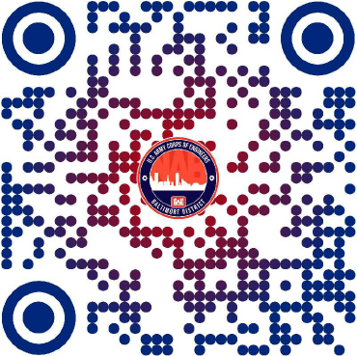
Doing business with us
USACE - Baltimore District --> Business With Us

Slide 18
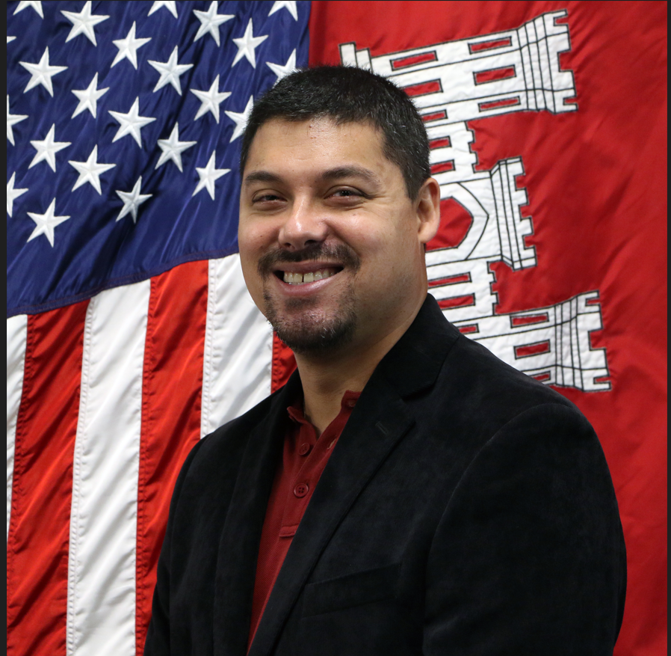
SMALL BUSINESS OFFICE (1 of 2)
Key Highlights (FY23):
Over $373M awarded to small businesses.
Small Business Office grew from one to 2-1/2 FTEs.
How to Reach Us:
CENAB-SB@usace.army.mil
Tamika Gray
Deputy for Small Business
Michael Stearns
Deputy for Small Business

Slide 19
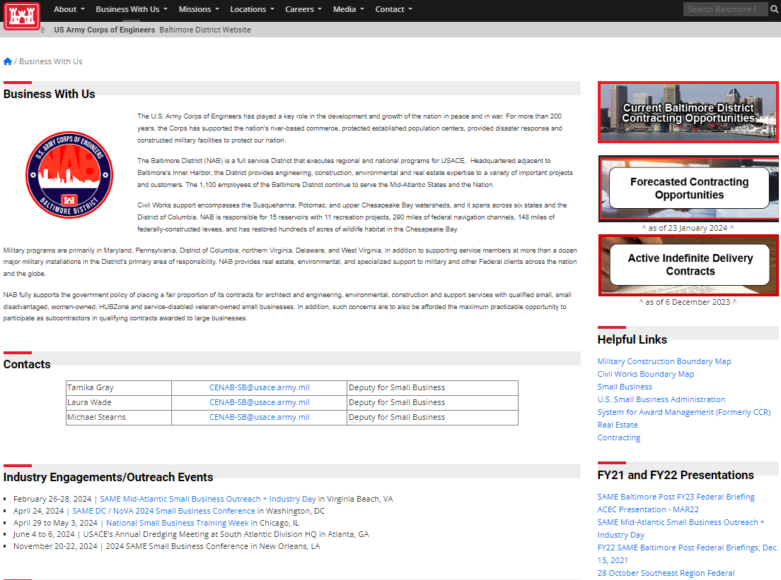
Doing business with us
More Information on Small Business
Forecasts /
Active IDCs
Small Business Points of Contact
District Boundary
Maps
Engagements / Outreach Events

Slide 20




FOLLOW US
@USACEBaltimore

Slide 21
BUILDING STRONG.

