Slide 1


SAME MID-ATLANTIC SMALL BUSINESS OUTREACH + INDUSTRY DAY
Michael Stearns
USACE - Baltimore District
Small Business Office
28 FEBRUARY 2024

Slide 2
AGENDA
01 | WHO WE ARE | M. Stearns
02 | SMALL BUSINESS OFFICE | m. stearns
03 | OBLIGATIONS ($m) FY20 TO FY23 | m. stearns
04 | FY23 PROGRAM HIGHLIGHTS | m. stearns
05 | FY24 CONTRACTING OPPORTUNITIES | m. stearns
06 | DOING BUSINESS WITH US | m. stearns
07 | FOLLOW US | m. stearns

Slide 3
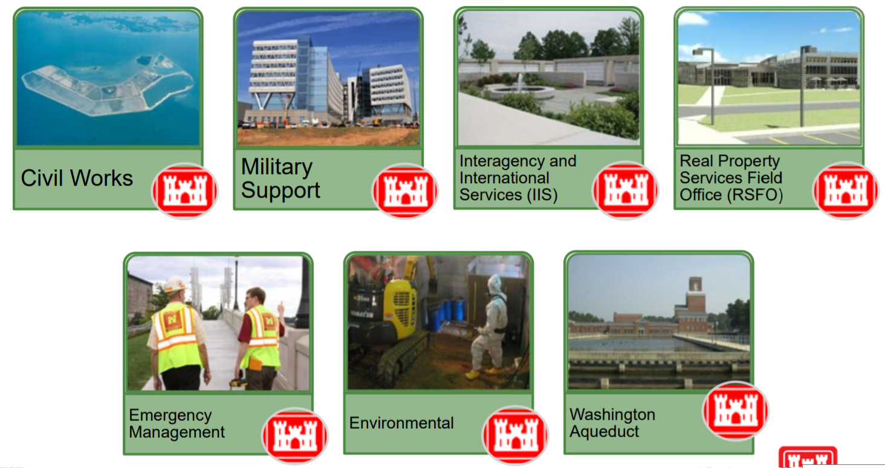
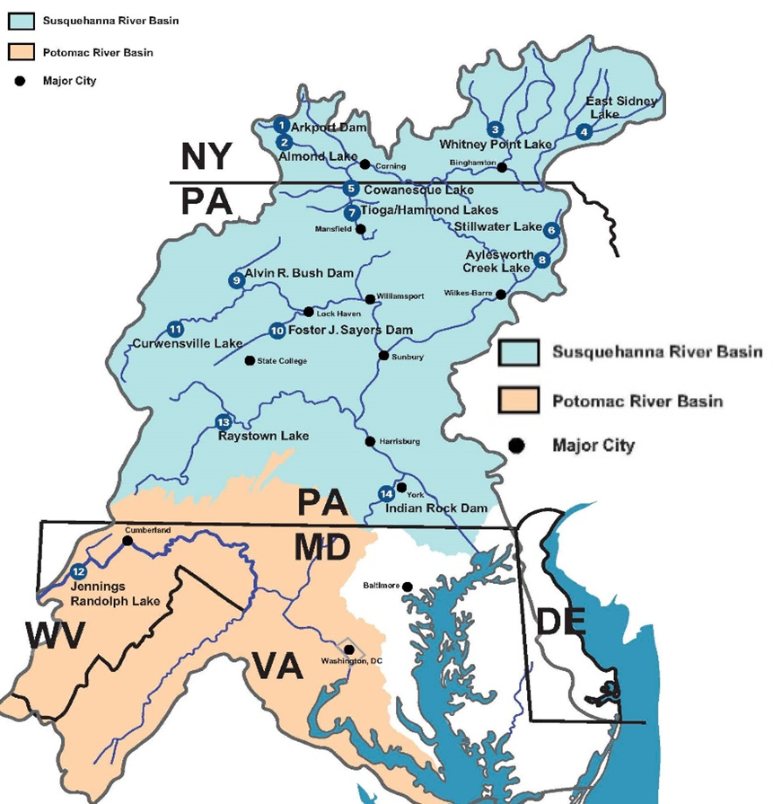
WHO WE ARE
MISSION
Deliver vital engineering solutions in collaboration with our partners to serve and strengthen the Nation, energize the economy, and reduce disaster risks.

Slide 4
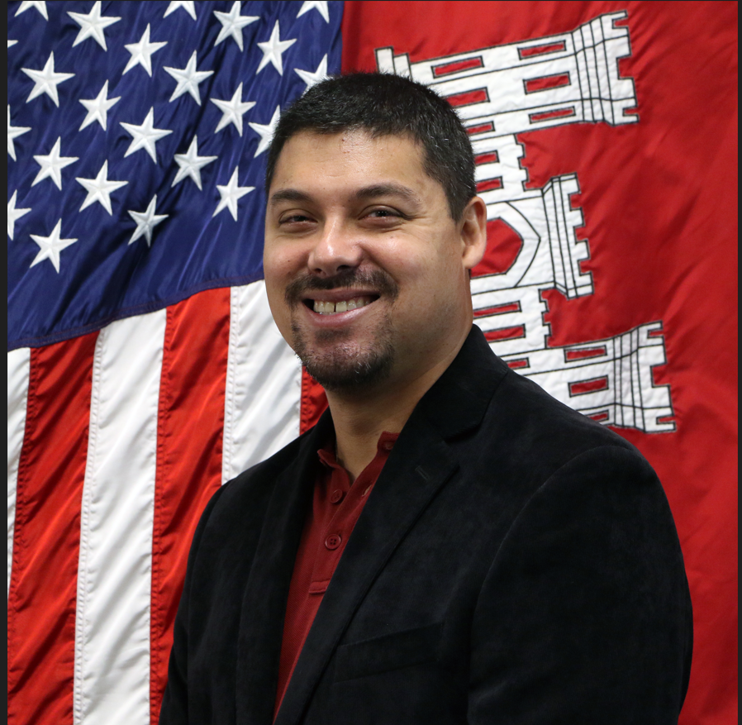
SMALL BUSINESS OFFICE (1 of 2)
Key Highlights (FY23):
Over $373M awarded to small businesses.
Small Business Office grew from one to 2-1/2 FTEs.
Initiatives (FY24):
More frequent updates to our Forecast of Contracting Opportunities, Active IDC List, and Small Business Goal Achievements.
Visiting outlying installations and project offices to discuss small business matters.
Updating language for Small Business Participation evaluation factor. Includes a template for submission and restricts number of pages.
Assisting Contracting Division with implementing strategies for contractor compliance with FAR Clause 52.219-14 (Limitations on Subcontracting).
Tamika Gray
Deputy for Small Business
Michael Stearns
Deputy for Small Business

Slide 5
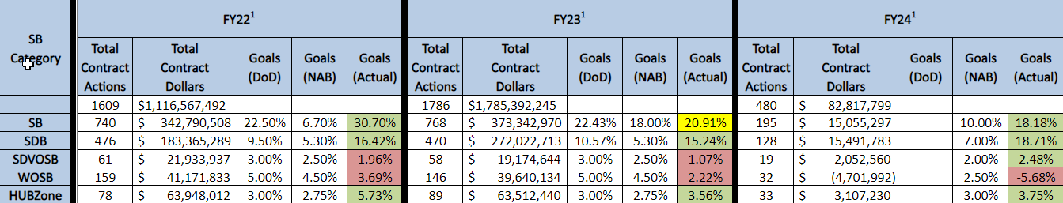
SMALL BUSINESS OFFICE (2 of 2)
FY22 to FY24 Small Business Goals / Accomplishments (as of February 5, 2024)
Dates​ | Engagement Title​ | Location​
April 11, 2024 | Baltimore District Industry Day | Baltimore, MD
April 16 to 18, 2024 | Southeast Region Federal Construction Infrastructure and Environmental Summit | Wilmington, NC
April 24, 2024 | SAME DC / NoVA 2024 Small Business Conference | Washington, DC
April 30 to May 3, 2024 | DoD Small Business Training Week | Chicago, IL
June 4 to 6, 2024 | USACE’s Annual Dredging Meeting at South Atlantic Division HQ | Atlanta, GA
November 20 to 22, 2024 | 2024 SAME Small Business Conference | New Orleans, LA
Future Industry Engagements (as of February 12, 2024)

Slide 6
OBLIGATIONS ($m) FY20 TO FY23

Slide 7
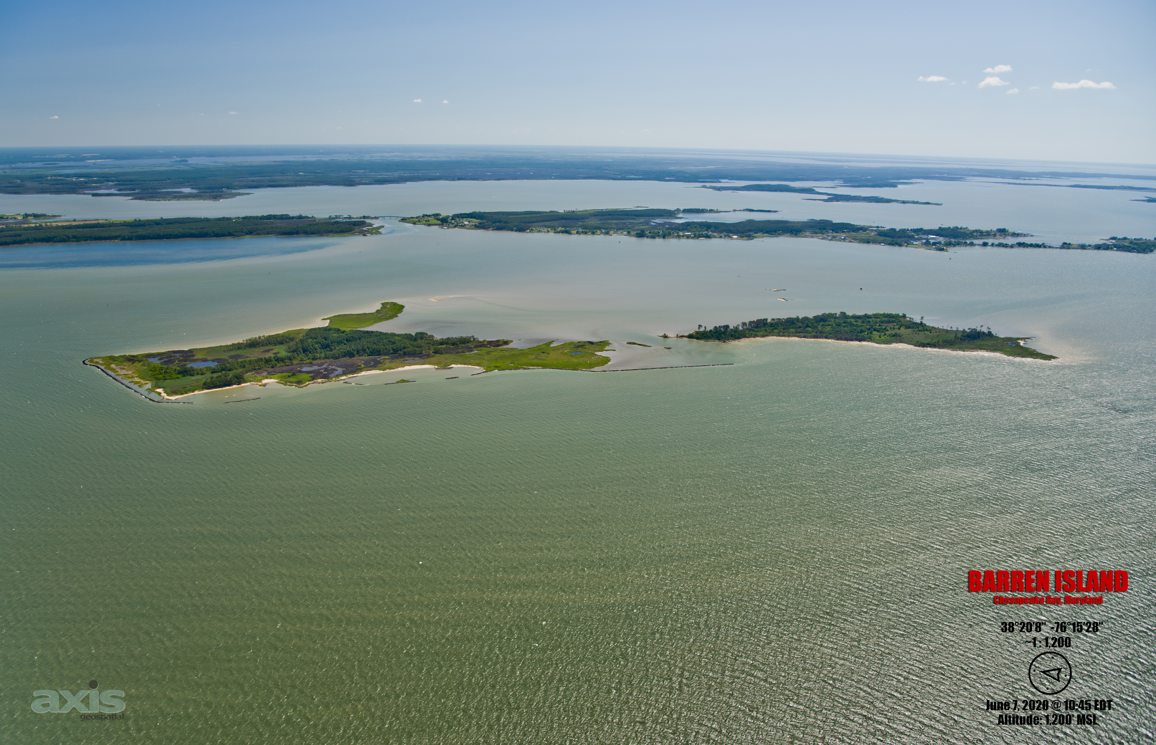
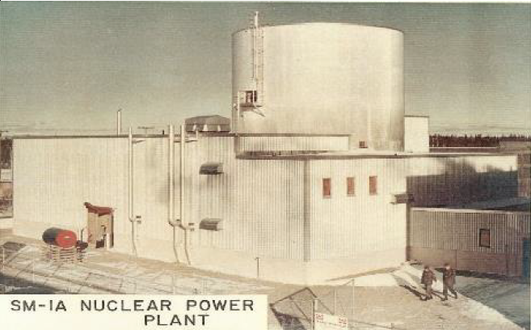
Fy23 program highlights
Renovate Nolan Building for INSCOM
Fort Belvoir, VA
Construct East Campus Building 5
Integrated Design and Construction
Fort Meade, MD
Baltimore Harbor Maintenance Dredging
Barren Island Ecosystem Restoration
Initial Construction Contract
Decommission and Dismantle SM-1A Reactor
Fort Greely, AK

Slide 8
Fy24 contracting opportunities
Architectural-engineering services (1 of 2)
Description | Location | Anticipated Solicitation Date (By Quarter) | Capacity | Anticipated Acquisition Strategy
Value-Engineering Services (Contemplates Award of Three Contracts) | NAD-wide | FY24, Q2 | $9M | SB Set-Aside
Multi-Disciplined Design Services for Military / SRM Programs (MATOC) (Contemplates Targeted Award of Six Contracts) | NAD-wide | FY24, Q3 | $240M | Unrestricted
Multi-Disciplined Design Services for Military / SRM Programs (MATOC) (Contemplates Targeted Award of Six Contracts) | NAD-wide | FY24, Q3 | $60M | SB Set-Aside
Paula Beck
Chief, Contracting Division
Kevin Coleman, PE
Chief, Construction Division
Mary Foutz, PE
Chief, Engineering Division
Ray McNeil
Chief, RSFO

Slide 9
Fy24 contracting opportunities
Architectural-engineering services (2 of 2)
Description | Location | Anticipated Solicitation Date (By Quarter) | Capacity | Anticipated Acquisition Strategy
Surveying and Geospatial Mapping Services (MATOC) (Contemplates Award of Up to Three Contracts) | NAD-wide | FY24, Q3 | $8M | SB Set-Aside
Cost Engineering / Scheduling Services (MATOC) (Contemplates Award of Up to Three Contracts) | NAD-wide | TBD | TBD | SB Set-Aside
Description | Location | Anticipated Solicitation Date (By Quarter) | Magnitude of Construction | Anticipated Acquisition Strategy
Construction Management Services for BEP Currency Production Facility | Beltsville, MD | FY24, Q2 | $10M to $25M | Unrestricted

Slide 10
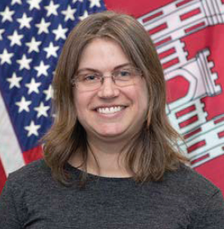
Fy24 contracting opportunities
environmental services (1 of 2)
Description | Location | Anticipated Solicitation Date (By Quarter) | Capacity | Anticipated Acquisition Strategy
Multiple-Award Environmental Services (MAES) (MATOC) (Contemplates Targeted Award of 10 Contracts, which includes a Small Business Reserve Targeted Award of Six Contracts) | NAD-wide, CONUS, Alaska, Hawaii and Puerto Rico | FY24, Q2 | $500M | Unrestricted w/SB Reserves
Emily Schiffmacher, PE
Chief, EMDC

Slide 11
Fy24 contracting opportunities
environmental services (2 of 2)
Description | Location | Anticipated Solicitation Date (By Quarter) | Magnitude of Construction | Anticipated Acquisition Strategy
Optimized Remediation Contract for Joint Base McGuire-Dix-Lakehurst | Burlington County, NJ | FY24, Q2 | $25M to $100M | Unrestricted
Optimized Remediation Contract for Joint Base Cape Cod | Buzzards Bay, MA | FY24, Q2 | $25M to $100M | Unrestricted
BRAC PFAS RIs at Four Army Installations | Nation-wide | FY24, Q3 | $10M to $25M | Unrestricted

Slide 12
Fy24 contracting opportunities
INTERNATIONAL AND INTERAGENCY SUPPORT
Description | Location | Anticipated Solicitation Date (By Quarter) | Magnitude of Construction | Anticipated Acquisition Strategy
Construct Bureau of Engraving and Printing (BEP) Currency Production Facility | Beltsville, MD | FY24, Q2 | Over $500M | Unrestricted
Dike Marsh Wetland Restoration and Stabilization - Fix Sill Settlement | Alexandria, VA | FY24, Q2 | $500k to $1M | SB Set-Aside
Carrie Ogzar
BEP Program Manager

Slide 13
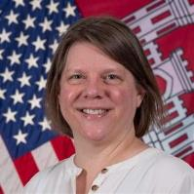
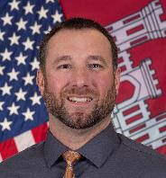

Fy24 contracting opportunities
Milcon / rsfo (1 of 5)
Description | Location | Anticipated Solicitation Date (By Quarter) | Magnitude of Construction | Anticipated Acquisition Strategy
Construct Fire Station at Letterkenny Army Depot | Chambersburg, PA | FY24, Q2 | $25M to $100M | Competitive 8(a)
DLA Site Improvements at Fort Meade | Anne Arundel County, MD | FY24, Q2 | $10M to $25M | Competitive 8(a)
Replace Chiller at Building 210 for Naval Research Laboratory | Washington, DC | FY24, Q2 | $5M to $10M | Competitive 8(a)
Ian Griffith
Chief, Military Programs and Project Management
Jillian Cazalet
North Area
Program Manager
Dave Robbins
Central Area
Program Manager
Robin Enstrom
South Area
Program Manager

Slide 14
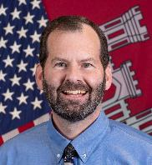
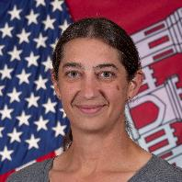
Fy24 contracting opportunities
Milcon / rsfo (2 of 5)
Description | Location | Anticipated Solicitation Date (By Quarter) | Magnitude of Construction | Anticipated Acquisition Strategy
Construct Joint Missile Maintenance Facility and ACP at Letterkenny Army Depot | Chambersburg, PA | FY24, Q3 | $25M to $100M | Unrestricted
Steam Sterilization Plant Fit-Out at Fort Detrick | Frederick, MD | FY24, Q3 | $25M to $100M | Unrestricted
Effluent Decontamination System for Fort Detrick | Frederick, MD | FY24, Q3 | $25M to $100M | TBD
Bill Tully
Capital Area
Program Manager
Sarah Doerfler
Installation Support
Program Manager
Daria Van Liew, PE
East Campus Integrated
Program Office

Slide 15
Fy24 contracting opportunities
Milcon / rsfo (3 of 5)
Description | Location | Anticipated Solicitation Date (By Quarter) | Magnitude of Construction | Anticipated Acquisition Strategy
Repair Buildings 309 and 390 at Aberdeen Proving Ground | Harford County, MD | FY24, Q3 | $25M to $100M | TBD
Construct Mission Support Facility at Fort Carson | Fort Carson, CO | FY24, Q3 | $10M to $25M | TBD
Repair Building 6330 (Gaffney Fitness Center) at Fort Meade | Anne Arundel County, MD | FY24, Q3 | $10M to $25M | TBD
Demolition of Buildings 121 (Bliss Hall) and 122 (Root Hall) at Carlisle Barracks | Carlisle, PA | FY24, Q3 | $10M to $25M | Competitive 8(a)
Repair Building 213 at Fort Belvoir | Fairfax County, VA | FY24, Q3 | $5M to $10M | Competitive 8(a)
Relocate Recycling Center at Fort Meade | Anne Arundel County, MD | FY24, Q3 | $5M to $10M | SB Set-Aside

Slide 16
Fy24 contracting opportunities
Milcon / rsfo (4 of 5)
Description | Location | Anticipated Solicitation Date (By Quarter) | Magnitude of Construction | Anticipated Acquisition Strategy
Construct Lot 12 (Riverbank Park) at Fort Meade | Anne Arundel County, MD | FY24, Q3 | $5M to $10M | SB Set-Aside
Abatement of NCO Quarters / Pool Complex within UEPH Site at Joint Base Myer-Henderson Hall | Arlington, VA | FY24, Q3 | $1M to $5M | SB Set-Aside
Construct Extension of Remote Inspection Facility at Fort Belvoir | Fairfax County, VA | FY24, Q3 | $1M to $5M | Competitive 8(a)
Replace Transformers at Buildings 210, 214, and 215 for Naval Research Laboratory | Washington, DC | FY24, Q3 | $1M to $5M | SB Set-Aside
Replace Chiller at Building A47 for Naval Research Laboratory | Washington, DC | FY24, Q3 | $1M to $5M | SB Set-Aside
Construct Component Rebuild Shop, Phase 1 at Letterkenny Army Depot | Chambersburg, PA | FY24, Q4 | $250M to $500M | Unrestricted

Slide 17
Fy24 contracting opportunities
Milcon / rsfo (5 of 5)
Description | Location | Anticipated Solicitation Date (By Quarter) | Magnitude of Construction | Anticipated Acquisition Strategy
Repair Chamberlin Avenue at Fort Meade | Anne Arundel County, MD | FY24, Q4 | $1M to $5M | SB Set-Aside
Repair Building 215 at Fort Belvoir | Fairfax County, VA | FY24, Q4 | $100k to $250k | SB Set-Aside

Slide 18
Fy24 contracting opportunities
CIVIL WORKS (1 of 3)
Description | Location | Anticipated Solicitation Date (By Quarter) | Magnitude of Construction | Anticipated Acquisition Strategy
Barren Island Ecosystem Restoration - Phases 2 and 3 | Dorchester County, MD | FY24, Q2 | $25M to $100M | SB Set-Aside
Replace Tunnel and Warm Water Slide Gate at Raystown Lake | Huntingdon County, PA | FY24, Q2 | $10M to $25M | SB Set-Aside
Replace Dam Gate and Hoist at Stillwater Lake | Forest City, PA | FY24, Q2 | $1M to $5M | Unrestricted
Justin Callahan, PMP
Civil Programs and
Project Management
Bill Seib
Chief, Operations Division

Slide 19
Fy24 contracting opportunities
CIVIL WORKS (2 of 3)
Description | Location | Anticipated Solicitation Date (By Quarter) | Magnitude of Construction | Anticipated Acquisition Strategy
Repair Spillway at Cowanesque Lake | Lawrenceville, PA | FY24, Q2 | $1M to $5M | SB Set-Aside
Shoal Removal at Codorus Creek Flood Risk Management (Levee) | York County, PA | FY24, Q2 | $1M to $5M | WOSB Set-Aside
Replace Gatehouse Electrical System at Stillwater Lake | Forest City, PA | FY24, Q2 | $500k to $1M | SB Set-Aside
Replace Guardrail at East Sydney Dam | Franklin, NY | FY24, Q2 | $100k to $250k | SB Set-Aside
Cell 6 and 11 Dike Raisings at Poplar Island | Talbot County, MD | FY24, Q3 | $5M to $10M | SB Set-Aside
Sewer Extension at Moscow Borough | Moscow Borough, PA | FY24, Q3 | $1M to $5M | Unrestricted

Slide 20
Fy24 contracting opportunities
CIVIL WORKS (3 of 3)
Description | Location | Anticipated Solicitation Date (By Quarter) | Magnitude of Construction | Anticipated Acquisition Strategy
Dam Control Tower Electrical Rehabilitation at Stillwater Lake | Forest City, PA | FY24, Q3 | $500k to $1M | SB Set-Aside
Replace Pedestrian Bridge at Northwest Branch Anacostia | Adelphi, MD | FY24, Q3 | $500k to $1M | Unrestricted
Road Paving at Foster Joseph Sayers Dam | Beech Creek, PA | FY24, Q3 | $250k to $500k | SB Set-Aside
Baltimore Harbor Maintenance Dredging - York Spit Channel | Chesapeake Bay, MD | FY24, Q4 | $10M to $25M | Unrestricted
FY25 Baltimore Harbor Maintenance Dredging - MD Portions | Patapsco River and Chesapeake Bay, MD | FY24, Q4 | $25M to $100M | Unrestricted
North East River Maintenance Dredging | Cecil County, MD | FY24, Q3 | $1M to $5M | SB Set-Aside

Slide 21
Fy24 contracting opportunities
Washington aqueduct (1 of 2)
Description | Location | Anticipated Solicitation Date (By Quarter) | Capacity | Anticipated Acquisition Strategy
Residual Hauling and Disposal at Washington Aqueduct (SATOC) | Washington, DC | FY24, Q2 | $18.5M | Competitive 8(a)
Construction, Maintenance, and Repair at Washington Aqueduct (JOC) | Washington, DC | FY24, Q2 | $15M | Unrestricted
Rudy Chow, PE
General Manager
Washington Aqueduct

Slide 22
Fy24 contracting opportunities
Washington aqueduct (2 of 2)
Description | Location | Anticipated Solicitation Date (By Quarter) | Magnitude of Construction | Anticipated Acquisition Strategy
Truck Scale Maintenance and Repair Services at Washington Aqueduct | Washington, DC | FY24 Q2 | $25k to $100k | Unrestricted
Repair Caustic Soda Tank #13 at Washington Aqueduct | Washington, DC | FY24, Q2 | $25k to $100k | SB Set-Aside
Replace McMillan North Clearwell at Washington Aqueduct | Washington, DC | FY24, Q3 | $25M to $100M | Unrestricted
Cable Inspection and Lubrication at Washington Aqueduct | Washington, DC | FY24, Q3 | $500k to $1M | SB Set-Aside

Slide 23
Fy24 contracting opportunities
services (1 of 2)
Description | Location | Anticipated Solicitation Date (By Quarter) | Magnitude of Construction | Anticipated Acquisition Strategy
Herbicide Application at Cowanesque Lake, Tioga-Hammond Lake, and Mansfield Protective Works | Tioga County, PA | FY24, Q2 | $500k to $1M | SB Set-Aside
Mowing and Trimming Services for Southern New York Local Flood Protection Project | NY | FY24, Q2 | $250k to $500k | SB Set-Aside
Aquatic Plant Control at Raystown Lake | Huntingdon County, PA | FY24, Q2 | $100k to $250k | SB Set-Aside
Wildlife Enhancement Services at Raystown Lake | Huntingdon County, PA | FY24, Q2 | $100k to $250k | SB Set-Aside
Herbicide Application at Jennings Randolph Lake | Mineral County, WV | FY24, Q2 | $25k to $100k | SB Set-Aside
Park Attendant Services at Jennings Randolph Lake | Mineral County, WV | FY24, Q2 | $25k to $100k | SB Set-Aside

Slide 24
Fy24 contracting opportunities
services (2 of 2)
Description | Location | Anticipated Solicitation Date (By Quarter) | Magnitude of Construction | Anticipated Acquisition Strategy
Elevator Maintenance (Intake Control Tower) at Jennings Randolph Lake | Mineral County, WV | FY24, Q2 | $25k to $100k | SB Set-Aside

Slide 25
Fy24 contracting opportunities
supplies
Description | Location | Anticipated Solicitation Date (By Quarter) | Magnitude of Construction | Anticipated Acquisition Strategy
Furnish and Install Television Monitors, Menu Boards, Order Confirmation Screens, and Order Kiosks at Joint Base Myer-Henderson Hall | Arlington, VA | FY24, Q2 | $250k to $500k | SB Set-Aside

Slide 26
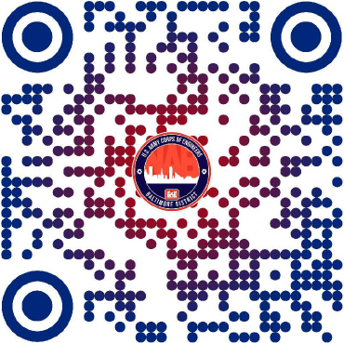
Doing business with us
USACE - Baltimore District --> Business With Us

Slide 27
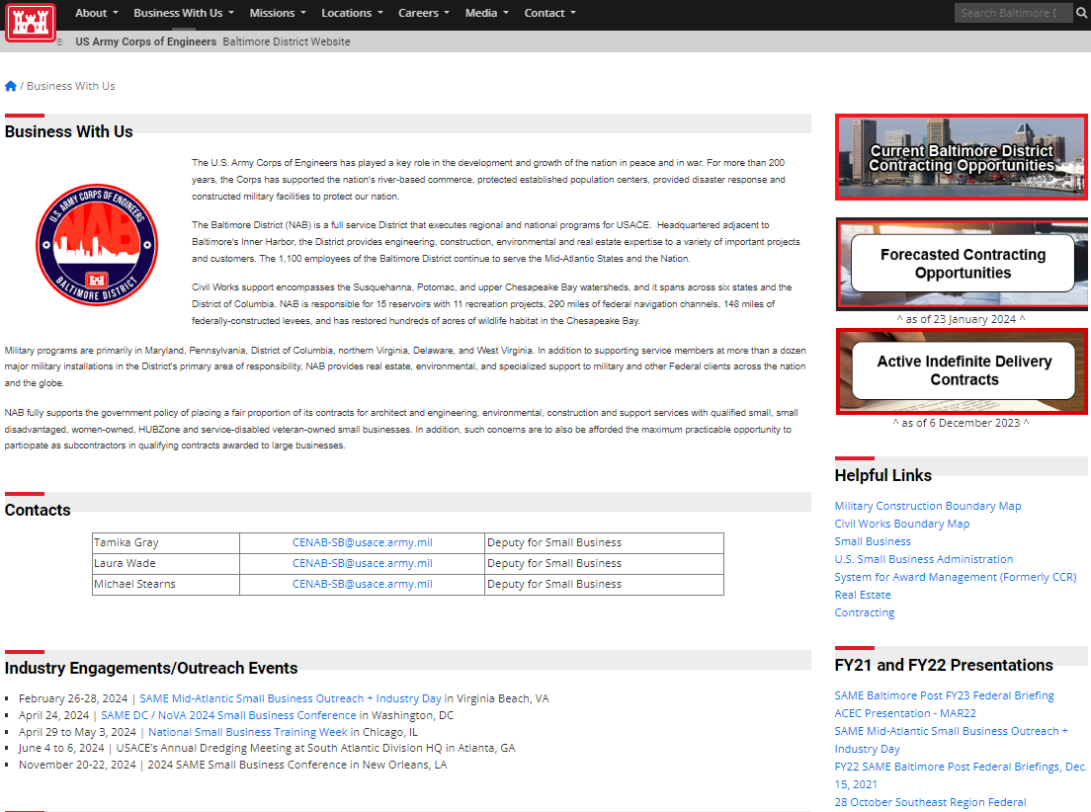
Doing business with us
More Information on Small Business
Forecasts /
Active IDCs
Small Business Points of Contact
District Boundary
Maps
Engagements / Outreach Events

Slide 28




FOLLOW US
@USACEBaltimore

Slide 29
BUILDING STRONG.

