Slide 1



SAME PHILADELPHIA POST RESILIENCE AND SMALL BUSINESS SYMPOSIUM
Michael Stearns
USACE - Baltimore District
Small Business Office
13 NOVEMBER 2024

Slide 2
agenda
01 | USACE - Baltimore district | M. STEARNS
02 | SMALL BUSINESS OFFICE | M. STEARNS
03 | OBLIGATIONs | M. STEARNS
04 | Small business accomplishments | M. STEARNS
05 | program highlights | M. STEARNS
06 | Fy25 contracting opportunities | M. STEARNS
07 | Doing business with us | M. STEARNS
1

Slide 3
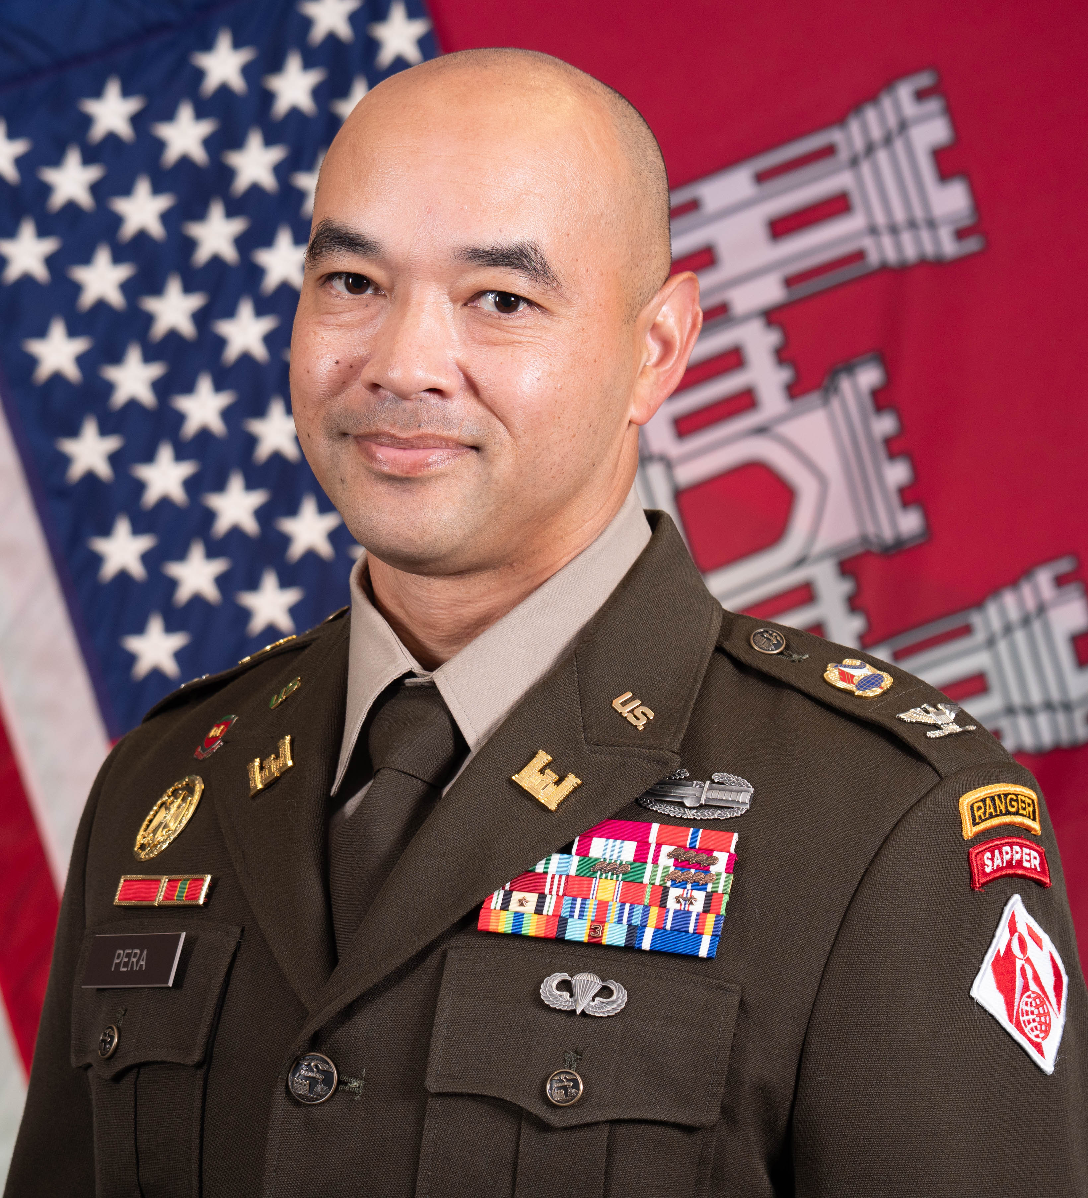
USACE - Baltimore district
District commander
70th District Commander and District Engineer of USACE - Baltimore District.
Prior to commanding Baltimore District, served as the Deputy Director of Operations for the Tradecraft and Technology Group at the National Geospatial Intelligence Agency.
Executive Officer to U.S. Army Chief of Engineers and Commanding General of USACE from 2022 to 2023.
Commissioned as an Engineer Officer in USACE in June 2001.
Earned a Bachelor of Science in Engineering Management from West Point, including one semester at the U.S. Naval Academy, and a Master of Science in Engineering Management from the Missouri University of Science and Technology.
Colonel Francis B Pera
2

Slide 4
USACE - Baltimore district
general information
1,200 civilians employed
290 miles of federal navigation channels maintained
148 miles of federal flood risk management levees overseen, preventing ~$16B in damages
27 military installations / programs supported within the Pennsylvania, Maryland, District of Columbia, and Virginia areas
15 reservoir projects managed, preventing ~$4B in flood damages
11 recreation projects operated, hosting 15M+ visitors
Operates Washington Aqueduct, which supplies an average of 135M gallons of drinking water to the District of Columbia, Arlington County, and other portions of Northern Virginia
Supports oyster restoration via the construction of 670+ acres of oyster reefs to improve water quality and habitat for other Chesapeake Bay creatures
Protects environmentally sensitive coastlines through the restoration of 1,715 acre of remote island habitats
Leases and supports 300+ Armed Forces Career Centers and 180+ housing units
Supports the National Response Plan as part of Federal Emergency Management Agency’s (FEMA) team
Regional Center of Expertise for fire protection, HTRW, radiological health physics, secure facility design, and subsurface explorations
Technical Center of Expertise for DoD National Relocation Program (DNRP)
3

Slide 5
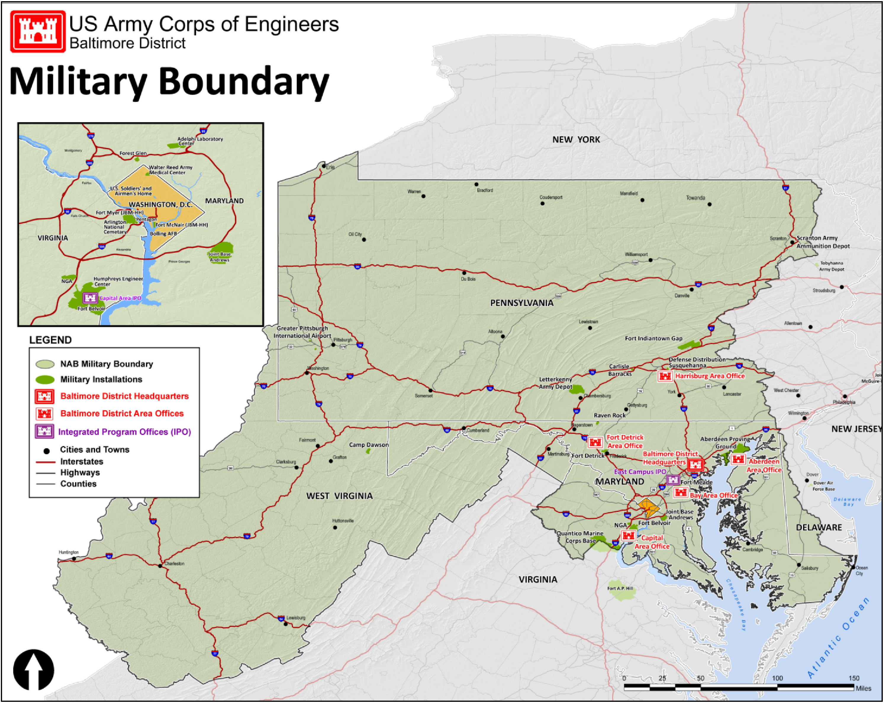
USACE - Baltimore district
military construction boundary Map
  Military Installations / Portfolios Supported
  Pennsylvania
  Carlisle Barracks
  DLA Distribution Center Susquehanna
  Fort Indiantown Gap
  Letterkenny Army Depot
  Raven Rock Mountain Complex
Maryland
Aberdeen Proving Ground
Adelphi Laboratory Complex
Fort Detrick
Fort Meade
Joint Base Andrews
USDA Beltsville Agricultural Research Center
District of Columbia
JBMM-HH (Fort McNair)
Joint Base Anacostia - Bolling
Naval Research Laboratory
  Virginia
  Fort Belvoir
  Humphreys Engineering Center
  JBM-HH (Fort Myer)
  Pentagon
4

Slide 6
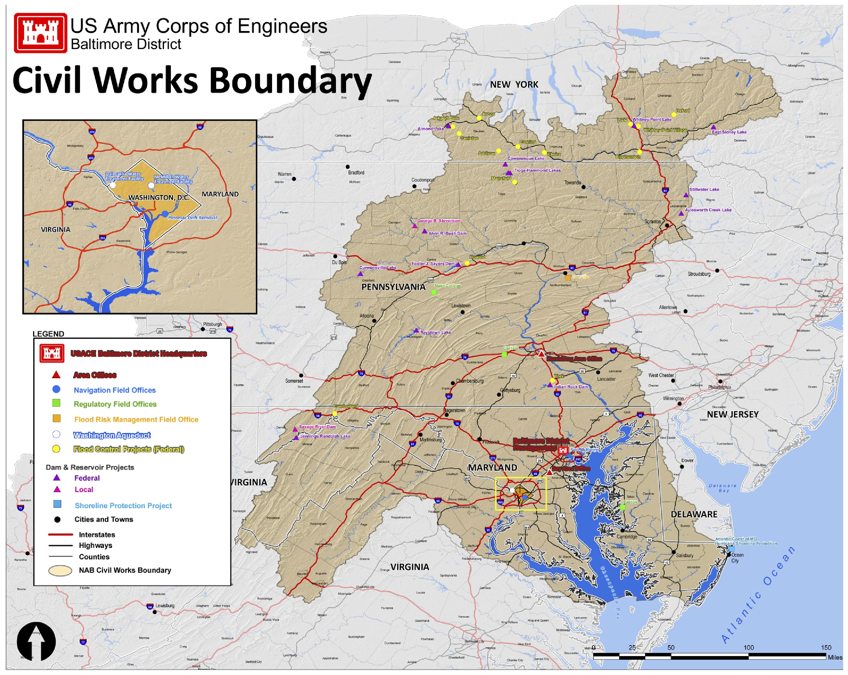
USACE - Baltimore district
civil works boundary Map
  Dam and Recreational Sites
  New York
  Almond Lake
  Arkport Dam
  East Sidney Lake
  Whitney Point Lake
  Pennsylvania
  Alvin R. Bush Dam
  Aylesworth Lake
  Codorus Creek
  Cowanesque Lake
  Curwensville Lake
  Foster J. Sayers Dam
  Indian Rock Dam
  Raystown Lake
  Stillwater Lake
  Tioga - Hammond Lakes
  West Virginia
  Jennings Randolph Lake
5

Slide 7
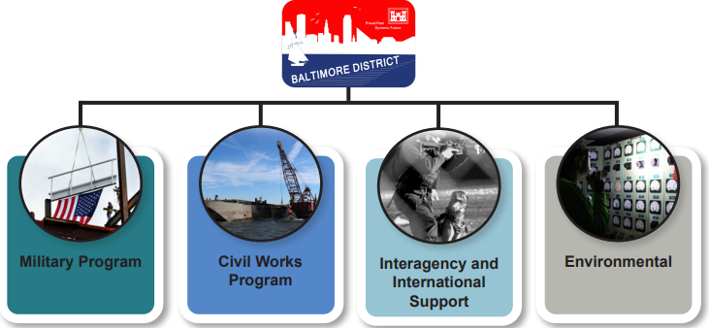
USACE - Baltimore district
our programs / mission statement
MISSION
Deliver vital engineering solutions in collaboration with our partners to serve and strengthen the Nation, energize the economy, and reduce disaster risks.
6

Slide 8
Small business office
Mission statement / small business policy
MISSION STATEMENT - hq USACE, OFFICE OF SMALL BUSINESS PROGRAMS (OSBP):
“To sustain the U.S. Army Corps of Engineers as a premier organization in developing small businesses and maximizing their opportunities to participate in our procurements, thereby ensuring a broad base of capable suppliers to support the Corps of Engineers' mission and strengthen our nation’s economic development.”
FEDERAL ACQUISITION REGULATION (FAR) 19.201(a) - GENERAL POLICY:
“It is the policy of the Government to provide maximum practicable opportunities in its acquisitions to small business, veteran-owned small business, service-disabled veteran-owned small business, HUBZone small business, small disadvantaged business, and women-owned small business concerns. Such concerns must also have the maximum practicable opportunity to participate as subcontractors in the contracts awarded by any executive agency, consistent with efficient contract performance. The Small Business Administration (SBA) counsels and assists small business concerns and assists contracting personnel to ensure that a fair proportion of contracts for supplies and services is placed with small business.”
7

Slide 9
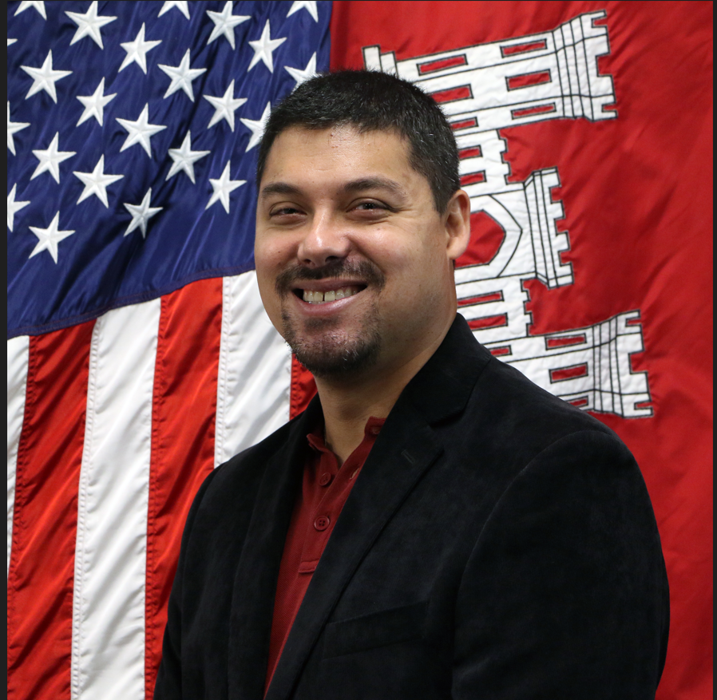
Small business office
Highlights (fy24) and initiatives (fy25)
Key Highlights (FY24):
Highest ever dollars obligated for SB (~$420M) and SDB (~$298M).
Met our SDVOSB goal for the first time since FY21 and for only the third time since FY13.
Met our HUBZone goal for the sixth consecutive year.
Awards made to six new small business entrants to the Government and 12 new small business entrants to USACE.
Initiatives (FY25):
Automating and sharing historical data to assist with market research and notifying Industry of opportunities.
Targeting outreach towards socioeconomic categories we historically have difficulties in achieving goals with (i.e., SDVOSBs and WOSBs).
Streamlining capability presentations with internal stakeholders to ensure maximum participation and quicker turnaround times with requests.
Sending out weekly notices of USACE - Baltimore District’s original postings on SAM.gov.
How to Reach Us:
CENAB-SB@usace.army.mil
Tamika Gray
Deputy for Small Business
Michael Stearns
Deputy for Small Business
8

Slide 10
obligations total contract actions / dollars (fy22 to fy24)
Information is from SAM → Data Bank → Standard Reports → Federal Contract Actions and Dollars
9
Notes:
10
NOTES:
Information is a comparison of the 55 DoDAACs under USACE.
There are currently nine USACE Districts / Center with two or more small business professionals. They are highlighted in green. They are:
Baltimore (x2.5)
Huntsville (x5)
Jacksonville (x2)
Los Angeles (x2)
Louisville (x2)
Mobile (x2)
New Orleans (x2)
Omaha (x2)
Sacramento (x2)

Slide 11
obligations
Top 5 naics codes (Fy22 to fy24)
Information is from SAM → Data Bank → Standard Reports → Total Actions by NAICS
Click Below for Detailed Information on Top NAICS Obligations for Small Business and Socioeconomic Categories
Total
SB
SDB
SDVOSB
WOSB
HUBZone
10
Notes:
11
NOTES:
Information is a comparison of the 55 DoDAACs under USACE.
There are currently nine USACE Districts / Center with two or more small business professionals. They are highlighted in green. They are:
Baltimore (x2.5)
Huntsville (x5)
Jacksonville (x2)
Los Angeles (x2)
Louisville (x2)
Mobile (x2)
New Orleans (x2)
Omaha (x2)
Sacramento (x2)

Slide 12
Small business accomplishments
goal achievements (fy24)
 | Goals (Actual) met or exceeded Goals (Army) and Goals (NAB).
 | Goals (Actual) met or exceeded Goals (Army) or Goals (NAB) but not both.
 | Goals (Actual) did not meet Goals (Army) and Goals (NAB).
11
Notes:
ACRONYMS:
DoD Department of Defense
FY Fiscal Year
HUBZone Historically Underutilized Business Zone
NAB Baltimore District
NAD North Atlantic Division
SB Small Business
SDB Small Disadvantaged Business
SDVOSB Service-disabled Veteran-owned Small Business
WOSB Women-owned Small Business

Slide 13
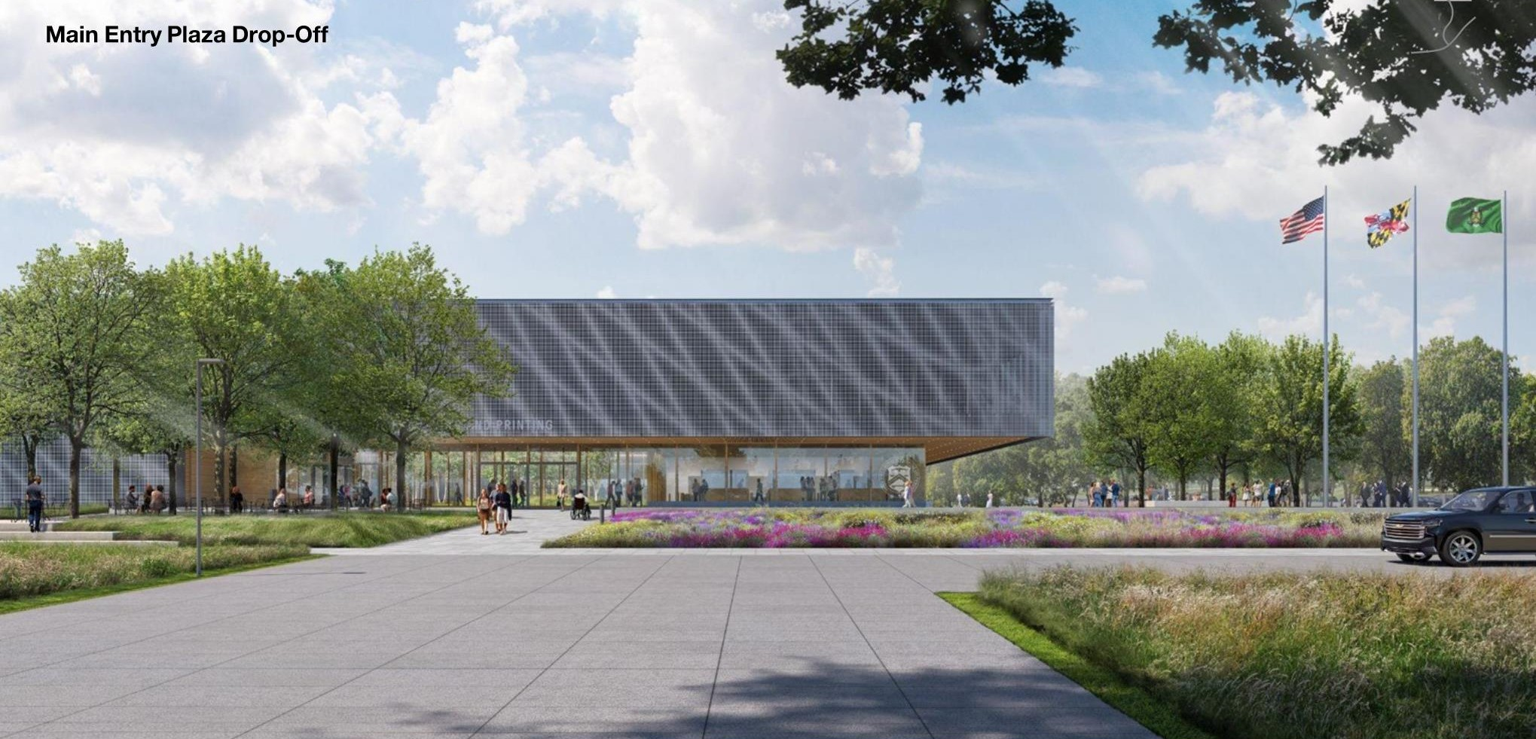
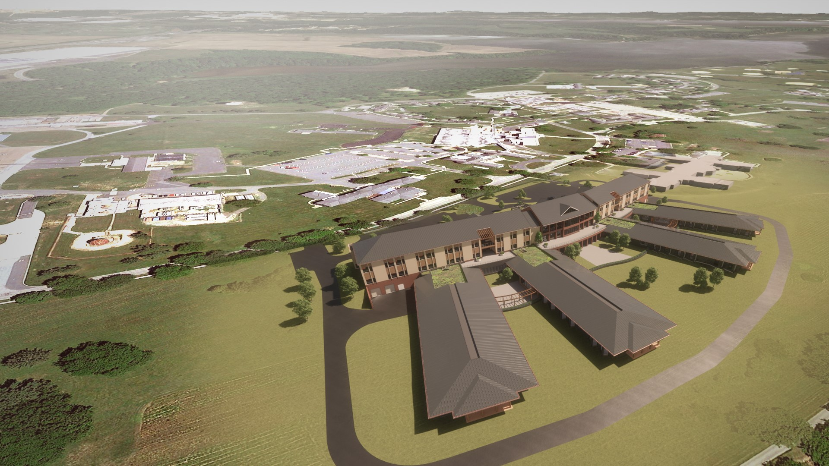
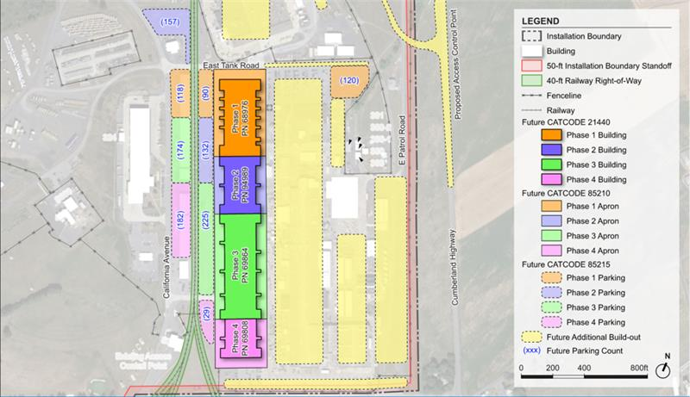
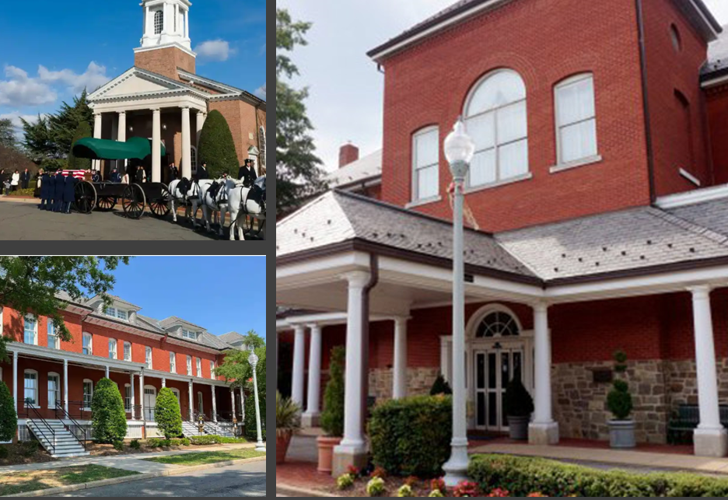
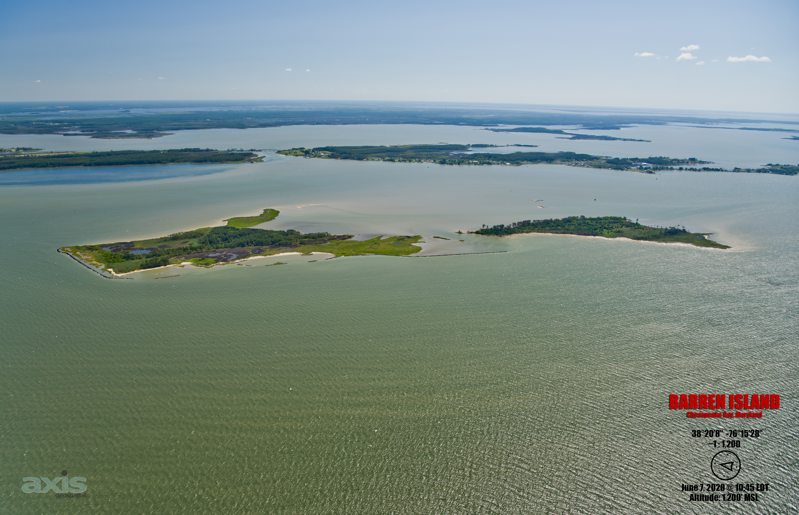
Program Highlights
Bureau of Engraving and Printing
Currency Production Facility
Beltsville, MD
Veteran Affairs
Community Living Center
Perry Point, MD
Multiple Projects
Letterkenny Army Depot
Chambersburg, PA
Multiple Projects
Joint Base Myer - Henderson Hall
Fort Myer, VA
Mid Chesapeake Bay Island
Ecosystem Restoration
Dorchester County, MD
12

Slide 14
Fy25 contracting opportunities
Disclaimers / Notes:
Forecast of Contracting Opportunities (FCO) is required semiannually per Public Law (PL) 100-656 (Business Opportunity Development Reform Act of 1988).
FCO does not show potential 8(a) sole source awards and procurements being issued as delivery / task orders off existing contracts.
FCO is for informational purposes only. The information listed therein is subject to change.
The requirements may or may not be executed and are contingent upon funding, real estate, permits, congressional approvals, and other factors that affect the requirements.
Under ‘Anticipated Solicitation Date’, green, bolded text confirms that the solicitation is / was available on http://www.sam.gov as of the date of this update. Black text represents a projected solicitation date.
Under ‘Anticipated Acquisition Strategy’, green, bolded text confirms that the strategy has been verified via market research. Black text represents a projected acquisition strategy.
Projected strategies are subject to change based on market research and as requirements are further defined. Small business concerns are highly encouraged to respond to Baltimore District's Sources Sought Notices, which is an influential form of market research.
13

Slide 15
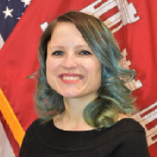
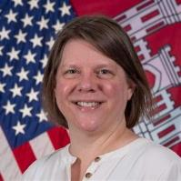
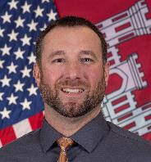
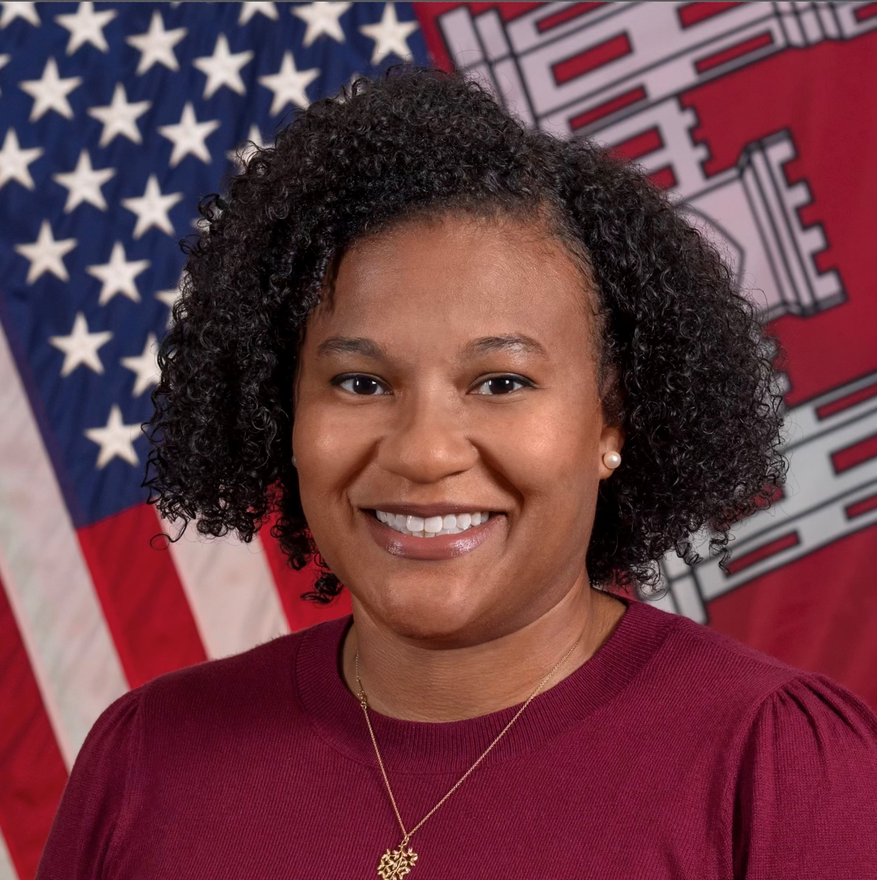
Fy25 contracting opportunities division / program points of contact (1 of 3)
Daria Van Liew, PE
Acting Deputy District Engineer
PPMD
Maria Orosz, PG
Deputy Chief
PPMD
Ian Griffith, PMP
Chief, Military Programs Branch
PPMD
Justin Callahan, PMP
Chief, Civil Project Management
Branch - PPMD
Carrie Ozgar, PE, PMP
BEP Program Manager
PPMD
Jillian Cazalet
North Area Program Manager
PPMD
Dave Robbins
Central Area Program Manager
PPMD
Bernadette Osterhaus
South Area Program Manager
PPMD
14

Slide 16
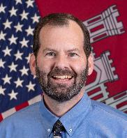
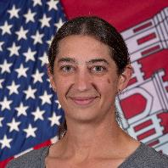
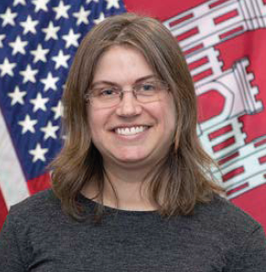
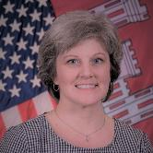

Fy25 contracting opportunities division / program points of contact (2 of 3)
Bill Tully
Capital Area Program Manager
PPMD
Sarah Doerfler
Installation Support Program Manager
PPMD
Paula Beck, CPCM
Chief, Contracting Division
Mary Foutz, PE
Chief, Engineering Division
Emily Schiffmacher, PE, PMP
Chief, EMDC
Amy Guise, PMP
Chief, Planning Division
Stan Graham
Chief, Real Estate Division
Kevin Coleman, PE
Chief, Construction Division
15

Slide 17
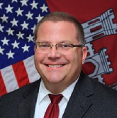
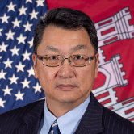
Fy25 contracting opportunities division / program points of contact (3 of 3)
Ray McNeil
Chief, RSFO
Bill Seib
Chief, Operations Division
Rudy Chow, PE
General Manager
Washington Aqueduct
16

Slide 18
Fy25 contracting opportunities architectural-engineering services (1 of 2)
Description | Location | Anticipated Solicitation Date (By Quarter) | Capacity | Anticipated Acquisition Strategy
Value-Engineering Services (MATOC) (Contemplates Award of Three Contracts) | NAD-wide | FY24, Q4 | $9M | Set-Aside SB
Multi-Disciplined Design Services for Military / SRM Programs (MATOC) (Contemplates Targeted Award of 12 Contracts. Includes a Small Business Reserve Targeted Award of Six Contracts) | NAD-wide | FY25, Q1 | $500M | Unrestricted w/SB Reserves
Topographic, Surveying, Mapping, and Geospatial Services (MATOC) (Contemplates Award of Three Contracts) | NAD-wide | FY25, Q1 | $8M | Set-Aside SB
Commissioning Support Services (SATOC) | Fort Meade, MD | FY25, Q2 | TBD | TBD
A-E Services for Civil Works (MATOC) (Contemplates Targeted Award of ????? Contracts) | NAD-wide | FY25, Q3 | $60M | Set-Aside SB
17

Slide 19
Fy25 contracting opportunities architectural-engineering services (2 of 2)
Description | Location | Anticipated Solicitation Date (By Quarter) | Magnitude of Construction | Anticipated Acquisition Strategy
Construction Management Services for BEP Currency Production Facility | Beltsville, MD | FY25, Q1 | $25M to $100M | Set-Aside SB
18

Slide 20
Fy25 contracting opportunities environmental services
Description | Location | Anticipated Solicitation Date (By Quarter) | Magnitude of Construction | Anticipated Acquisition Strategy
No Opportunities to Forecast
19

Slide 21
Fy25 contracting opportunities international and interagency support
Description | Location | Anticipated Solicitation Date (By Quarter) | Magnitude of Construction | Anticipated Acquisition Strategy
C&O Canal Rehabilitation (Phase 2) | Great Falls, MD | FY25, Q3 | $500k to $1M | Set-Aside SB
20

Slide 22
Fy25 contracting opportunities milcon / rsfo (1 of 5)
Description | Location | Anticipated Solicitation Date (By Quarter) | Capacity | Anticipated Acquisition Strategy
Design-Build Construction for NSWC (SATOC) | Indian Head, MD | FY25, Q3 | $20M | Competitive 8(a)
21

Slide 23
Fy25 contracting opportunities milcon / rsfo (2 of 5)
Description | Location | Anticipated Solicitation Date (By Quarter) | Magnitude of Construction | Anticipated Acquisition Strategy
Construct Cyberwarfare Operations Facility | Fort Meade, MD | FY25, Q1 | $100M to $250M | Unrestricted
Construct Child Development Center (CDC) | Fort Meade, MD | FY25, Q1 | $25M to $100M | TBD
Construct Component Rebuild Shop (Phase 1) at Letterkenny Army Depot | Chambersburg, PA | FY25, Q2 | $250M to $500M | Unrestricted
Construct Test Maintenance Fabrication Facility | Aberdeen Proving Ground, MD | FY25, Q2 | $25M to $100M | TBD
Construct Missile / Munitions Distribution Facility at Letterkenny Army Depot | Chambersburg, PA | FY25, Q2 | $25M to $100M | TBD
Repair Exterior of Building 3119 (Maintenance Hanger) | Joint Base Andrews, MD | FY25, Q2 | $5M to $10M | Set-Aside SB
22

Slide 24
Fy25 contracting opportunities milcon / rsfo (3 of 5)
Description | Location | Anticipated Solicitation Date (By Quarter) | Magnitude of Construction | Anticipated Acquisition Strategy
Construct Two Overwatch Guard Facilities for Two ACPs | Fort Belvoir, VA | FY25, Q2 | $1M to $5M | Set-Aside HUBZone
Repair Building 61 / 61A (Roosevelt Hall) at Fort McNair | Washington, D.C. | FY25, Q3 | $25M to $100M | TBD
Repair Taxiway and Ramp for D.C. Air National Guard (ANG) | Joint Base Andrews, MD | FY25, Q3 | $25M to $100M | TBD
Repair Building 350 (Phase 3) at Letterkenny Army Depot | Chambersburg, PA | FY25, Q3 | $10M to $25M | TBD
Repair Building 6330 (Gaffney Fitness Center) | Fort Meade, MD | FY25, Q3 | $10M to $25M | TBD
Repair Building 370 - Task 2 at Letterkenny Army Depot | Chambersburg, PA | FY25, Q3 | $10M to $25M | TBD
23

Slide 25
Fy25 contracting opportunities milcon / rsfo (4 of 5)
Description | Location | Anticipated Solicitation Date (By Quarter) | Magnitude of Construction | Anticipated Acquisition Strategy
Repair Building 1416 | Fort Belvoir, VA | FY25, Q3 | $10M to $25M | Competitive 8(a)
Badge Door Renovation for Room C3E55 for DISA | Fort Meade, MD | FY25, Q3 | $100k to $250k | Set-Aside SB
Repair Building 215 (Office) | Fort Belvoir, VA | FY25, Q3 | $100k to $250k | Set-Aside SB
Construct UEPH at Joint Base Myer - Henderson Hall | Fort Myer, VA | FY25, Q4 | $100M to $250M | Unrestricted
Construct Rocket and Missile Maintenance Facility at Letterkenny Army Depot | Chambersburg, PA | FY25, Q4 | $25M to $100M | Unrestricted
Repair Building 251 (Troop Medical Clinic) at Joint Base Myer - Henderson Hall | Fort Myer, VA | FY25, Q4 | $25M to $100M | TBD
24

Slide 26
Fy25 contracting opportunities milcon / rsfo (5 of 5)
Description | Location | Anticipated Solicitation Date (By Quarter) | Magnitude of Construction | Anticipated Acquisition Strategy
Repair the Interiors of Buildings 213 and 1978 | Fort Belvoir, VA | FY25, Q4 | $10M to $25M | TBD
Construct Apron Expansion at McLaughlin Air National Guard Base | Charleston, WV | FY25, Q4 | $5M to $10M | Set-Aside SB
Construct Mission Support Facility | Fort Carson, CO | FY25 | $5M to $10M | TBD
Construct Extension of Remote Inspection Facility | Fort Belvoir, VA | FY25 | $1M to $5M | Competitive 8(a)
25

Slide 27
Fy25 contracting opportunities civil works (1 of 3)
Description | Location | Anticipated Solicitation Date (By Quarter) | Magnitude of Construction | Anticipated Acquisition Strategy
Shoal Removal at Codorus Creek Flood Risk Management (Levee) | York, PA | FY25, Q1 | $1M to $5M | Set-Aside WOSB
Replace Dam Gate and Hoist at Stillwater Lake | Clifford, PA | FY25, Q1 | $1M to $5M | Unrestricted
Repair Outlet Tunnel, Gate, and Stoplog Guides at Stillwater Lake | Clifford, PA | FY25, Q1 | $500k to $1M | Set-Aside SB
Atlantic Coast of Maryland Beach Renourishment | DE / MD | FY25, Q3 | $10M to $25M | Unrestricted
Rock Wall Stabilization at Alvin Bush Dam | Kettle Creek, PA | FY25, Q3 | $10M to $25M | Unrestricted
Outlet Work Gates | Whitney Point, NY | FY25, Q3 | TBD | TBD
26

Slide 28
Fy25 contracting opportunities civil works (2 of 3)
Description | Location | Anticipated Solicitation Date (By Quarter) | Magnitude of Construction | Anticipated Acquisition Strategy
James Island Ecosystem Restoration (Phase 1) | Dorchester County, MD | FY25, Q4 | $250M to $500M | Unrestricted
Baltimore Harbor and Channels Maintenance Dredging - Cape Henry | Virginia Beach, VA | FY25, Q4 | $10M to $25M | Unrestricted
Upper Wicomico River Maintenance Dredging | Salisbury, MD | FY25, Q4 | $10M to $25M | TBD
North East River Maintenance Dredging | Elkton, MD | FY25, Q4 | $1M to $5M | Set-Aside SB
Rock Hall Harbor Maintenance Dredging | Rock Hall, MD | FY25, Q4 | $1M to $5M | Set-Aside SB
St. Patricks Creek Maintenance Dredging | St. Mary’s County, MD | FY25, Q4 | $1M to $5M | Set-Aside SB
27

Slide 29
Fy25 contracting opportunities civil works (3 of 3)
Description | Location | Anticipated Solicitation Date (By Quarter) | Magnitude of Construction | Anticipated Acquisition Strategy
Bank Armoring of Low Level Outlet Channel and Deposition Removal at Raystown Lake | Hesston, PA | FY25, Q4 | $1M to $5M | Set-Aside SB
28

Slide 30
Fy25 contracting opportunities
Washington aqueduct (1 of 2)
Description | Location | Anticipated Solicitation Date (By Quarter) | Capacity | Anticipated Acquisition Strategy
Mechanical Services (SATOC) | Washington, D.C. | FY25, Q1 | $20M | Set-Aside SB
Electrical Services (SATOC) | Washington, D.C. | FY25, Q1 | $8M | Competitive 8(a)
Water Mains and Valves Emergency Repair Services (SATOC) | Washington, D.C. | FY25 | $8M | Competitive 8(a)
29

Slide 31
Fy25 contracting opportunities
Washington aqueduct (2 of 2)
Description | Location | Anticipated Solicitation Date (By Quarter) | Magnitude of Construction | Anticipated Acquisition Strategy
Grounds Maintenance | Washington, D.C. | FY25, Q1 | $1M to $5M | Set-Aside SB
Cable Inspection and Lubrication | Washington, D.C. | FY25, Q1 | $500k to $1M | Set-Aside SB
Clean, Inspect, Repair, and Reline Sodium Hypochlorite Tanks | Washington, D.C. | FY25, Q1 | $500k to $1M | Set-Aside SB
30

Slide 32
Fy25 contracting opportunities services
Description | Location | Anticipated Solicitation Date (By Quarter) | Magnitude of Construction | Anticipated Acquisition Strategy
Forest Herbicide Application Services for Raystown Lake | Hesston, PA | FY25, Q1 | $100k to $250k | SB Set-Aside
Refuse Collection Services for Tioga-Hammond and Cowanesque Lakes | Tioga, PA | FY25, Q1 | $100k to $250k | SB Set-Aside
Water Testing Services at Tioga-Hammond and Cowanesque Lakes | Tioga, PA | FY25, Q1 | $25k to $100k | SB Set-Aside

Slide 33
Fy25 contracting opportunities supplies
Description | Location | Anticipated Solicitation Date (By Quarter) | Magnitude of Construction | Anticipated Acquisition Strategy
No Opportunities to Forecast
31

Slide 34
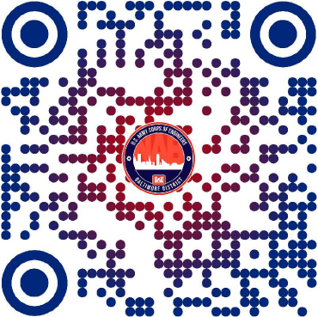
Doing business with us qr code to Baltimore district webpage
USACE - Baltimore District → Business With Us
32

Slide 35
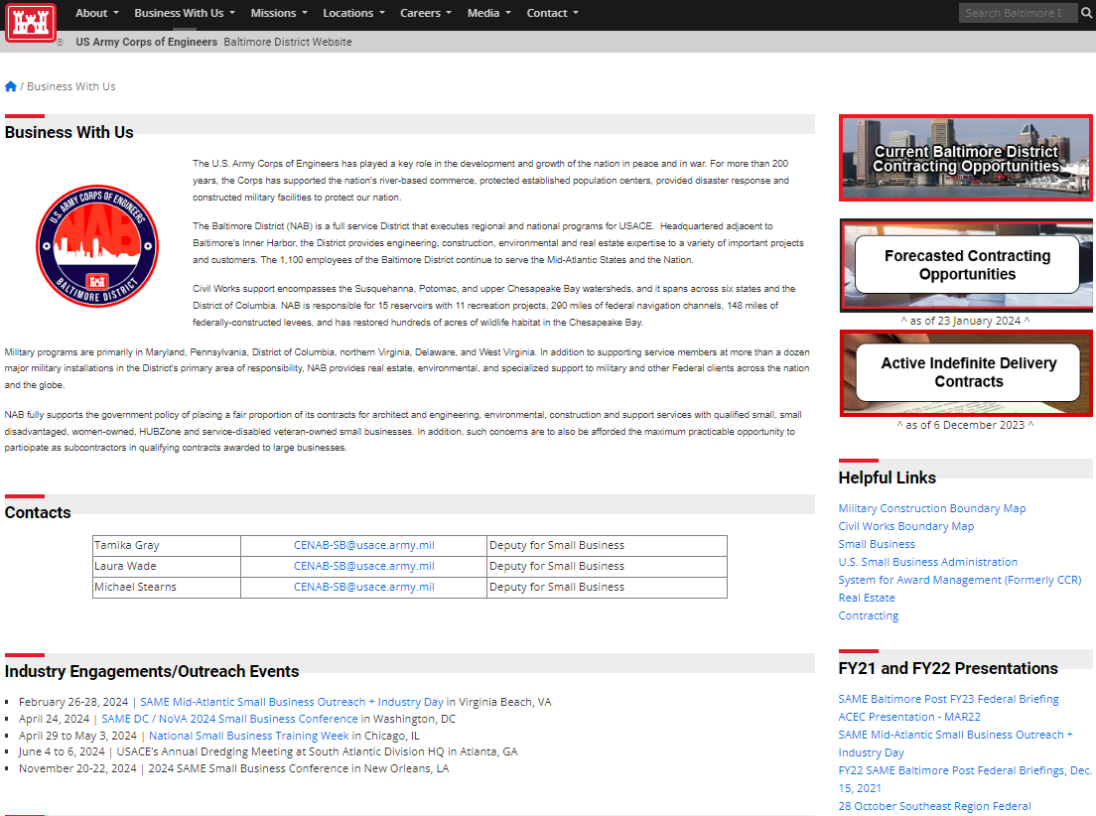
Doing business with us
Baltimore district webpage
Active Opportunities
on SAM
More Information on
Small Business
Forecasts /
Active IDCs
Small Business Points of Contact
District Boundary
Maps
Engagements / Outreach Events
33

Slide 36
Doing business with us
Future industry engagements
Dates​ | Engagement Title​ | Location​
11/13/2024 | SAME Philadelphia Post Resilience and Small Business Symposium | Philadelphia, PA
11/20/2024 | Industry Day - Veteran Affairs Community Living Center | Perry Point, MD
11/20/2024 to 11/22/2024 | 2024 SAME Small Business Conference | New Orleans, LA
11/2024 or 12/2024 | USACE Baltimore District 2nd Industry Day | Baltimore, MD
12/18/2024 | FY25 Federal Briefings, Scholarship Award Recognition, and Holiday Celebration | Baltimore, MD
02/24/2025 to 02/26/2025 | SAME Mid-Atlantic Small Business Outreach + Industry Day | Virginia Beach, VA
34

Slide 37




Doing business with us
Follow us on social media
@USACEBaltimore
35

Slide 38
BUILDING STRONG.
36

Slide 39
Backup slides

Slide 40
Acronyms and expansions

Slide 41
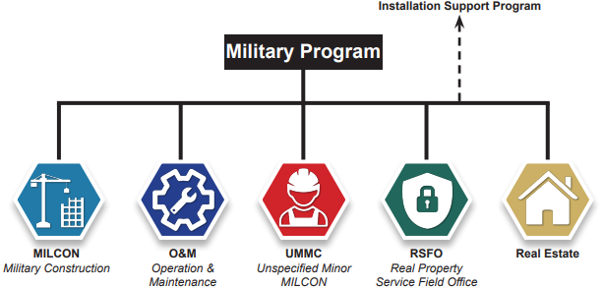
USACE - Baltimore district
military programs

Slide 42
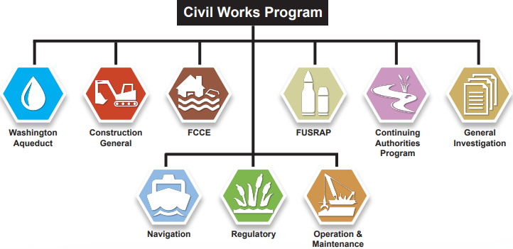
USACE - Baltimore district
civil works program

Slide 43
USACE - Baltimore district
interagency and international support
Provides technical assistance to non-DoD federal agencies, state and local governments, tribal nations, private U.S. firms, international organizations, and foreign governments.
Most work is funded on a reimbursable basis.
Projects are managed under the governance structure that most closely matches to scope of the project.

Slide 44
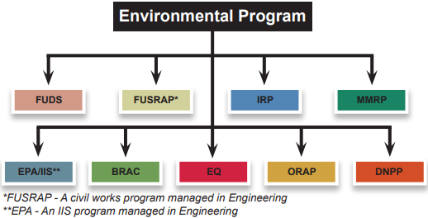
USACE - Baltimore district
environmental program

Slide 45
Small Business Office
Small business professional authorities
Title 15, United States Code § 644 (Awards or Contracts)
DoD Instruction 4205.01, DoD Small Business Program (SBP), 31 August 2018
Federal Acquisition Regulation (FAR) - Part 19, Small Business Programs, Current Edition
Defense Federal Acquisition Regulation Supplement (DFARS) - Part 19, Small Business Programs, Current Edition
Army Federal Acquisition Regulation Supplement (AFARS) - Part 19, Small Business Programs, Current Edition

Slide 46
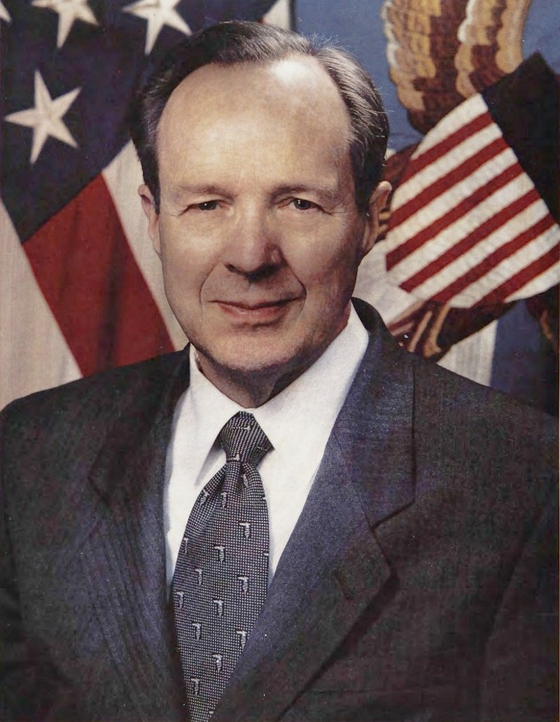
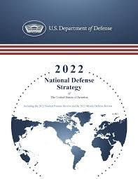
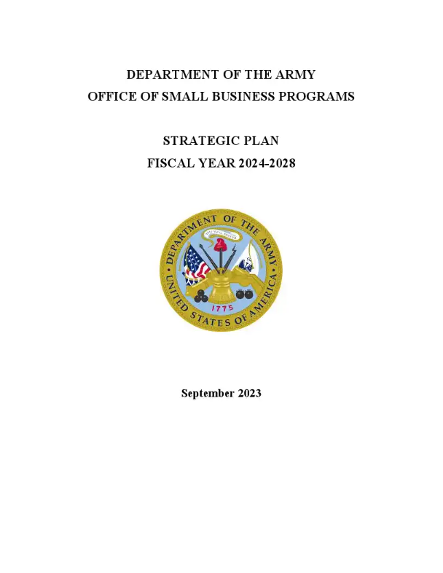
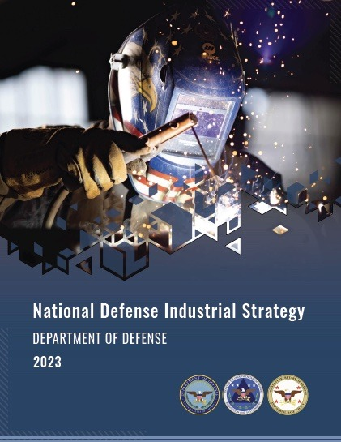


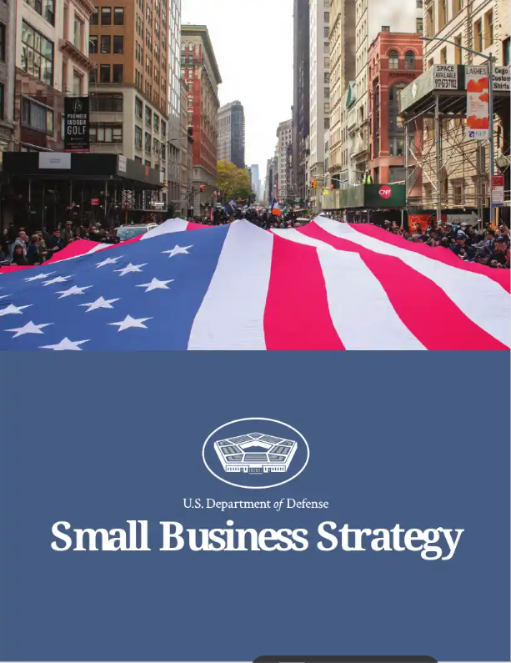
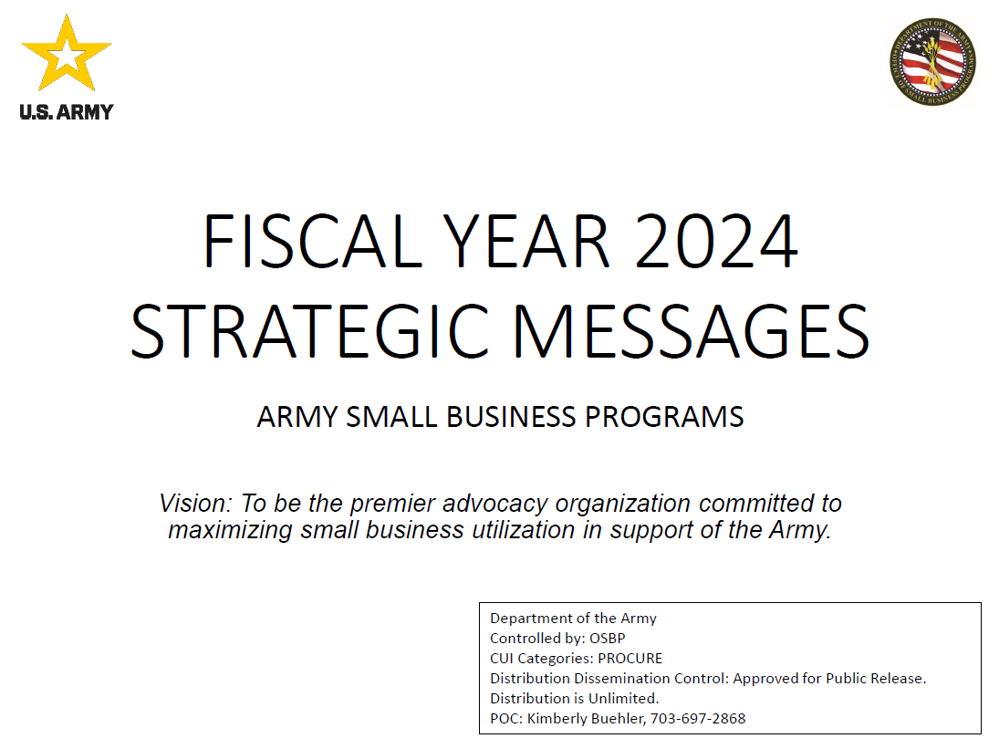
Defense industrial base (dib)
1993
The Last Supper
10/2022
NSS
08/2024
USACE Baltimore District
10/2022
DoD NDS
01/2023
DoD Small Business Strategy
09/2023
DA, OSBP Strategic Plan (FY24 to FY28)
10/2023
DA, OSBP FY24 Strategic Messages
11/2023
DoD NDIS
Notes:
NOTES:
1993 (Fall) The Last Supper - Dinner at The Pentagon, hosted by Secretary of Defense (SECDEF) Les Aspin and Deputy Secretary of Defense (Deputy SECDEF) William Perry. Deputy SECDEF Perry announced a shift in DoD policy to encourage consolidation amongst defense contractors. This was due to post-Cold War peace dividend and the need to survive upcoming budget cuts. Dinner was attended by two-dozen industry defense leaders. The number of prime defense contractors in the United States would ultimately decline from 51 to five (e.g., Lockheed Martin, Raytheon Technologies Corporation, General Dynamics Corporation, The Boeing Company, and Northrop Grumman Corporation).
2022-10 National Security Strategy (NSS) - Issued by the Biden-Harris Administration. Highlights the war in Ukraine and criticality to possess a vibrant DIB for the United States and its allies and partners.
2022-10 DoD National Defense Strategy (NDS) - Issued by SECDEF Lloyd Austin III. Requires the DoD to adapt and fortify their defense ecosystem. Strengthening the DIB is one means.
2023-01 DoD Small Business Strategy - Issued by SECDEF Lloyd Austin III. Cites that small businesses account for over 93% of all employer firms and over 44% of our Nation’s economic activity. Despite this, DoD has yet to utilize the full potential of small businesses. In fact, participation of small businesses in the DIB has declined 40% over the past decade. Strategy promotes a strong, dynamic, and robust small business industrial base via reducing barriers to entry, increasing small business set asides, and leveraging small business programs.
2023-09 DA, Office of Small Business Programs (OSBP) - Strategic Plan for Fiscal Year 2024-2028 - Reemphasizes NSS, NDS, and DoD Small Business Strategy.
2023-10 DA, Office of Small Business Programs (OSBP) - Fiscal Year 2024 Strategic Messages - Issued by Director for the Army Office of Small Business Programs, Ms. Kimberly Buehler. Three mission areas:
Mission Area 1 - Advise the Secretary of the Army and the Army leadership on small business-related matters.
Mission Area 2 - Maximize opportunities for innovative initiatives that contribute to expanding the small business industrial base.
Mission Area 3 - Leverage Small Businesses to ensure expansion and/or sustainment of the industrial base and provide opportunities to obtain innovative technologies, supplies, and services for our soldiers.
2023-11 DoD National Defense Industrial Strategy (NDIS) - Issued by Deputy SECDEF Kathleen Hicks. Reiterates NDS. Prioritizes fortification of the DIB in order to maintain a robust, resilient, and dynamic defense industrial ecosystem. This is key to integrated deterrence and building enduring military advantages.
2024-08 USACE - Baltimore District - In FY24, we have confirmed six new small business entrants to the Government and 12 new small business entrants to USACE.

Slide 47
obligations
Top 10 naics codes - sb (Fy23 to fy24)
Information is from SAM → Data Bank → Standard Reports → Total Actions by NAICS
Click Below for Detailed Information on Top NAICS Obligations for Small Business and Socioeconomic Categories
Total
SB
SDB
SDVOSB
WOSB
HUBZone

Slide 48
obligations
Top 10 naics codes - SDB (Fy23 to fy24)
Information is from SAM → Data Bank → Standard Reports → Total Actions by NAICS
Click Below for Detailed Information on Top NAICS Obligations for Small Business and Socioeconomic Categories
Total
SB
SDB
SDVOSB
WOSB
HUBZone

Slide 49
obligations
Top 10 naics codes - SDVOSB (Fy23 to fy24)
Information is from SAM → Data Bank → Standard Reports → Total Actions by NAICS
Click Below for Detailed Information on Top NAICS Obligations for Small Business and Socioeconomic Categories
Total
SB
SDB
SDVOSB
WOSB
HUBZone

Slide 50
obligations
Top 10 naics codes - WOSB (Fy23 to fy24)
Information is from SAM → Data Bank → Standard Reports → Total Actions by NAICS
Click Below for Detailed Information on Top NAICS Obligations for Small Business and Socioeconomic Categories
Total
SB
SDB
SDVOSB
WOSB
HUBZone

Slide 51
obligations
Top 10 naics codes - HUBZONE (Fy23 to fy24)
Information is from SAM → Data Bank → Standard Reports → Total Actions by NAICS
Click Below for Detailed Information on Top NAICS Obligations for Small Business and Socioeconomic Categories
Total
SB
SDB
SDVOSB
WOSB
HUBZone

Slide 52
obligations
Sb concern spending (FY13 to FY24)
Information is from SAM → Data Bank → Standard Reports → Small Business Achievements, Excluding Deobligations
Click Below for Detailed Historical Information on Small Business and Socioeconomic Spending and Goals
Total
SB
SDB
SDVOSB
WOSB
HUBZone

Slide 53
Small business accomplishments goal achievements (fy20 to fy23)
 | Goals (Actual) met or exceeded Goals (Army) and Goals (NAB).
 | Goals (Actual) met or exceeded Goals (Army) or Goals (NAB) but not both.
 | Goals (Actual) did not meet Goals (Army) and Goals (NAB).
Notes:
ACRONYMS:
DoD Department of Defense
FY Fiscal Year
HUBZone Historically Underutilized Business Zone
NAB Baltimore District
SB Small Business
SDB Small Disadvantaged Business
SDVOSB Service-disabled Veteran-owned Small Business
WOSB Women-owned Small Business

Slide 54
Small business accomplishments
Sb Concerns spending / goals (Fy13 to FY24)
Information is from SAM → Data Bank → Standard Reports → Small Business
Achievements, Excluding Deobligations
Click Below for Detailed Historical Information on Small Business and Socioeconomic Spending and Goals
Total
SB
SDB
SDVOSB
WOSB
HUBZone

Slide 55
Small business accomplishments
SDB Concern spending / goals (Fy13 to FY24)
Information is from SAM → Data Bank → Standard Reports → Small Business
Achievements, Excluding Deobligations
Click Below for Detailed Historical Information on Small Business and Socioeconomic Spending and Goals
Total
SB
SDB
SDVOSB
WOSB
HUBZone

Slide 56
Small business accomplishments
SDVOSB Concern spending / goals (Fy13 to FY24)
Information is from SAM → Data Bank → Standard Reports → Small Business
Achievements, Excluding Deobligations
Click Below for Detailed Historical Information on Small Business and Socioeconomic Spending and Goals
Total
SB
SDB
SDVOSB
WOSB
HUBZone

Slide 57
Small business accomplishments
WOSB Concern spending / goals (Fy13 to FY24)
Information is from SAM → Data Bank → Standard Reports → Small Business
Achievements, Excluding Deobligations
Click Below for Detailed Historical Information on Small Business and Socioeconomic Spending and Goals
Total
SB
SDB
SDVOSB
WOSB
HUBZone

Slide 58
Small business accomplishments
HUBZone Concern spending / goals (Fy13 to FY24)
Information is from SAM → Data Bank → Standard Reports → Small Business
Achievements, Excluding Deobligations
Click Below for Detailed Historical Information on Small Business and Socioeconomic Spending and Goals
Total
SB
SDB
SDVOSB
WOSB
HUBZone

