Slide 1
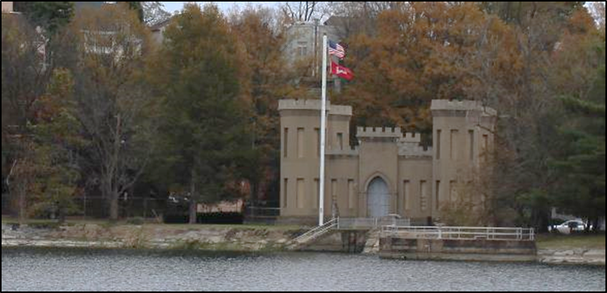

DOING BUSINESS WITH BALTIMORE DISTRICT
American Council of Engineering Companies (ACEC)/Metropolitan Washington (MW)
Federal Government Luncheon
FY2022 Overview Briefing
30 March 2022

Slide 2
AGENDA
District Overview
Contract Opportunities
  Future IDIQs
  Military Program: Various Installations
  Other Construction Opportunities
  Environmental Opportunities
  Civil Works/Infrastructure Investment & Jobs Act 2022 (IIJA)
Current Trends
Doing Business With Us

Slide 3
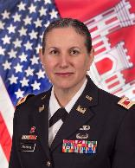

An overview: Baltimore District
Overview
A full service district serving 6 states and the District of Columbia in the mid-Atlantic and National Capital regions
Provides primary support to 14 military installations
Manages water resources in the Susquehanna and Potomac watersheds and upper Chesapeake Bay
Provides all drinking water to our Nation’s capital
Executes regional and national programs for USACE
The Numbers
1,100 civilian employees
$1.7B expenditures per year
290 miles of federal channels
16 reservoir projects
11 recreational projects
15 million+ visitor hours per year
600 acres of oyster habitat restored
$16B in flood damages prevented to date
Col. Estee Pinchasin, commander
Support to our Military
Support to the Public
District Capabilities
Engineering, Design, and Construction
Environmental Services
Dredging Federal Channels
Dam/Levee Operations & Maintenance
Disaster Response & Recovery
Real Estate Services
Value Engineering
Hurricane Modeling
Military Munitions Response
Radiological Center of Expertise

Slide 4
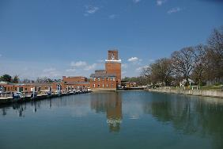
Future idiq contract opportunities
Architect/Engineer Task Order Contracts
$200M Environmental AE MATOC > NAD-Wide > 3QFY22 > SB and UNR/Quals Based
Construction Task Order Contracts (Includes DB & DBB)
$499M Construction MATOC > NAB-Wide > 3QFY22 > UNR/SB Reserve
$49M Intelligence Community SATOC/Bethesda > 3QFY22 > UNR
$100M WHS/Raven Rock Mountain Complex Construction SATOC > 3QFY22 > UNR
Washington Aqueduct Opportunity
$35M A/E IDIQ > 3QFY22[SF330 due: 11APR22]

Slide 5
FUTURE CONSTRUCTION CONTRACT opportunities
Military Program
Fort Belvoir, VA
  $25M-$50M Veterinary Clinic > 4QFY22 > DB
Fort Detrick, MD
  $25M-$50M Repair USAMRIID Laboratory (Effluent Decontamination System) Building 8100 > 2QFY23 > DB
  $25M-$50M Incinerator Facility > FY23 > DB
Ft. Meade
  $10M-$25M BLDG 2234 (DPW/INSCOM) > 3QFY22/23 > DB
  $5M-$10M Former Asymmetrical Warfare Group Facility (2270) > 3QFY22 > DB
East Campus – Ft. Meade
  $500-$1B East Campus Building #5 (ECB5) > 2QFY23 > ECI/UNR

Slide 6
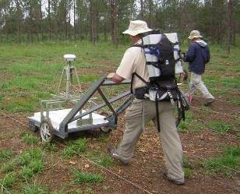
FUTURE CONTRACT opportunities
Other Construction Contracting Opportunities
USDA-BARC – Modernization of Research Facilities, Beltsville
  $25-$100M Building 308 > 3QFY22 > DB
  $25-$100M Building 005 > 3QFY22 > DB
$100M-$500M Veteran’s Affairs Community Living Center(Perry Point, MD) > FY22/23 > TBD
Environmental Services Contracting Opportunities
$240M Multiple Award Environmental Services (MAES) Task Order Contract > 1QFY23 > UNR/SB Reserve MATOC
$100M Army National Guard PFAS RI/FS SATOC (Nationwide) > 3QFY22 > UNR

Slide 7
RECENT & FUTURE CONSTRUCTION CONTRACTS
Civil Works Program – Infrastructure Investment & Jobs Act 2022 (IIJA)
>$1M
  Campground/Water Sewage Treatment Repairs, Cowanesque Lake, PA > 3QFY22 > TBD
  Recreation Site Repairs, Raystown Lake, PA > 3QFY22 > TBD
  Engineering & Design for Maintenance Dredging, Slaughter, MD > 1QFY23 > TBD
  $1M > Wastewater Treatment Plant Upgrades, Tioga-Hammond, PA > 3QFY22 > TBD
  Engineering & Design of Tidal Inlet Flood Gates, Washington, DC > 4QFY22 > TBD
$1M-$5M
  Maintenance Dredging, Herring Bay & Rockhold Creek, MD > 1QFY23 > TBD
  Maintenance Dredging, Northeast River, MD > 1QFY23 > TBD
  Sediment & Debris Removal/Repairs/Rehabilitation, York Indian Rock Dam, PA > 4QFY22 > TBD

Slide 8
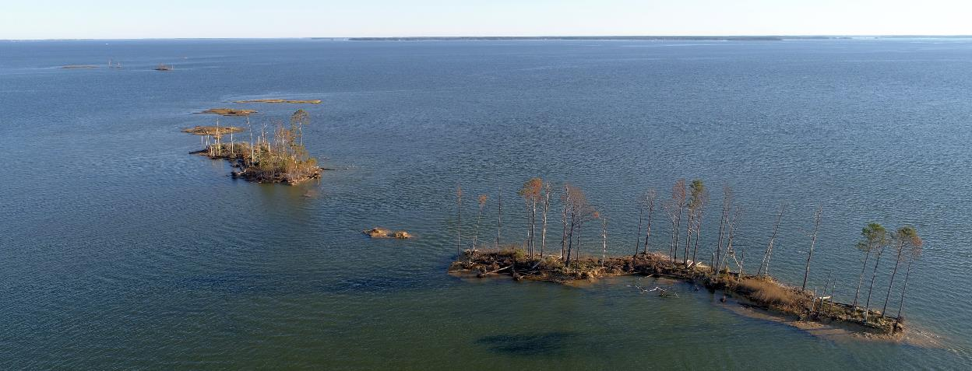
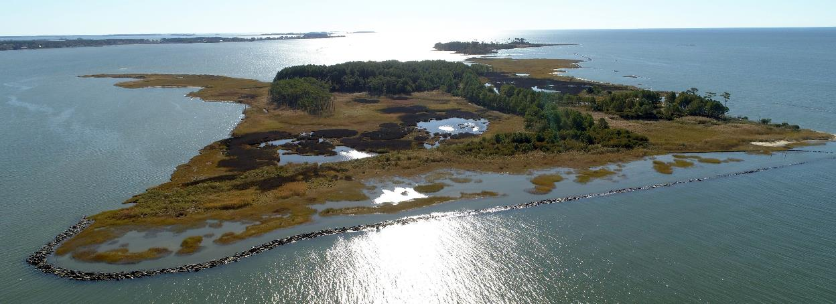
RECENT & FUTURE CONSTRUCTION CONTRACTS
Civil Works Program – IIJA Continued
>$5M
  $5M-$10M > National Mall Levee Raising, Washington, DC > 4QFY23 > TBD
  $25M-$40M > Barren Island Breakwater & Sill Construction (Mid-Bay), Dorchester County, MD > 4QFY22 > IFB
Civil Works Program
$1M-$5M > 8,300 LF Sanitary Sewer Extension, Moscow Burrough, PA > 2QFY23 > TBD
$5-$10M > 150KCY Maintenance Dredging, Wicomico River, Wicomico County, MD > 3QFY22 > SB
$10M-$15M > 7 Miles of Stream Restoration, NW/NE Branches, Anacostia River, Prince Georges County, MD > 1QFY23 > TBD
$10M-$25M > 2.2MCY Maintenance Dredging, Baltimore Harbor & MD Approach, MD > 4QFY22 > UNR

Slide 9
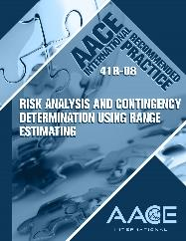
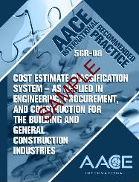
Current TRENDS
Design Management Support
Design Construction Agent (DCA) Cost Assessments: FY22 & beyond
ASCEi RP56R-08 Cost Estimate Classification System; ENG FORM 6196 FEB 2021
Cost / Schedule Risk Analyses (CSRAs): FY23 & beyond
ASCEi RP41R-08 Risk Analysis and Contingency Determination Using Range Estimating
J&A Requirement for Brand name or equal/BOD: Effective May 31, 2019
Update to DFARS 211.104 and DFARS 211.170

Slide 10
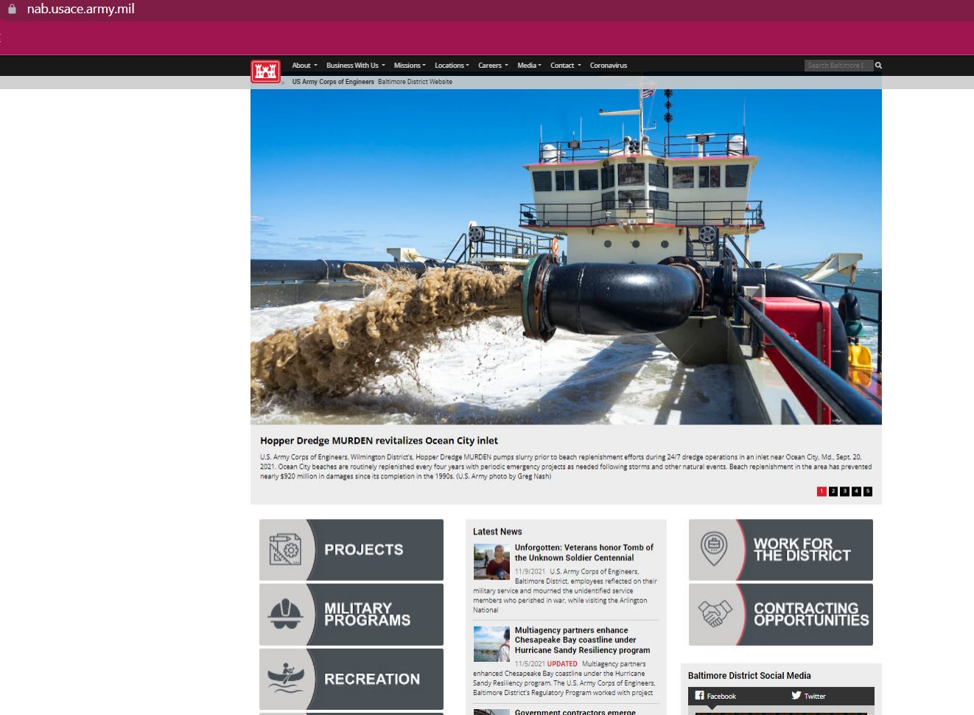
Doing business with us
http://www.nab.usace.army.mil/

Slide 11

FY21 Small business Accomplishments
Category | Dollars | Actual % / Statutory Goals/ NAB FY21 SB Goals
Small Business | $194,263,758 | 17.43% / 23% / 22.3%
Small Disadvantaged | $120,450,610 | 10.81% / 5% /4.07%
Women-Owned | $27,168,623 | 2.44% / 5% / 4.07%
Service-Disabled Veteran-Owned | $12,224,169 | 1.10% / 3% / .90%
HUBZone | $40,700,332 | 3.65% / 3% / 3%
Total Dollars Obligated (to include SB awards): $1,124,055,293
Green - Met both the statutory and USACE NAB SB goal
Amber - Met the statutory goal, but didn’t meet the USACE NAB SB goal
Red - Didn’t meet the statutory or USACE NAB SB goal

Slide 12



Baltimore district contacts
COL Estee Pinchasin, District Commander, 410-962-4545 Estee.S.Pinchasin@usace.army.mil
David Morrow, Deputy District Engineer (PPMD), 410-962-7960, David.Morrow@usace.army.mil
Paula Beck, Contracting Division, 410-962-0874, Paula.M.Beck@usace.army.mil
Justin Callahan, Civil Works Programs, 410-962-6693,Justin.Callahan@usace.army.mil
Hanif Drzal, Washington Aqueduct, 202-587-9366, Hanif.K.Drzal@usace.army.mil
Shelley Spayde, Military Programs, 410-962-6785, Shelley.A.Spayde@usace.army.mil
Ray McNeil, RSFO/Intelligence Community, 410-854-0702, Raymond.J.McNeil@usace.army.mil
Michael Rogers, Environmental Programs, 410-962-2207, Michael.J.Rogers@usace.army.mil
Mary Foutz, Chief, Engineering Division, 410-962-4660, Mary.P.Foutz@usace.army.mil
Tamika Gray, Small Business, 410-962-2587, Tamika.Gray@usace.army.mil
Today’s presentation is available for download at:
http://www.nab.usace.army.mil/BusinessWithUs.aspx
Stay engaged
with us online!
www.nab.usace.army.mil
@USACEBaltimore
https://www.facebook.com/USACEBaltimore/

Slide 13


