Slide 1
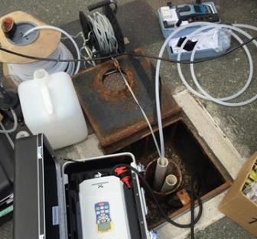
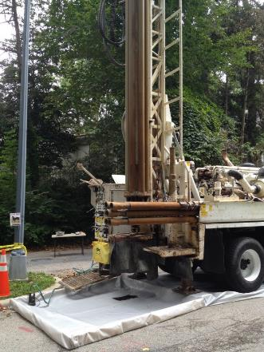
Spring Valley Formerly UsED defense site
“The USACE Mission in Spring Valley is to identify, investigate and remove or remediate threats to human health, safety or to the environment resulting from past Department of Defense activities in the area.”
Groundwater
Proposed Plan
Community Meeting
13 August 2024

Slide 2
Agenda
  Welcome and Introductions
  CERCLA Process
  Spring Valley FUDS Background
  2016 Groundwater Remedial Investigation Report
  2023 Groundwater Remedial Investigation Addendum
  Groundwater Proposed Plan
  Next Steps
  Ways to Comment
  Questions

Slide 3
Introductions
  Project Team:
  United States Army Corps of Engineers (USACE) Baltimore District
  U.S. Environmental Protection Agency, Region III
  D.C. Department of Energy and Environment
  USACE Contractor, AECOM
  Why are we here?
  Present the Proposed Plan for Spring Valley FUDS Groundwater
  Receive public input on the preferred approach

Slide 4
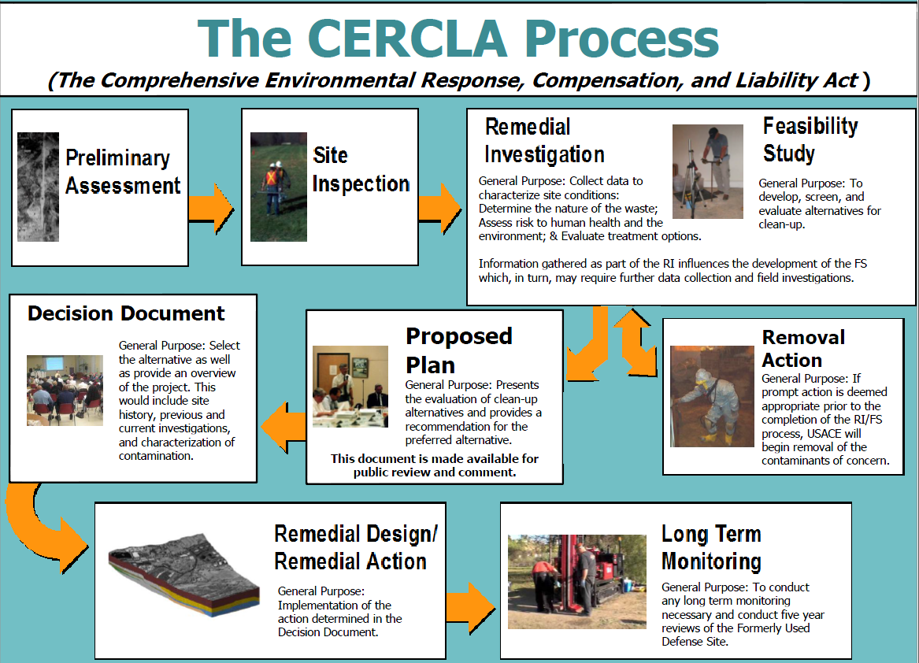
August 2024

Slide 5
Spring Valley FUDS BACKGROUND
  During WWI, the American University Experiment Station (AUES) was established by the U.S. Government (1917-1920) for research and testing of chemical agents, equipment, and munitions
  Since 1993, USACE has conducted numerous investigations and removals in the area used by AUES during WWI, including:
    Arsenic soil investigation and removals
    Munition investigations and removals resulted in recovery of over 1100 munitions items (MEC and MD), 85 known or suspected chemical
    Glenbrook road soil removal to bedrock
    Soil and debris removal at Public Safety Building
    Groundwater investigations

Slide 6
gRoundwater REMEDIAL INVESTIGATION (RI)
  Groundwater Remedial Investigation initiated in 2004
  Groundwater RI Main Objectives:
  Determine groundwater and surface water occurrence, flow, and chemistry
  Determine if AUES activities impacted local groundwater quality
  Determine nature and extent of any detected contamination
  Assessment of potential human health risks posed by chemicals detected in groundwater and surface water

Slide 7
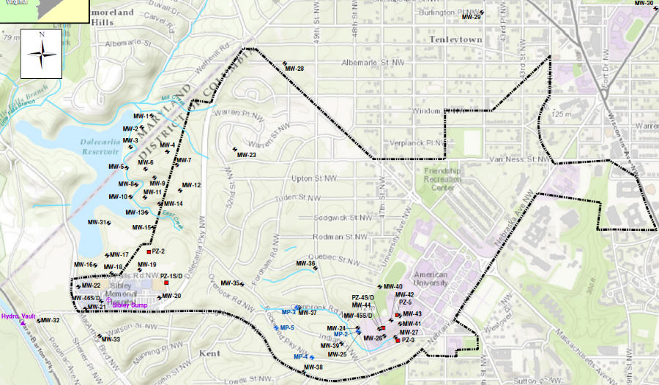
groundwater REMEDIAL INVESTIGATION
GROUNDWATER AND SURFACE WATER MONITORING NETWORK
56 monitoring wells installed and sampled
27 surface water locations sampled
Sampling conducted from 2005 through 2021

Slide 8
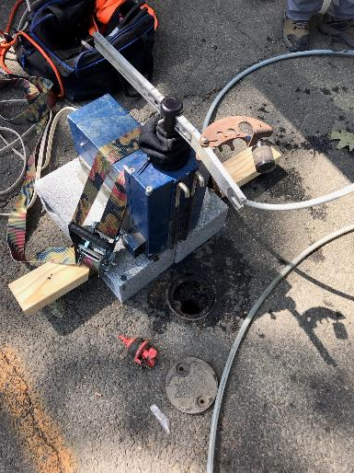
gRoundwater RI
  Groundwater Chemistry
  Over 250 different chemicals were analyzed from the groundwater and surface water samples to determine potential impacts from AUES activities.
  Maximum detected chemical concentrations were compared to regulatory drinking water standards and screening criteria to determine Chemicals of Potential Concern (COPCs)
  COPCs were then evaluated in the Human Health Risk Assessment
Groundwater Sampling Well

Slide 9
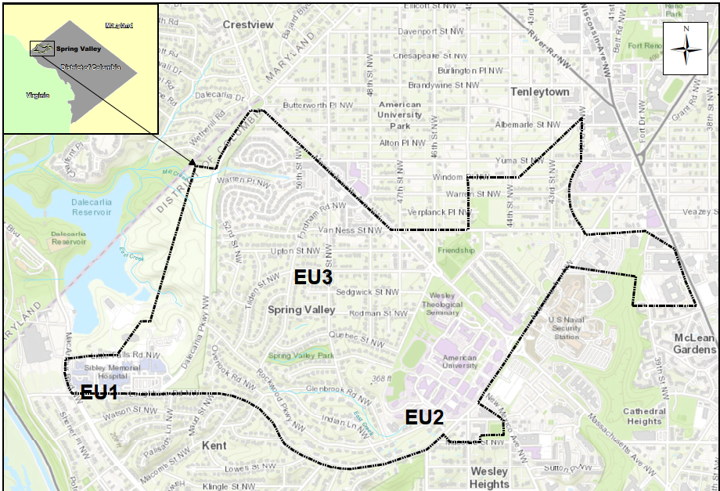
2016 RISK ASSESSMENT
Groundwater was divided into three Exposure Units (EUs) 1, 2, and 3
EU1 = Sibley Hospital
EU2 = American University
EU3 = FUDS Boundary
excluding EU1 and EU2

Slide 10
HUMAN HEALTH RISK ASSESSMENT
Human health risk assessment (HHRA) is an estimate of the potential for health impact.
HHRAs are based on:
  Conservative assumptions concerning how individuals may be exposed to contaminated media (e.g., groundwater) and for how long.
  Published toxicity data for the chemicals to which exposure is assumed.
Receptors considered: Adult Resident, Child Resident, AU Student, Site Workers
Current and potential Future exposure scenarios considered
  Current - evaluated pathways for watering lawns
  Future – evaluated using groundwater for drinking water

Slide 11
2016 REMEDIAL INVESTIGATION CONCLUSIONS
The 2016 RI determined no unacceptable risk for both current and future exposure scenarios for groundwater at EU1 and EU3.
    NO ACTION is required at EU1 and EU3
The RI determined no unacceptable risk for the current exposure scenario (watering lawns) at EU2.
At EU2, arsenic and perchlorate posed unacceptable risk if groundwater was used as a drinking water source (Pre-2016 groundwater data).

Slide 12
Exposure Unit 2
Areas encompassing the
EU2 Monitoring Wells
MP = Multiport well
MW = Monitoring well
PZ = Piezometer

Slide 13


Remedial Investigation (RI) Addendum
13
Based on results of 2016 RI Report, a Feasibility Study considered different alternatives to address the unacceptable risk identified at EU2, assuming the groundwater is used for drinking water.
2018 Draft Proposed Plan - USACE Baltimore District, DOEE and USEPA disagreed upon proposed final remedy at EU2
Dispute Resolution - Conduct further groundwater sampling at EU2. Three groundwater sampling events were completed in 2019, 2020, and 2021 to evaluate changes in perchlorate and arsenic concentrations in EU2.
The 2023 RI Addendum summarizes the results of the 2019 – 2021 groundwater sampling and updates the risk assessment

Slide 14
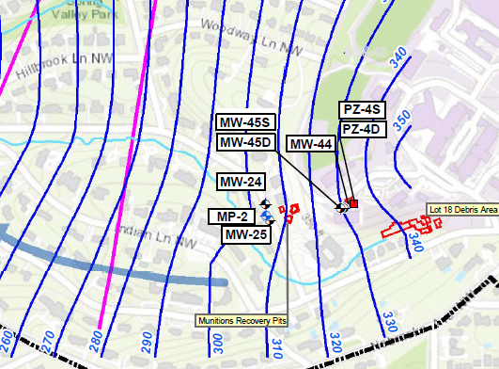
Remedial Investigation (RI) Addendum
14
Arsenic and Perchlorate at EU2
2019 to 2020 groundwater concentrations for arsenic are below the federal maximum contaminant level (MCL) of 10 μg/L
2019 to 2021 groundwater concentrations for perchlorate range from 2 µg/L to 32.5 µg/L with some concentrations (MW-44 and PZ-4D) still above drinking water health advisory of 15 µg/L
Groundwater trend analyses for arsenic and perchlorate were updated; EU2 wells show either no trend or downward concentration trends

Slide 15
Remedial Investigation (RI) Addendum
15
2023 Human Health Risk Assessment Conclusions
SUMMARY OF CANCER RISK - Probability of an individual developing cancer over a lifetime of exposure
  No unacceptable cancer risk for Current and Future Land Use
SUMMARY OF NON-CANCER HAZARD INDEX (HI) - Sum of chemical non-cancer hazard estimates for all exposure pathways evaluated for each receptor
  No unacceptable non-cancer risk for Current Land Use
  For Future Land Use, if groundwater is used as a drinking water source, HI threshold of 1 is slightly exceeded due to the presence of perchlorate, cobalt, and manganese.

Slide 16
2023 Addendum to the Groundwater RI
2023 Human Health Risk Assessment Conclusions:
Lines of Evidence Review for Perchlorate, Cobalt, Manganese
Perchlorate was eliminated as a chemical of concern based on the following:
  Detections of perchlorate above the drinking water health advisory level are now limited to one location, indicating that a plume does not exist.
  Trend analysis indicates that perchlorate concentrations are decreasing
  Potential soil source materials near Kreeger Hall have been removed
  The HQ for perchlorate was 1.4, only slightly above the HI threshold of 1
Manganese and cobalt were eliminated as chemicals of concern because the Partners agreed that these compounds are pervasive at low levels in the environment, and there is no evidence of a site-related release.

Slide 17
SVFUDS GROUNDWATER PROPOSED PLAN
17
USACE proposes that NO ACTION is required for the Groundwater at Spring Valley FUDS
The 2023 RI Addendum identified no actionable risk from exposure to groundwater at Spring Valley FUDS for both current and potential future exposure scenarios

Slide 18
SPRING VALLEY FUDS GROUNDWATER
18
Next Steps…
Public Comment Period ends on September 20, 2024
USACE will consider any public comments received on the preferred remedy, and provide a formal response to comments in a Responsiveness Summary that will go in the Record of Decision
Record of Decision will select the final remedy, to be completed by September 2025
Record of Decision will be placed in the Information Repository at Tenley-Friendship Branch Library, and will be available online at: https://www.nab.usace.army.mil/Home/Spring-Valley/

Slide 19
How to submit comments
19
The Groundwater Proposed Plan was made available to the public on August 6 for a formal 45-day public comment period, which will run until September 20th
Meeting recorder can take oral or written comments tonight
Email or mail comments by midnight on September 20, 2024, to:
Documents are available at the Information Repository at Tenley-Friendship Branch Library, or online at:
https://www.nab.usace.army.mil/Home/Spring-Valley/Groundwater/
Email: NAB-PAO@usace.army.mil
Mail: ATTN: Cynthia Mitchell
2 Hopkins Plaza
Baltimore, MD 21201

Slide 20
Questions?

